Slide 1
Textual Based Generation of Adventure Games
Scene to Adventure Game
Ross Berkland
Supervisor: Professor Shaun Bangay

Slide 2
Introduction
Extension of text-to-scene system.
Extracts key concepts from a fiction book and uses these to generate an adventure game world.
This is done by annotating the text with tags.
And then incorporating these demarcated constraints into the game.

Slide 3
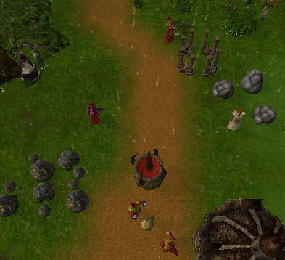
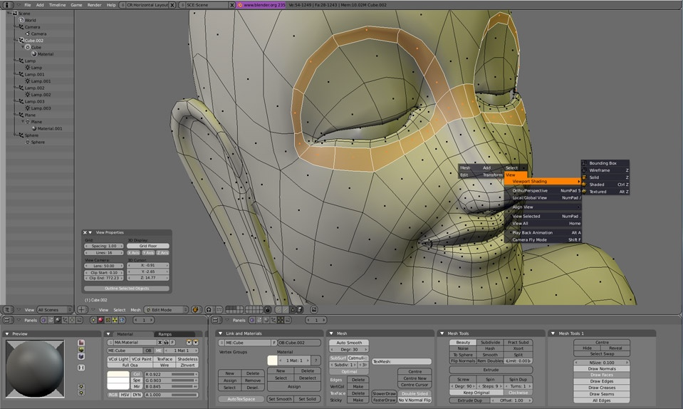
Resources
Freely available GLEST engine
OpenGL based game engine
Blender 3D modelling package
Custom plugins to handle content
Makes use of Python scripts

Slide 4
Previous Work
Text-to-Scene Systems.
Use constraint systems to incorporate key concepts of text into a computer generated scene. (e.g. WordsEye)
Work done by Shaun Bangay and Kevin Glass
Extended to generate animated scenes with character movement and actions.

Slide 5
Primary Goals
Creating the environment and terrain
Creating a suitable constraint system
Must be able to handle constraint interdependency
Incorporate story events as game goals
Associate behavior with characters
Extract and incorporate dialogue
Through the use of speaker identification techniques

Slide 6
More Goals
Implement NPCs (Non-Player Characters)
Artificial Intelligence dependent characters
Add multiplayer functionality
Allows multiple players to exist in the game world at one time

Slide 7
Approach
Discover suitable annotation method
Analyze various constraint systems
Familiarity with game engine
Investigation of game manual
Creating the world
Generic game world for testing
Managing the constraints
Take time intervals into account
Deals with characters and objects

Slide 8
Approach Continued
Implementation
Incorporate constraints into game engine
Create data structures as abstracts of characters and objects
Attributed these with various constraints
Possible Advancements
NPCs
Attribute NPCs with characters details from text
Multiplayer
Assert story consistencies across players computers

Slide 9
Evaluation
Primary goal is that of setting up a game world consistent with that specified in the text.
Player must recognise the realm and its various aspects (characters, places and objects)
Incorporate AI and multiplayer functionality

Slide 10
Outcomes
Simplify and speed up adventure game development
Allow game developers to focus on creativity
Give players the ability to modify their favourite stories in any way they see fit

