Slide 1
IDE and Visualisation of Abstract Syntax Trees for Coco/R
Presented by: Etienne Stalmans
Supervisor: Dr K Bradshaw
Notes:
Welcome to this, my final honours presentation.
I’m sure you all (except Prof Terry) are pretty tired of hearing about Compilers , I hope to make this as exciting as possible
As you all know, my project focused on Coco/R and producing improvements for it
I hope to show those improvements to you and to discuss some of the results achieved

Slide 3
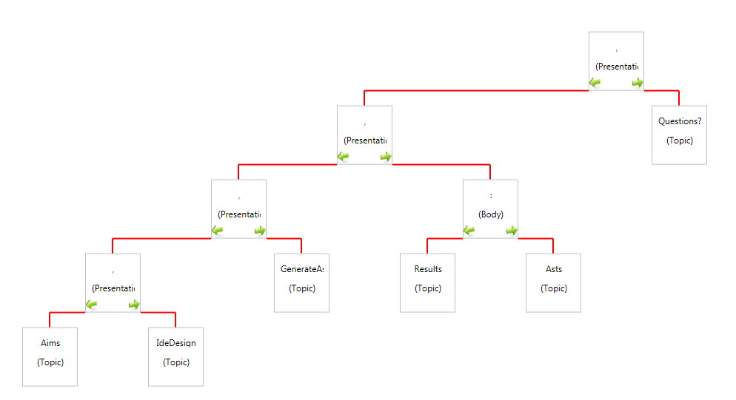

Slide 4
Outline
Aims of the project
IDE Design
AST implementation
Results
Future extensions
Questions
Notes:
The talk has been broken down into 5 main areas,
The aims of the project – a reminder of what we set out wanting to achieve
The design of the IDE and why we made the design decisions
How ASTs were generated and visualised
Results from our implementation
Where we see this going
And finally, a chance for you to hurl abuse at me.

Slide 5
Aims
Create IDE for Coco/R
Automatically Generate ASTs
Visualise ASTs
Improve learning through visualisation
Notes:
We set out with three main aims for the project
These were: Creating an IDE for Coco/R – as none exist at the moment
Create an automatic AST creation facility
Visualise the ASTs produced by the parser we generate
Use the visualisation to improve user understanding and learning

Slide 6
IDE Design
Why do we need an IDE?
What should be included?
What should the IDE look like?
How easy is the IDE to learn?
Notes:
Before designing the IDE, we needed to ask ourselves why do we need an IDE?
Currently users work in Ultra-edit or Notepad++, save, switch to console,
Do a “cmake” to compile the grammar
Do a “crun” to execute the grammar
As a tutor, I found most students forget to complete one of the steps,
Get lost without syntax highlighting – cant find errors
Struggle with current error reporting facilities
How will the IDE help?
Syntax highlighting – makes code more readable (debatable)
Easier spotting of errors
Common functions more accessible
Everything happens in one place
Should look like?
Uncluttered
Grouping of related features
Implicit feedback
Easy to learn

Slide 7
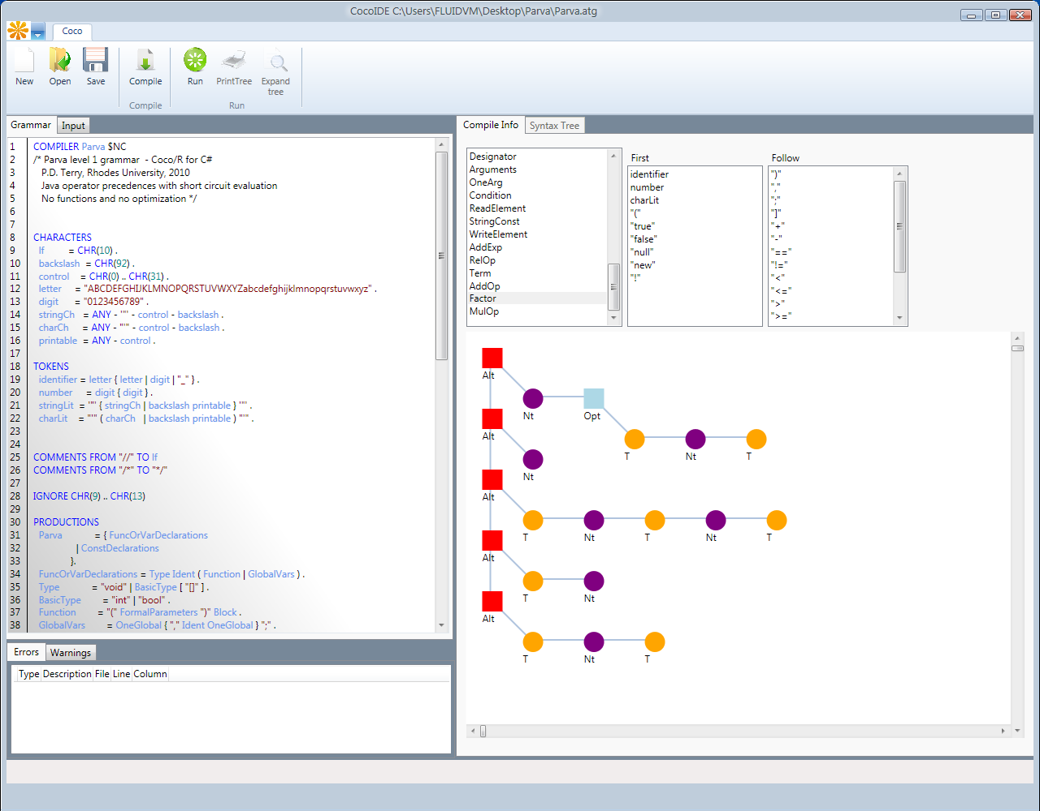
Notes:
Syntax highlighting aids readability (debatable)
Visualisation of data structures
Separate areas for editing and information
Feedback
All actions available, no need to use console

Slide 8
The Abstract Syntax Tree
Generic Data Structure
Binomial nodes
Type
Production
Left sub-tree
Right sub-tree
The limitations?
Notes:
Requires generic structure
No semantic knowledge, so don’t know what type of node needs to be constructed
Type – “string literal value”
Production – the non-terminal production within which this node is added
Left and right sub-trees, maintain left/right recursive nature of grammar

Slide 9
Code Generation
Coco/R automatically generates code
Scanner
Parser
Driver
How does AST generation fit in?
Modify code generation routines
Insert AST code according to rule-set
Notes:
Don’t change the scanner or driver
Modify the parser generator routines to include code generation for ASTs
Use similar rules to those already present in the Coco/R logic
No semantic knowledge available at code gen time, room for possible extension where user includes semantic annotations?

Slide 10
Visualising the AST
AST generated at run-time
Require a means to retrieve it
Use reflection
Know the data-structure
Trivial to walk the tree and visualise
Tree walked twice
Mini-tree generated
Easily extended
Notes:
AST is part of the generated parser, thus only available once that parser is executed
Need a means of accessing it
Use reflection in C#
We know the data structure, makes retrieval with reflection easy
Trivial to walk the tree once it is available, use pre-order traversal and draw tree
Tree walked twice to get width, ect to prevent overlapping branches
Generate mini-tree to use with navigation – context map
This visualisation method can easily be extended to provide more/less info
Draw different tree graph

Slide 11
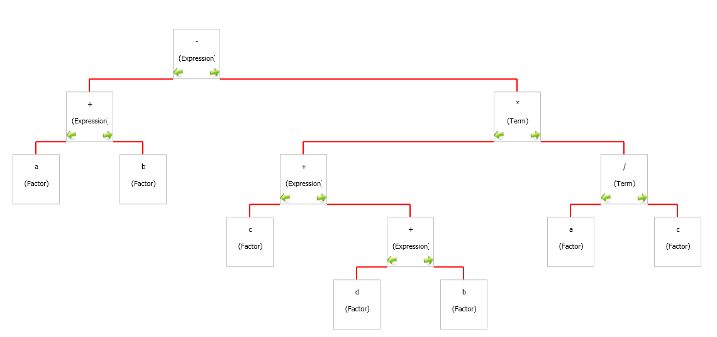
Notes:
As can be seen, very crisp, clear tree
Only necessary information presented
Don’t want to overload the user

Slide 12
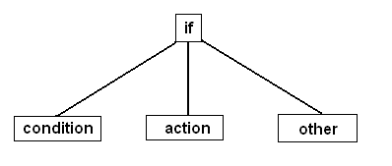
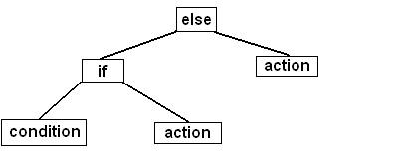
Results
Correct ASTs generated for simple LL(1) grammars
Errors start creeping in for more complex grammars
If-then-else problem, similar to dangling else situation
Incorrect tree is constructed
Notes:
Testing showed correct ASTs
Broke down with complex grammars due to lack of semantic knowledge
LL(1), so lack ability to look ahead and determine that this might be a three node subtree
If-then-else not always the case, if it’s a simple if-then, tree is drawn correctly
Relates to dangling else problem

Slide 13
Effect on effectiveness
Reduces effectiveness as learning aid
Confirms results from past studies
Opens avenue for future extensions
Still viable as demonstration tool
Notes:
Because of problems with more complex grammars
And incorrect grammars, made difficult to use as learning aid
Could lead to more confussion than actual understanding
Confirms results from past studies, where it is stated that need to find perfect examples for visualisation to be effective
Difficult to correctly visualise algorithms dynamically
Due to algorithm visualisation drawing “a mental model” – makes it hard for computer to decide what should be visualised
Still viable as demonstration tool – give correct grammar, will produce correct syntax tree

Slide 14
Future Extensions
Ability to handle more complex grammars
Will require annotations
Visualisation of parsing process
Step-by-step visualisation
Play/Pause controls
Notes:
Annotations – will alter goal of the system
System aims to provide layer of abstraction so that user does not need to understand ASTs
in order to be able to visualise AST
Provide step-by-step visualisation of data structures, parse stack ect
Could be useful for novice users

Slide 15
Questions?

