Slide 1
Visualisation
Visualisation of Abstract Syntax Trees and Coco/R IDE
Presented by: Etienne Stalmans
Supervisor: Dr K Bradshaw

Slide 2
Outline
Progress
Implementation
Planned Work
Demonstration
Questions

Slide 3
Progress
Literature review
Task:
Implement AST generator and user interface
Modify Coco/R source code
Study Coco/R source code
Design user interface
Notes:
Literature review has been completed
Studied Coco/R source code to understand how code generation works. Tried to determine where would be the best place to insert AST generation calls.
Modified Coco/R to generate AST generation statements
Designed user interface. Tried to keep it simple as possible
Implemented solution and tested resulting ASTs for accuracy compared to hand-generated ASTs

Slide 4
Implementation
Coco/R back-end
Automatically “attribute” user grammar according to set rules
Currently:
Expression<out AST a> (. AST b; .)
= Term<out a>
{ "+" Term<out b> (. a = AST.MakeBinNode(AST.add, a, b); .)
| "-" Term<out b> (. a = AST.MakeBinNode(AST.sub, a, b); .)
}.
Terry 2005 (p. 278)
Notes:
Current solutions require users to attribute grammar to produce AST
CocoIDE changes that, AST generation is automatic and doesn’t require user interaction
Rules determine where to insert AST calls in generated code
Rules determine left or right tree generation

Slide 5
Implementation
Example rule:
Expression = Term { “+” Term | “-” Term }.
Current Token: “Term”
Token Type: Non-Terminal
Rule: isFirst = True
Output:
Term (out l); //parse and add result to left branch
Notes:
Example of a production
Next screen shows source code produced

Slide 6
Example output
static void Exp(out TreeNode l) {
l = null; //make c# compiler happy
TreeNode r = null;
string symVal = la.val;
string prodVal = "Exp"; //used to identify node “type”
Term(out l); //parse and add result to left branch
while (la.kind == plus_Sym || la.kind == minus_Sym) {
if (la.kind == plus_Sym) {
symVal = la.val;
Get();
Term(out r); //parse and add result to right branch
l = new TreeNode(prodVal,symVal,l,r); //add to current node
} else {
symVal = la.val;
Get();
Term(out r); //parse and add result to right branch
l = new TreeNode(prodVal,symVal,l,r); //add to current node
}
}
}
Notes:
Source code produced by Coco/R.
Rules determine where to insert tree creation statements.

Slide 7
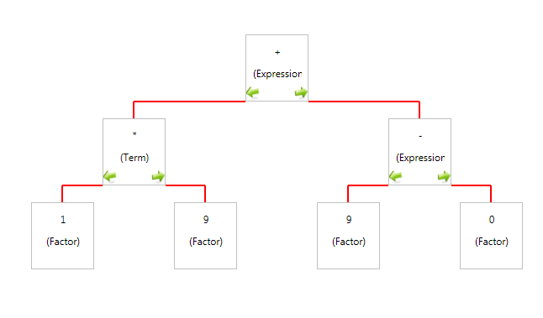
Example AST
(1*9) + (9-0) =
Notes:
AST produced by Coco/R
Tree is can collapse branches to make viewing easier

Slide 8
Planned Work
Compile process visualisation
Error recovery visualisation
Rule optimisation
Test benefits of visualisation

Slide 9
Demonstration

Slide 10
Questions?

