Slide 1
Adapting and Simplifying UCMAN for the iPhone
Investigator: Sascha Zeisberger
Supervisor: Prof. Richard Foss
Notes:
Start: Info about me and supervisor
I will be investigating UCMAN, and its adaption to the iPhone focusing on simplifying GUI elements and taking advantage of the touch screen interaction.

Slide 2
Background
What is UCMAN?
Audio Networking Application Suite
Connect, Control and Monitor Audio Devices
XFN Protocol
GUI Centric
Why use the iPhone as a platform?
Notes:
Audio networking app suite, Firewire based networks, subnets, routers
In a stadium situation, a large number of cables running between stage and front of house. Connections could be changed via manual patch bays, and volume control would be from the mixing console. Individual devices would be changed and monitored on-device. UCMAN allows remote computer connection management, device control and monitoring.
Runs over the XFN protocol
GUI centric – relies on providing an easy to use interface to a multitude of devices

Slide 3
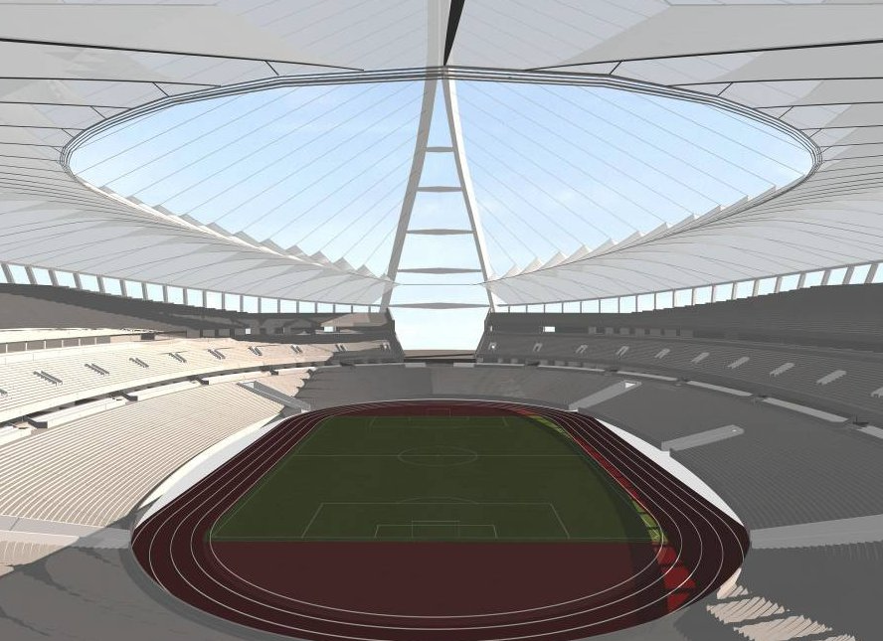
Scenario
Audio Device
UCMAN Station
Notes:
Stadium scenario – where 2 people were required, one to test sound levels and another to change the levels, now one is needed
The one can roam around a venue and test, control and do whatever to individual PoP’s (points of presence)
Also talk about controlling multiple input devices

Slide 4
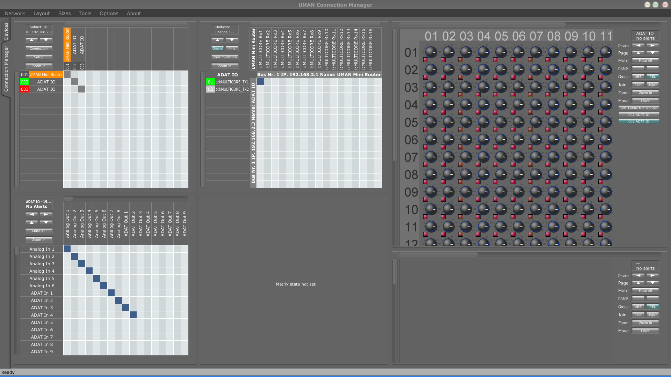
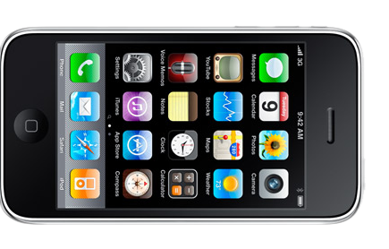
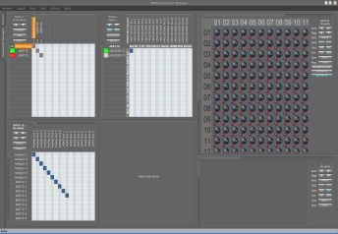
Why is a straight port not an option?
Notes:
Problems to be addressed:
Size and Touch screen accuracy == difficult to work with small controls
Performance loss as a result of lower hardware specs
Easy to read: small screen == low resolution == small text not as clear

Slide 5
Objectives
Port UCMAN to the iPhone
Achieve Fluid Performance
Measure Touch Accuracy
Accessibility and Legibility
Simplify GUI and Application Logic
Automated Patch-bay System?
Port UCMAN to the iPhone
Achieve Fluid Performance
Measure Touch Accuracy and Modify Controls Accordingly
Accessibility and Legibility
Simplify GUI and Application Logic
Automated Patch-bay System?
Notes:
Talk about hardware requirements
Touch accuracy becomes a factor to consider (go back to previous slide for example)
Accessibility and Legibility -> related to touch accuracy, however more GUI based examples
One of the problems of the current UCMAN system is that it may be too complex for those not versed in the art of audio engineering and networking.
We can automate the process of joining multicores, input and output mapping to just select device x’s input and connect it to device y’s output.

Slide 6
Extensions
Single-touch to multi-touch
Modify the interface to accept multi-touch commands
Possibly extend Juce Framework?
Wireless device tracking
Track position of iPhone relative to devices
Display options for closest device
Accelerometer?
Notes:
Self explanatory
Don’t dwell too much on this. Not purpose of project.
Accelerometer – possibly adjust device’s faders by tilting the iPhone?

Slide 7
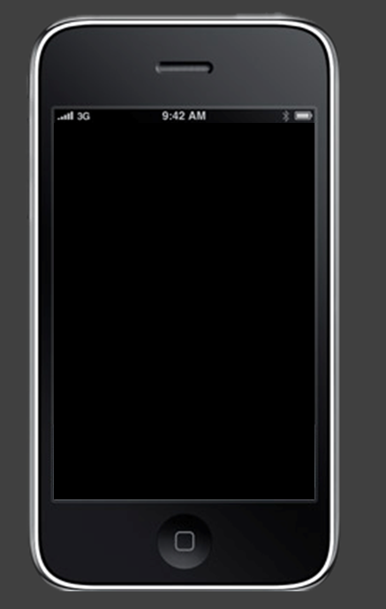
iQuestions?
?
Notes:
Question time.

