Slide 1
Adapting and Simplifying UCMAN for the iPhone
Investigator: Sascha Zeisberger
Supervisor: Prof. Richard Foss

Slide 2
Recap
UCMAN
Frontend application for controlling XFN-based devices
Project Aims
Port to the iPhone
Simplify usage by adding a Patchbay component to the application suite.

Slide 3
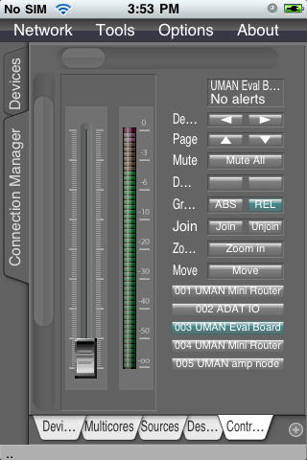
iPhone Development
It’s working! (sort of…)
Facilitated by using the Juce framework.
XFN used as a resource.
Disabling NIC selection.
Tweaking startup options.
Notes:
Speak about deskitems

Slide 4
Performance Issues
Performance is noticeably sluggish.
Poor response times.
High memory and CPU usage during network activities cause instability.
File system is sandboxed.
Notes:
Speak about deskitems

Slide 5
Design Issues
UCMAN has facilities that can be used to accommodate small screens.
Tab-based views makes navigation easier on small screens.
No official Juce support for landscape.
Controls are difficult to use.
Notes:
Speak about what aspects needed to be considered
What options on the type of port (straight, rebuild, interface with desktop app)
Issues
progress

Slide 6
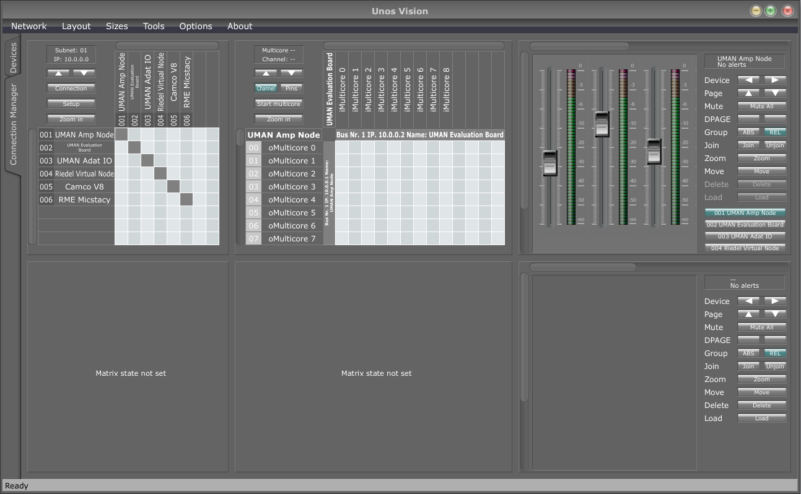
Desktop/iPhone Comparison
Notes:
Speak about what aspects needed to be considered
What options on the type of port (straight, rebuild, interface with desktop app)
Issues
progress

Slide 7
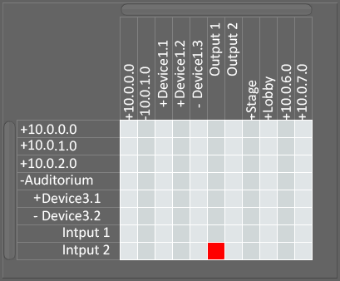
Patchbay Goals
Patchbays abstract the complexities of routing.
Easier to see active connections between endpoints.
Building the patchbay GUI from scratch should aid in optimizing GUI for small-screened touch devices.
Notes:
Since limited to the iPhone and iPad, not a lot of genericness has to be considered. Also there are a lot of features that do not work well with small screened touch devices

Slide 8
Patchbay Elements
Using UCMAN as backend provides support for:
Multiple instances.
Timing and synchronization.
Point-to-point connection creation.
Routing algorithm.
Control structure to represent network.
Current connections.
Notes:
Why is routing difficult? There is no mechanism to create end to end cons form one IP to an OP.
In a project this large, it becomes nice to control the behaviour. Not have to modify the main application behaviour.

Slide 9
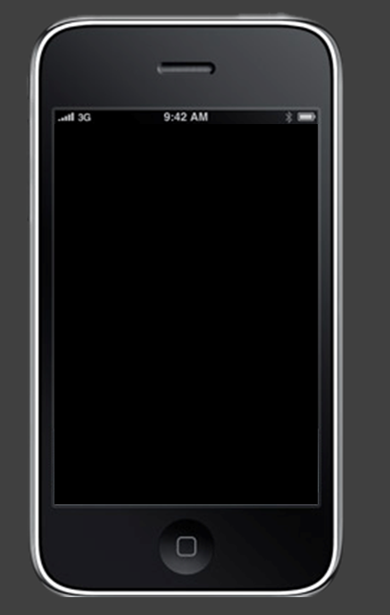
Questions?
?
Notes:
Question time.

Slide 10
iPhone/UnosVision Template [LessContent]
Main
Sub

Slide 11
iPhone/UnosVision Template [XtraContent]
Main point
Sub point

