Slide 1
Mobile Solution to Controlling Audio Networks
Investigator: Sascha Zeisberger
Supervisor: Prof. Richard Foss

Slide 2
Goals
Create mobile solution to audio network management
Larger networks become difficult to manage from a static
position
Mobile solution will provide flexibility as to where the
control point is situated
Will be based off an existing desktop application

Slide 3
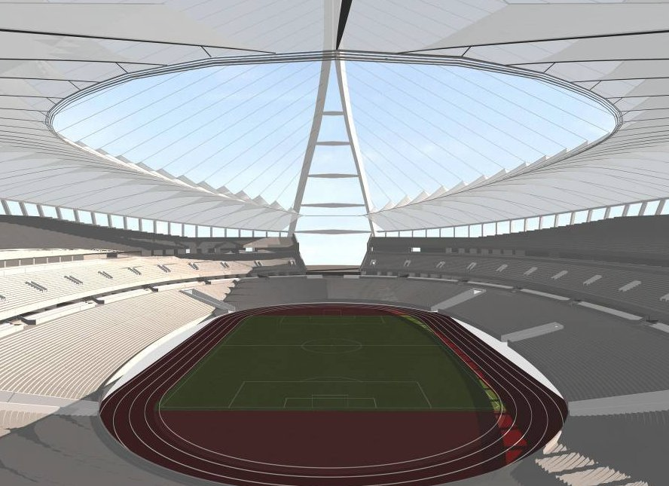
Scenario
Audio Device
Control Station
Notes:
Stadium scenario – where 2 people were required, one to test sound levels and another to change the levels, now one is needed
The one can roam around a venue and test, control and do whatever to individual PoP’s (points of presence)
Also talk about controlling multiple input devices

Slide 4
Background
Unos Vision
Audio network management suite
Uses X170 Protocol
Grid-based approach to audio networking
Majority of device interaction is via desk items
iPhone/iPod
Powerful smartphone
Flexible in terms of features (touch-screen, wireless…)

Slide 5
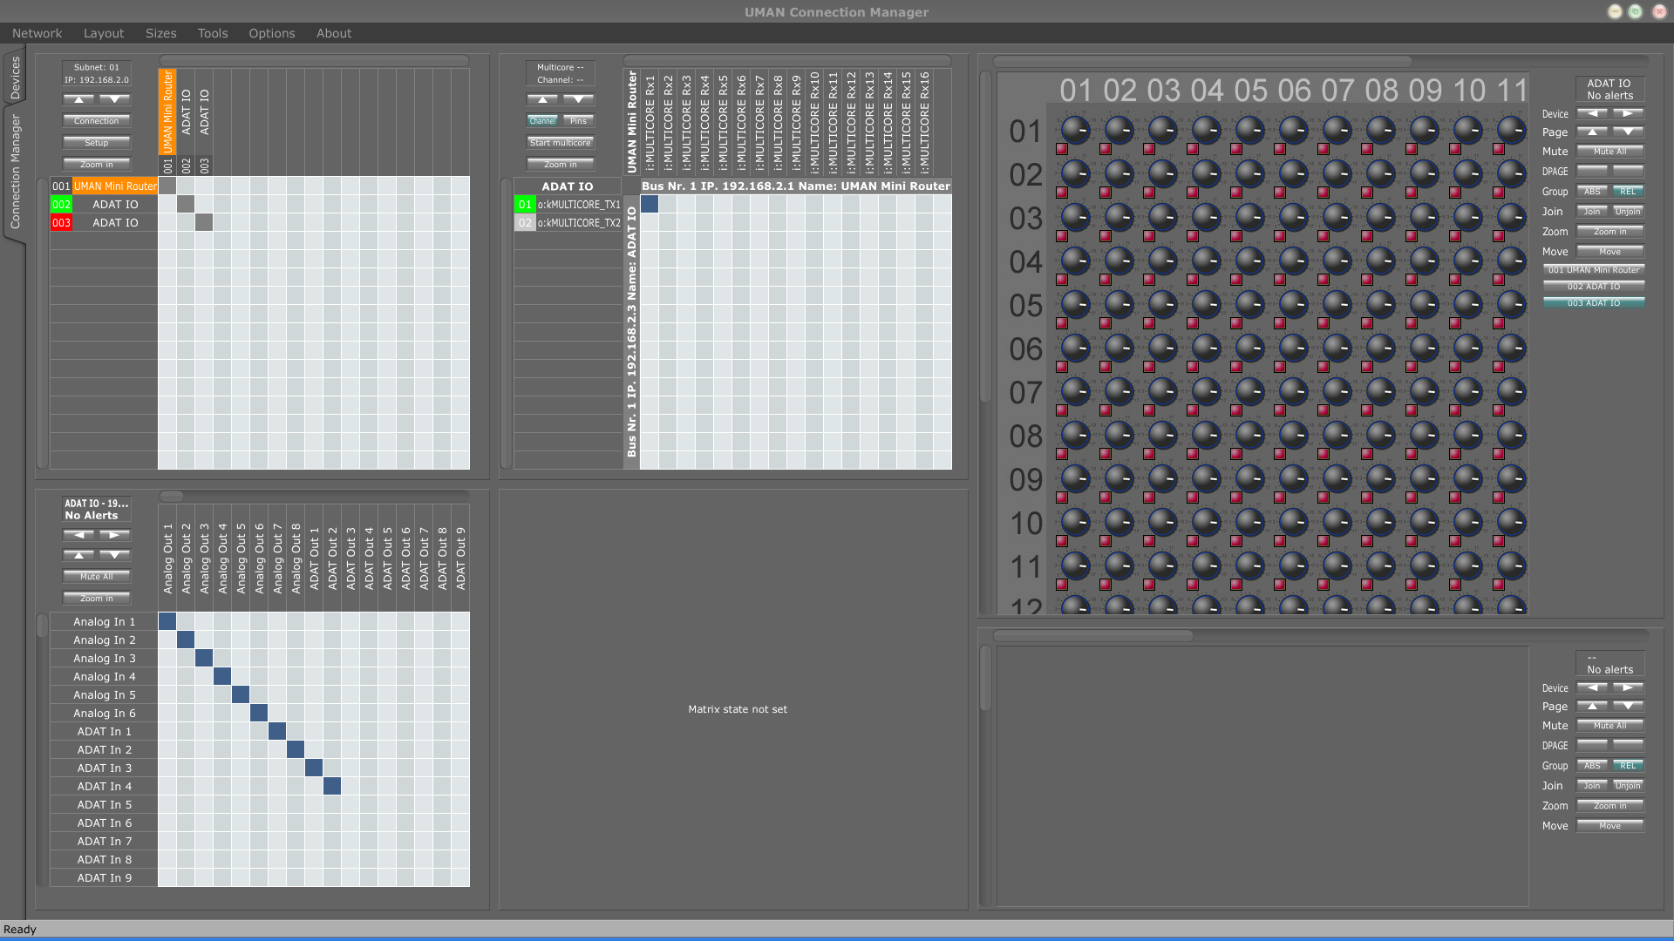
Unos Vision Example

Slide 6
First Step: Straight Port
Facilitated by using the Juce framework.
XFN, Juce and Unos rebuilt for Arm.
Program once, #ifdef everywhere
Evaluation
What features work
Apple’s Instruments utility to measure performance
Keystroke-Level Model to evaluate GUI

Slide 7
Issues
Performance:
Sluggish performance and crashes
Sandboxed file system broke many features
Design:
Tab-view provided better experience, but tedious to use
Juce was new to the iPhone - resulted in odd behavior
Controls were difficult to use

Slide 8
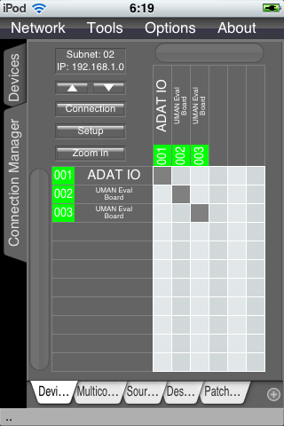
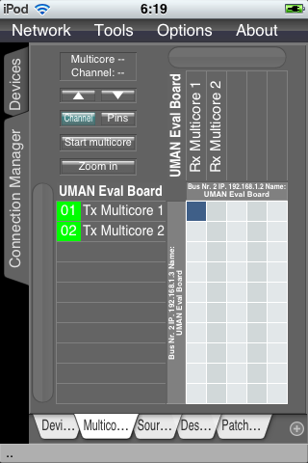
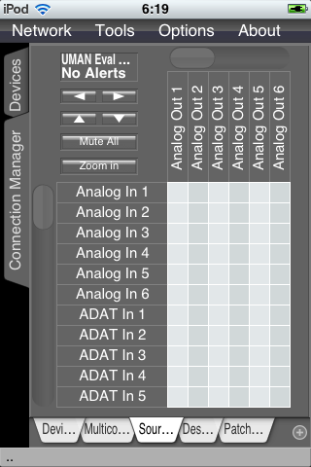
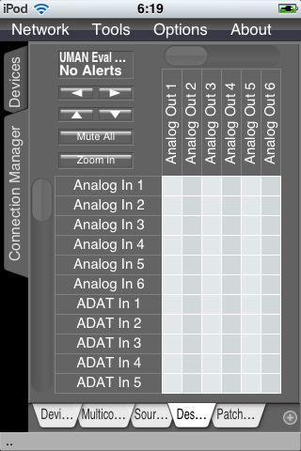
Tab View

Slide 9
Keystroke-Level Model
Predictive form of evaluation
Uses abstract representations to describe actions
Simplified version of this model was used
C for touch/click action
D for a drag/scroll action
Square brackets represent optional tasks (worst-case scenarios)

Slide 10
Keystroke-Level Model
Create connection between 2 devices on same subnet
[D]CC[D]CC[D]CC[D]C = 11 worst, 7 best
Create connection between 2 devices on different subnets
[D]CC[D]CC[D]C[cc[d]cc[d]c]CC[D]CC[D]CC[D]C = 25W,17B
Number of actions = 18 + number subnets to traverse* 7

Slide 11
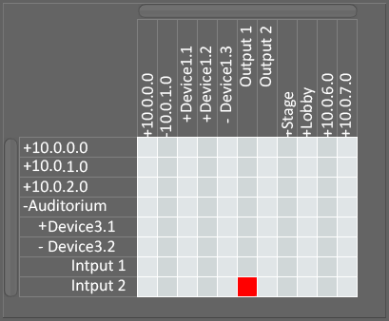
Patch Bay
Patch bays abstract the complexities of routing.
Create end-to-end connections
Tree-grid based patch-bay was used
Provides overview of network
Easy to represent on small screens
More efficient in terms of KLM
[D]C[D]C[D]C = 6W, 3B

Slide 12
Keystroke-Level Model

Slide 13
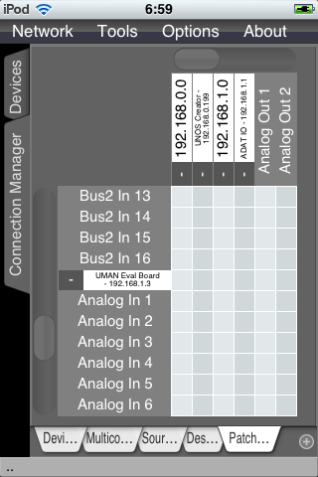
Patchbay Elements
Using Unos Vision as backend provides support for:
Multiple instances.
Timing and synchronization.
Point-to-point connection creation.
Routing algorithm
Internal routing
Router traversal

Slide 14
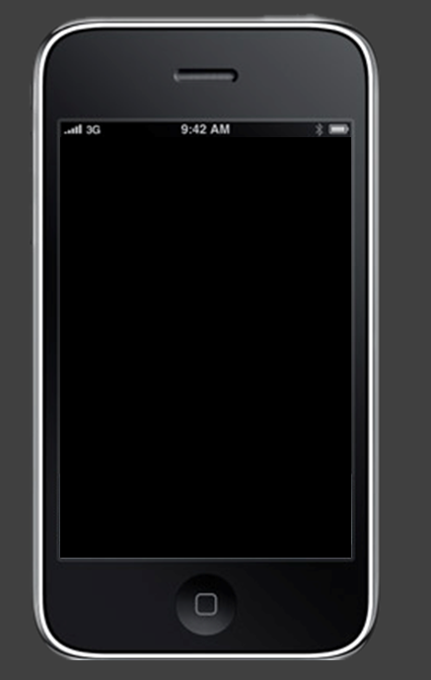
Demonstration and Questions
?
Notes:
Question time.

Slide 15
iPhone/UnosVision Template [LessContent]
Main
Sub

Slide 16
iPhone/UnosVision Template [XtraContent]
Main point
Sub point

