Slide 1
Computer Science Honours 2012
Controlling Distributed Audio Devices from a Graphical User Interface
Principal Investigator: Mitchell Hedges
Supervised by: Professor Richard Foss

Slide 2
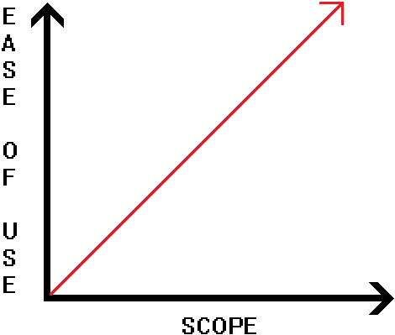
Project Overview
Ease of controlling devices
Cheaper once software is implemented
Control devices using a simple GUI
Versatility – User specified venue
Use existing software (free or supplied)

Slide 3
Background research
System Architect – advantages/disadvantages
Older protocols compared to X170
Scope of the X170
Ruby → Visual C++ → X170
Network simulation

Slide 4
The XFN/X170 stack
Protocol used for sound control
IP Based P2P network protocol
Seven tiered hierarchy
Functions used to initialize nodes
XFN messages sent to parameters to get/set values
(Example function)

Slide 5
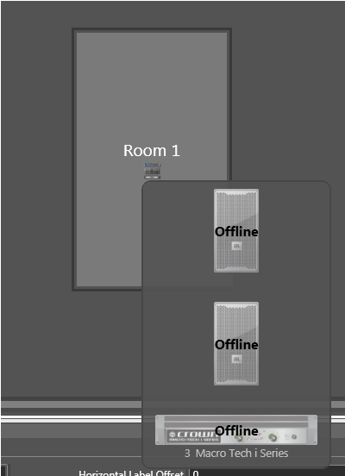
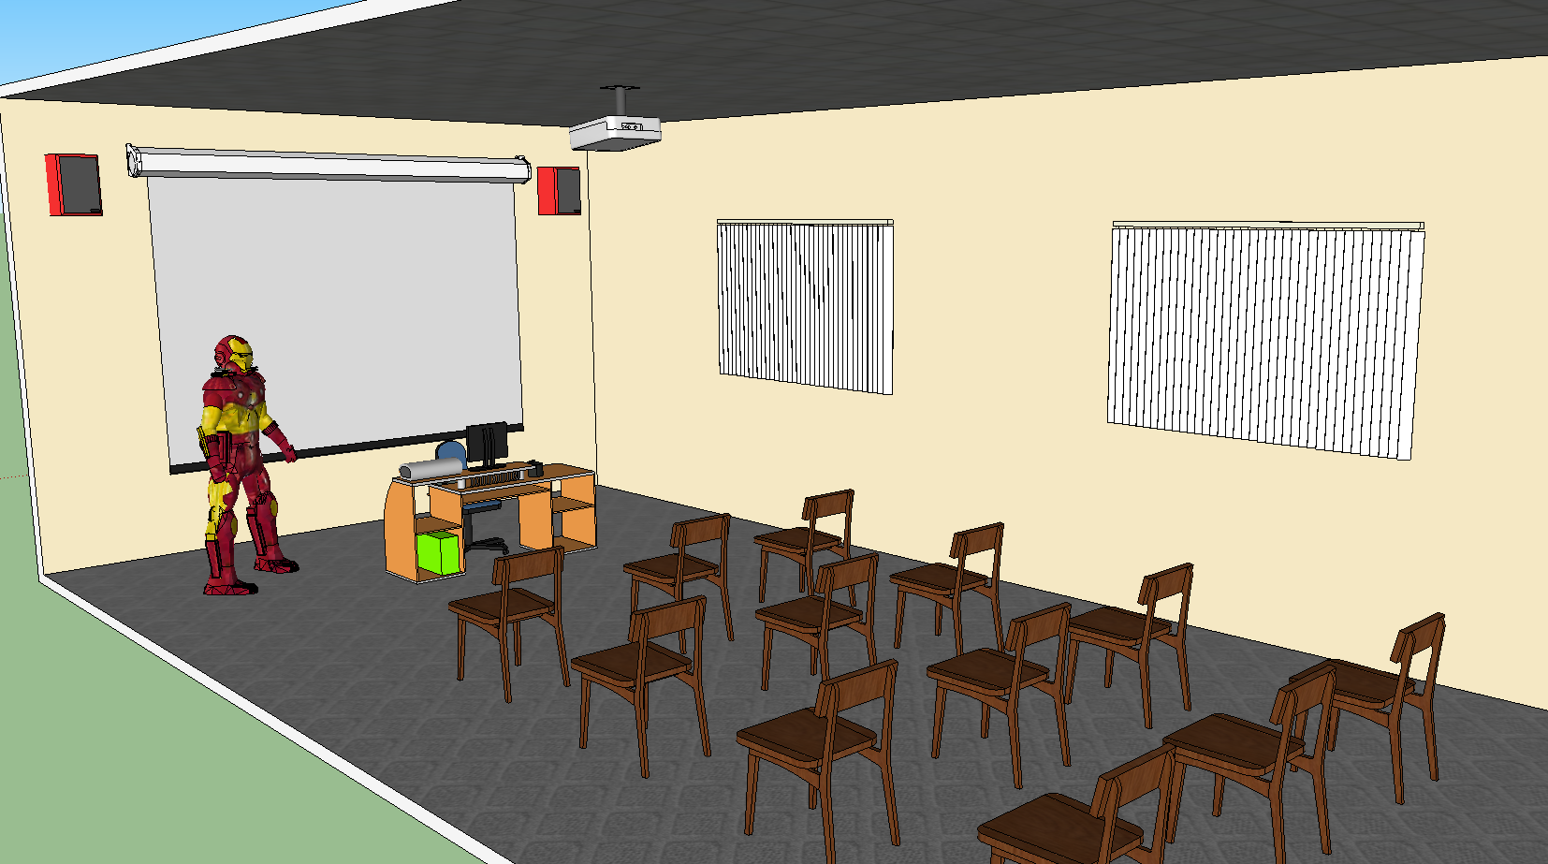
Why a GUI?

Slide 6
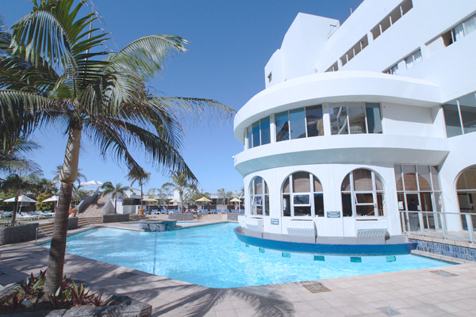
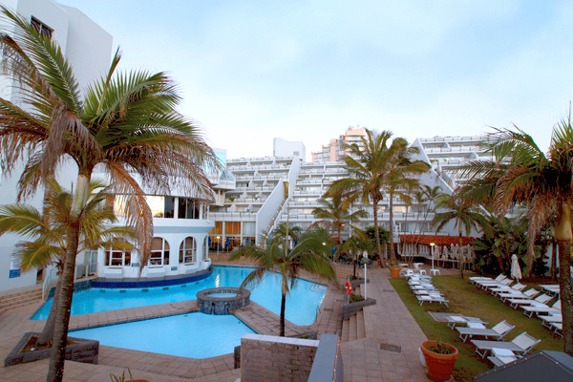
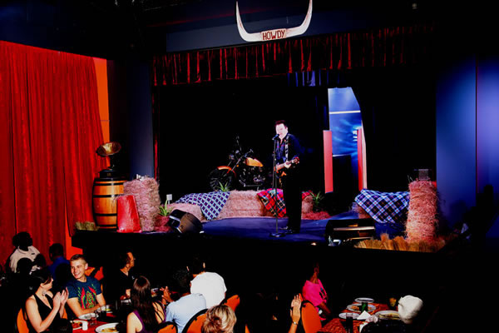
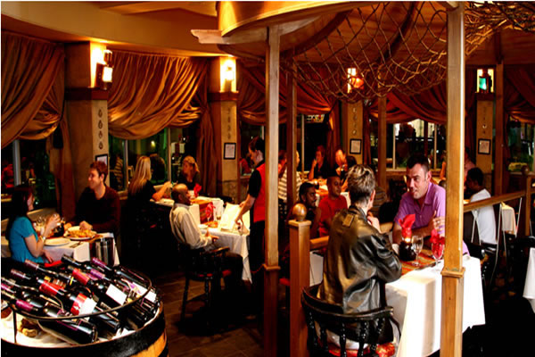
The Venue – La Montagne

Slide 7
Goals
Stick to dates of personal milestones
Be satisfied with end result
Establish a system that can be useful in future
Have fun and enjoy it!

Slide 8
Questions
??????????????????????????????????????????????????????????????????????????????????????????????????????????????????????????????????????????????????????????????????????????????????????????????????????????????????????????????????????????????????????????????????????????????????????????????????????????????????????????????????????????????????????????????????????????????????????????????????????????????????????????????????????????????????????????????????????????????????????????????????????????????????????????????????????????????????????????????????????????????????????????????????????????????????????????????????????????????????????????????????????????????????????????????????????????????????????????????????????????????????????????????????????????????????????????????????????????????????????????????????????????????????????????????????????????????????????????????????????????????????????????????????????????????????????????????????????????????????????????????????????????????????????????????????????????????????????????????????????????????????????????????????????????????????????????????????????????????????????

