Slide 1
Computer Science Honours 2012
Controlling Distributed Audio Devices from a 3D Graphical User Interface
Principal Investigator: Mitchell Hedges
Supervised by: Professor Richard Foss

Slide 2
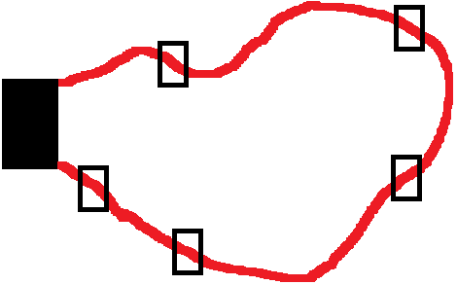
Avitech Systems
Based in Port Elizabeth
Owned and run by Lawrence Bricknell
Digital sound installations for large venues
Work devices around floor plan
Several standards for cabling
Mainly Bose devices
Biamp systems’ daVinci for control

Slide 3
IEEE 1722.1 – AVDECC 1
Audio/Video Discovery, Enumeration, Connection Management and Control
Uses the IEEE 1722 AVTP for streaming
5 types of AVDECC devices
Entity
Controller
Talker
Listener
Proxy

Slide 4
IEEE 1722.1 – AVDECC 2
3 Sub-protocols
AVDECC Discovery Protocol (ADP)
AVDECC Connection Management Protocol (ACMP)
ACMP Data Units (ACMPDU)
AVDECC Enumeration and Control Protocol (AECP)

Slide 5
WinPCap
Windows Packet Capture
Link Layer (Layer 2) packet capture
Captures “raw” packets
Useful for enumeration of devices using 1722.1 protocol
Used in Visual C++ for project
#include <pcap.h>

Slide 6
Literature Review 1
Sound System Control Protocols
Harman Pro HiQNet
Crossfire Network (XFN)
AVDECC
Graphical Sound Installation
UNOS Creator
Harman System Architect
BSS London Architect

Slide 7
Literature Review 2
Google Sketchup
Ruby
Ruby in Sketchup
User Interface
Cameras
Entities
Linking Visual C++ to Sketchup
Socket Programming in VC++/Sketchup

Slide 8
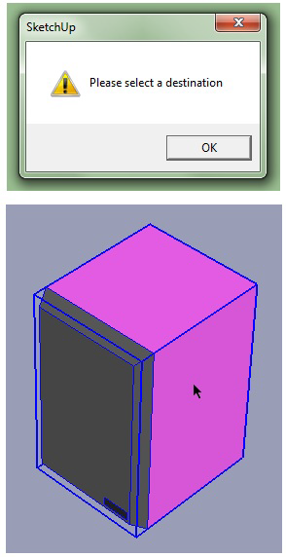
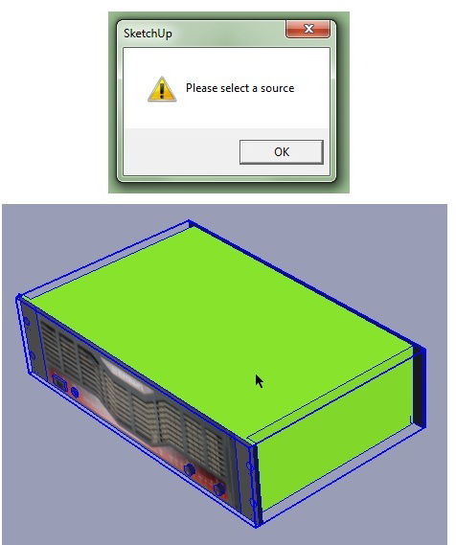
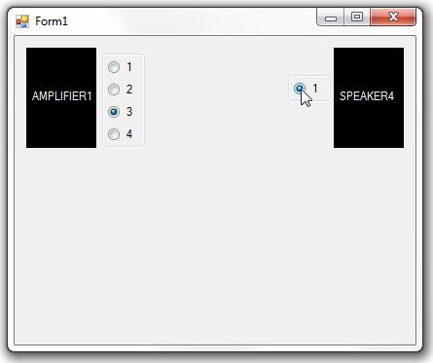
Interfaces

Slide 9
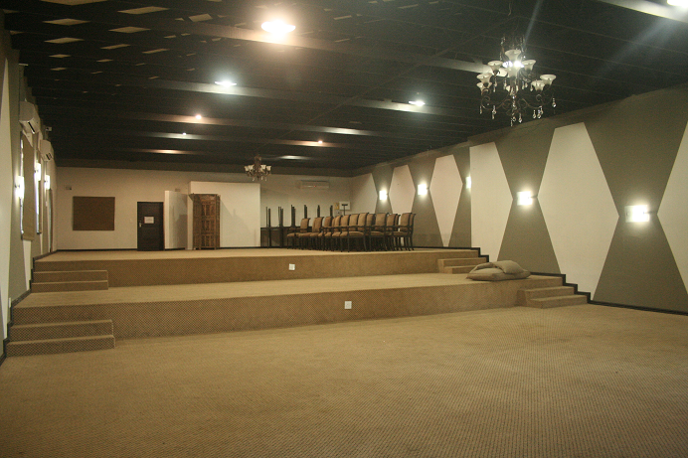
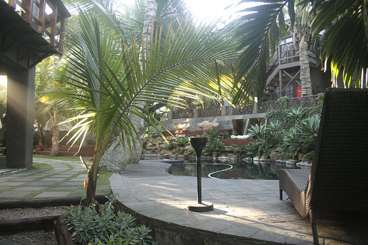
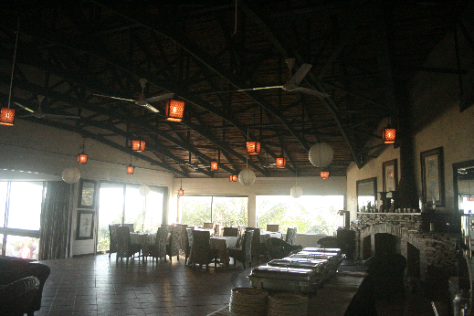
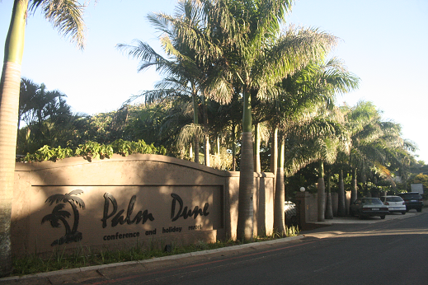
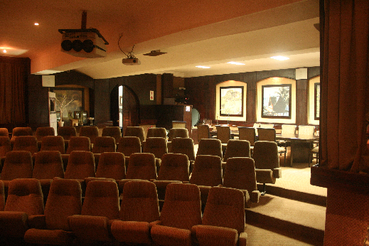
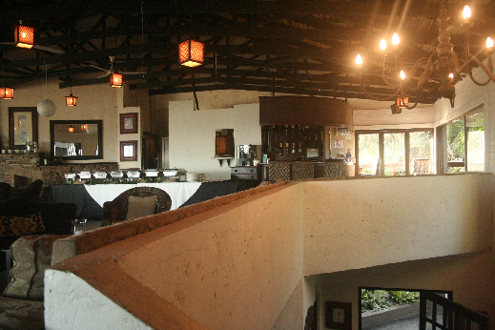
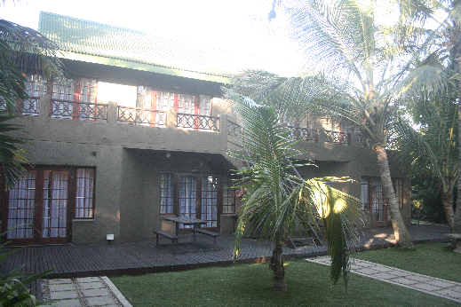
Venue Construction

Slide 10
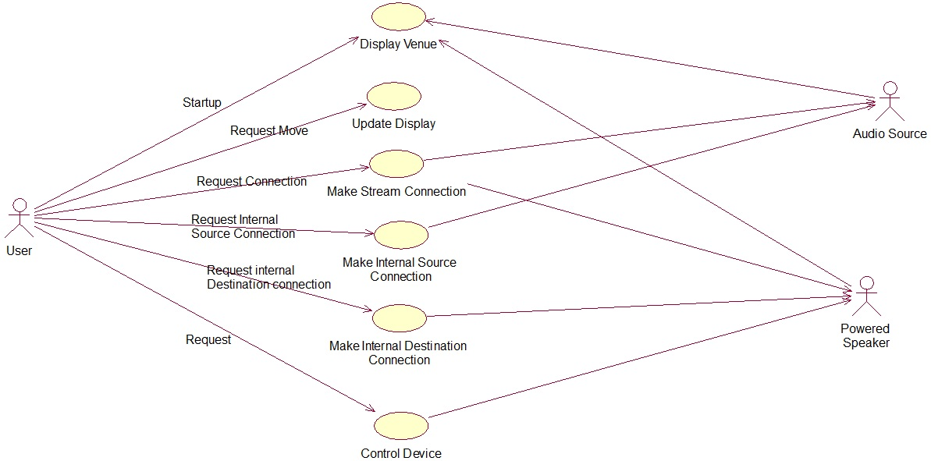
UML - Planning

Slide 11
Questions
?
?
?
?
?
?
?
?
?
?
?
?
?
?
?
?
?
?
?
?
?
?
?
?
?
?
?
?
?
?
?
?
?
?
?
?
?
?
?
?
?
?
?
?
?
?
?
?
?
?
?
?
?
?
?
?
?
?
?
?
?
?
?
?
?
?
?
?
?
?
?
?
?
?
?
?
?
?
?
?
?
?
?
?
?
?
?
?
?
?
?
?
?
?
?
?
?
?
?
?
?
?
?
?

