Slide 1
Computer Science Honours 2012
Controlling Distributed Digital Audio Devices
from a
3D Graphical User Interface
Principal Investigator: Mitchell Hedges
Supervised by: Professor Richard Foss
Acknowledgment: Osedum Igumbor

Slide 2
The Presentation
The Motivation
The Overview
The Approach
The Design
The Demonstration
The Future
The Questions

Slide 3
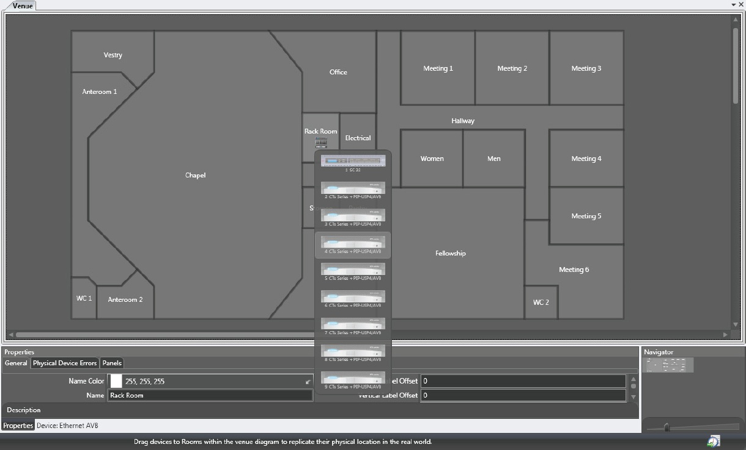
The Motivation
Venues using distributed audio moving from conventional to digital
Cost
Weight
Availability
In-depth study of current sound control capabilities
Harman System Architect
Biamp Systems’ daVinci/Tesira

Slide 4
The Motivation
Moving from 2D “blueprint” layout to 3D “first person” interface
User friendly
“Real life” interaction
Testing capabilities of Google Sketchup
Testing the quality of service / sound

Slide 5
The Overview
Controlling distributed audio
Simple control from a 3D interface
Layer 2 and 3 networking
3 – Sockets between Ruby and Visual C++
2 – IEEE 1722.1 AVDECC Protocol
Discovering devices on an AVB network
Making/Breaking audio streams between devices

Slide 6
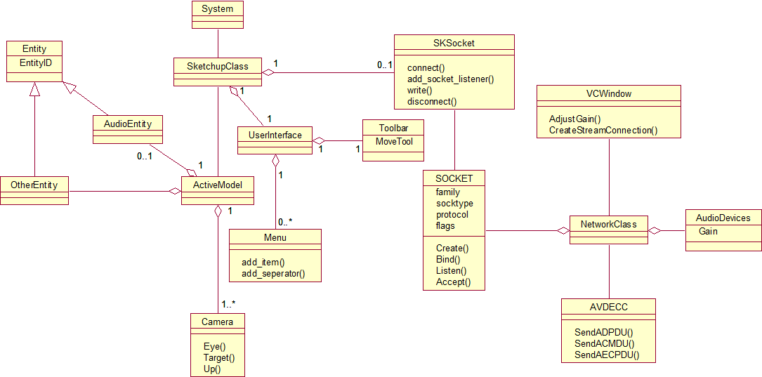
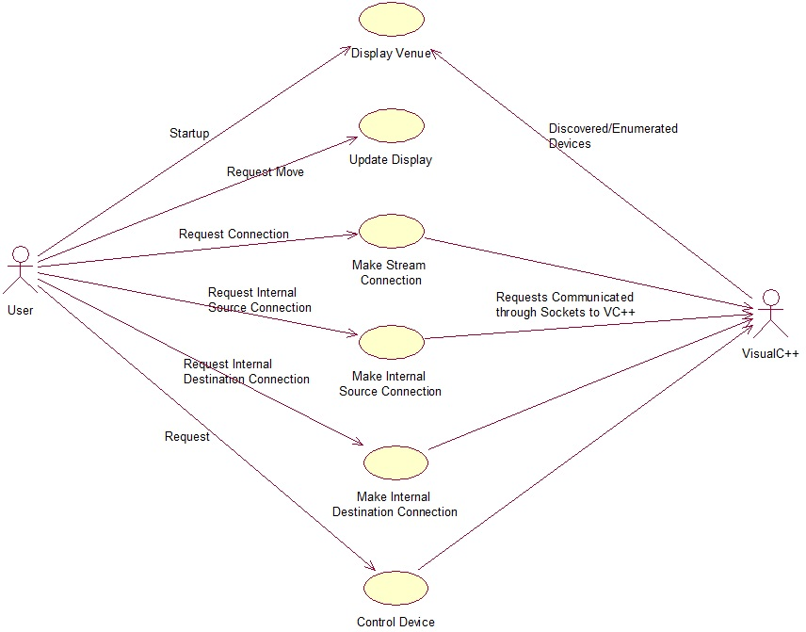
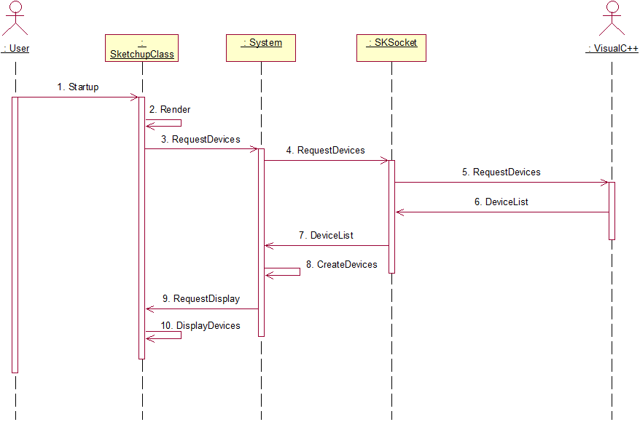
The Approach
Object Oriented (OO) approach
UML Diagrams
Repetitive cycles
Requirement specification
Use cases
Textual scenarios
Class diagram / Object model
Sequence diagrams

Slide 7
The Approach
Windows 7 OS
Google Sketchup
Notepad++
Microsoft Visual Studio
AVDECC C++ libraries

Slide 8
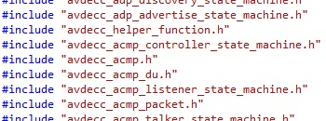
The Design – Program Structure
Include Libraries
Socket Connection
IP - 127.0.0.1
Port - 30456
Visual C++
Ruby (.rb)
C++ (.cpp)
1722.1 AVDECC

Slide 9
The Design – Program Structure
Specific style of messages sent through sockets
Begin with the message “Source” and have 3 letter commands that follow.
Separated with an underscore ‘_’ character
Examples
CPP_ENA_ATT_12:23:34:45:56:67:78:89
SKP_ACK_ENA_ATT_12:23:34:45:56:67:78:89
CPP_STR_CON
SKP_STR_12:23:34:45:56:67:78:89

Slide 10
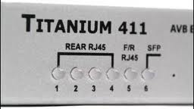
The Design – Component Layout

Slide 11
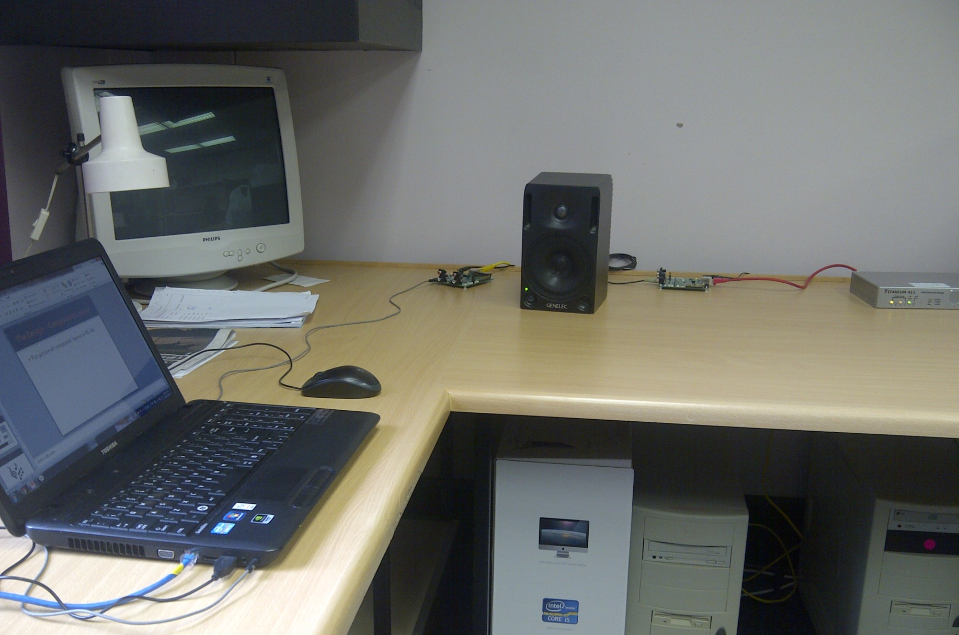
The Design – Component Layout

Slide 12
The Design - AVDECC
Audio/Video Discovery, Enumeration, Connection Management and Control
Layer 2
3 Sub-protocols
AVDECC Discovery Protocol (ADP)
AVDECC Connection Management Protocol (ACMP)
AVDECC Enumeration and Control Protocol (AECP)

Slide 13
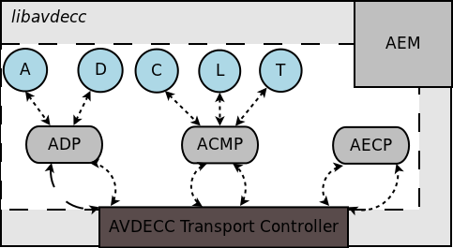
The Design - AVDECC

Slide 14
The Demonstration

Slide 15
The Future
Scalable solution
Testing QoS / QoA over large network
Number of devices
Distribution
Windows memory leaks
Breaking specific connections
Enable device pinging
Minimize VC++ interaction
Maximize automation
Implement AECP

Slide 16
The Questions

