Slide 1
The Automation of Flight and Image Recognition applied in Quadrocopters

Slide 2
Project motive and aim
Nature conservation
Reserve Security
Monitor poacher activity
Elements to be explored
Aerial location maintenance
Image processing and target tracking
Flight automation using:
Distance detection
3D mapping

Slide 3
Conceived Solution
Quadtocopters placed strategically within reserves
Solar powered towers
Gun shot sensors
Image recognition
Target tracking
Possible problems
Decoy gun shots
Attacks on the quadrocopter

Slide 4
Approach
Incremental approach
Focusing on:
Aerial location maintenance
Gyroscope
GPS sensor
Image processing and target tracking
Fiduciary diagrams
Humans – faces, aerial view of a human body
Non-natural colours
Thermal sensors
Flight automation using:
Distance judgement using lasers
3D mapping

Slide 5
Conclusion
Make technology available commercially
Benefits security and surveillance industries
New approaches to security management
Reduce cost of security over large areas

Slide 6
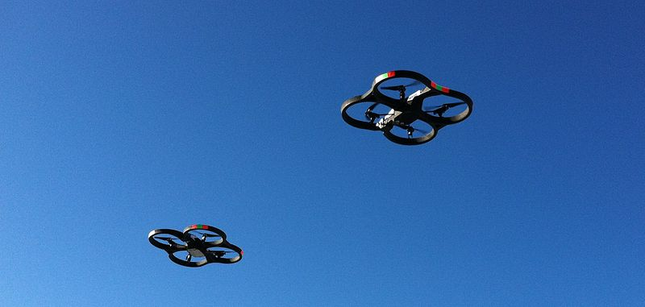
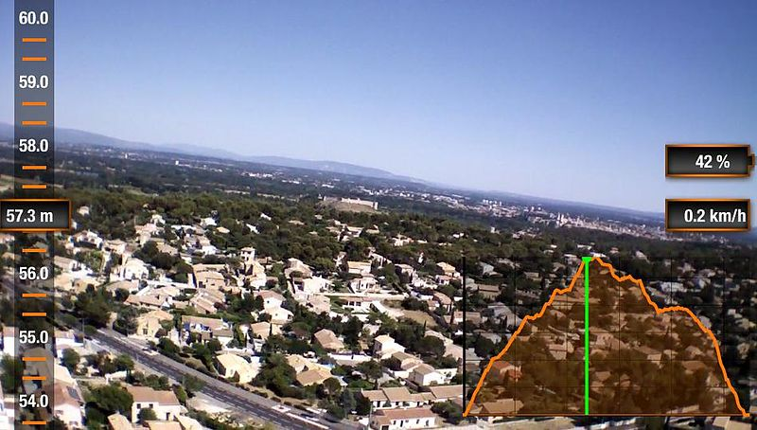
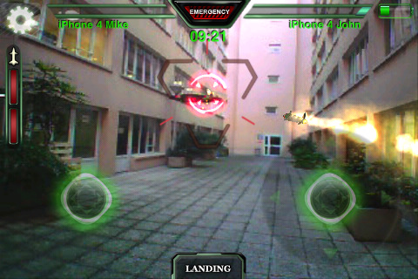
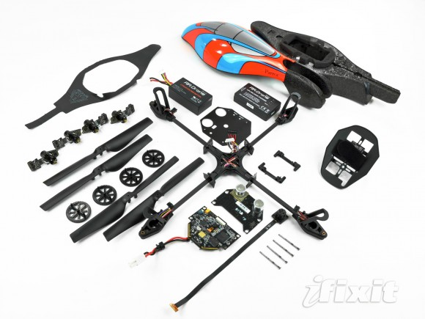
QUESTIONS?

