Slide 1
Autonomous target detection, recognition and tracking using the Parrot AR Drone
Oliver Boyers
Supervisor: James Connan

Slide 2
Overview
Project Goals
System Design
Implementation
Video Demo
Results
Limitations
Future Work
Questions?

Slide 3
Project Goals
Create a system that perform various detection techniques
Implement recognition of a detected target
Create an algorithm that sends flight commands to the AR Drone to perform target tracking
Test the capabilities of each detection and recognition algorithm

Slide 4
System Design
OpenCv
Camshift – HSV based tracking
Viola Jones – Haar cascade tracking with Adaboost training
Haar Cascades – Eye, face and upperbody
Fiducial Marker Tracking – Quadrilateral transformation, fiducial matrix reconstruction and comparrison
Eigenfaces and Fisherfaces – Linear Discriminant Analysis

Slide 5
Implementation
OpenCV – Image processing (Camshift, back propogation, thresholding etc.)
CVDrone library – Drone connection and Tracking
EZ – B Robotics IDE – Fiducial marker recognition, Haar Cascades, Viola Jones
Python – Fisherfaces Implementation

Slide 6
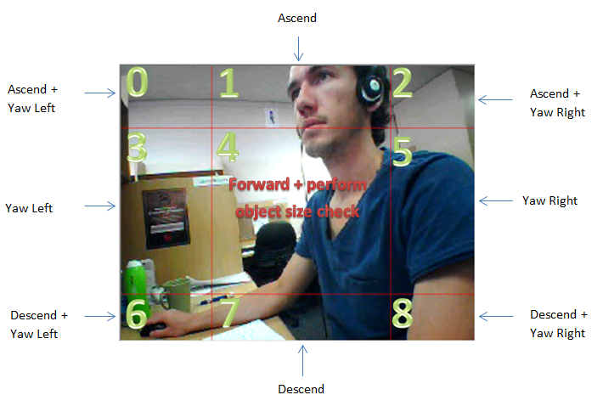
Tracking Implementation
Notes:
Once the object has been detected in the video stream the quadcopter needs to make flight decisions based on the objects position. This was implemented by using the rectangle around the object to determine the center point of the object. The processed video stream was then divided into nine quadrants. These quadrants are not all equally sized but rather slightly pushed to the edge of the video stream to create a larger quadrant in the center.
Flight commands are then sent to the AR Drone according to which quadrant the center of the tracked object falls into. In quadrant 4, the pitch of the AR Drone is set to move the drone forward. However, this forward motion cannot continue in definitely as the drone would crash in to the object it is tracking eventually. To prevent this, the program calculates the tracked objects total area (width x height) using the recrtangle that was drawn around to object. If this area is under a certain threshold to drone executes the forward motion. Otherwise the drone holds it's position a certain distance away from the object.

Slide 7
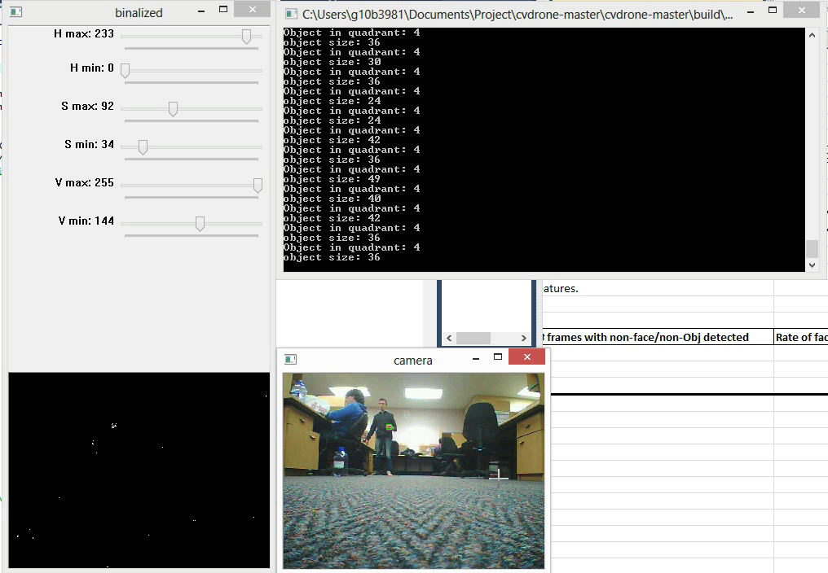
Camshift Tracking Demonstration
Notes:
Mention – greg playing games.

Slide 8
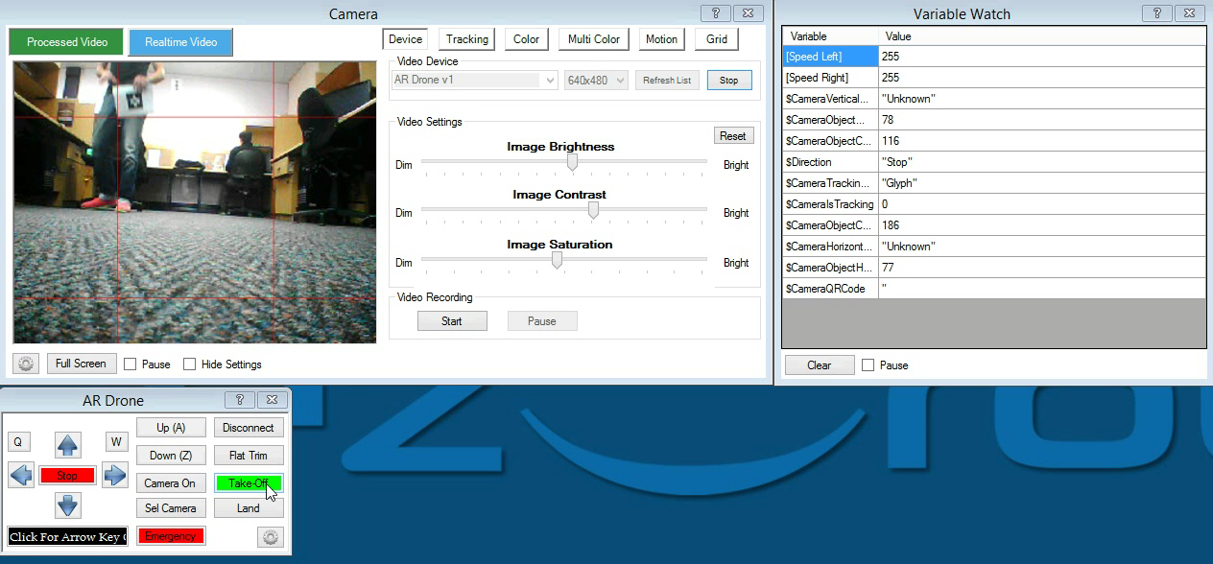
Fiducial Marker Tracking Demo

Slide 9
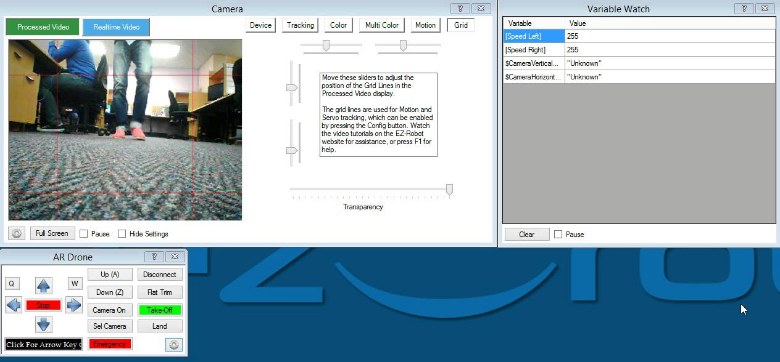
Fiducial Marker Code Execution

Slide 10
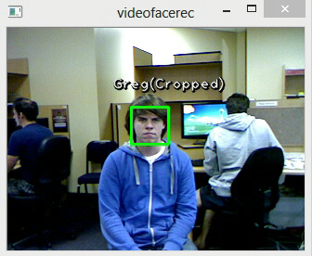
Fisherfaces Recognition
Notes:
Trained for 3 faces

Slide 11

Results and limitations
Viola Jones Results at 1m:
Distance capabilities
Angle capabilities
Notes:
The results from tests performed on the AR Drone were positive and highlighted many of the strengths and weaknesses that need to be considered when implementing a detection, recognition and tracking system for the drone. Many of the algorithms encountered problems with the detection of false positives and this impeded the drones ability to track a subject completely accurately. There were limitations on the distances at which algorithms could successfully track their subjects. This limitation is a consequence of many factors such as image pixel density, frame frequency and the lighting in a tracking environment. It is expected that the drones capable tracking distances would increase by making use of a higher quality camera and algorithms with more elaborate detection mechanisms. The inertial movement of the drone caused some flight test results to vary especially due to the small size of the testing environment. On a larger scale, the drones inertial movement is expected to become negligible to an extent. The relatively few number of angle that subjects were able to be detected at required tests to be performed in fairly ideal conditions. Advanced searching algorithms could be employed to assess an environment at as many angles as possible to deal with this limitation. When performing recognition, there was a small amount of time needed to process a detected subject. This led to significant delays in tracking command execution and limited the speed at which an object was able to move whilst successfully performing tracking. Toward the end of testing, the drones components became slightly damaged from test flight crashes and made some flight movements unpredictable. The drone was successfully able to detect, recognise and track various subjects during tests and provided useful insight into the AR Drones capability and limitations.

Slide 12
Future Work
Higher quality camera
Algorithm selection function
3D mapping
Onboard computer
More robust drone
Notes:
The results from tests performed on the AR Drone were positive and highlighted many of the strengths and weaknesses that need to be considered when implementing a detection, recognition and tracking system for the drone. Many of the algorithms encountered problems with the detection of false positives and this impeded the drones ability to track a subject completely accurately. There were limitations on the distances at which algorithms could successfully track their subjects. This limitation is a consequence of many factors such as image pixel density, frame frequency and the lighting in a tracking environment. It is expected that the drones capable tracking distances would increase by making use of a higher quality camera and algorithms with more elaborate detection mechanisms. The inertial movement of the drone caused some flight test results to vary especially due to the small size of the testing environment. On a larger scale, the drones inertial movement is expected to become negligible to an extent. The relatively few number of angle that subjects were able to be detected at required tests to be performed in fairly ideal conditions. Advanced searching algorithms could be employed to assess an environment at as many angles as possible to deal with this limitation. When performing recognition, there was a small amount of time needed to process a detected subject. This led to significant delays in tracking command execution and limited the speed at which an object was able to move whilst successfully performing tracking. Toward the end of testing, the drones components became slightly damaged from test flight crashes and made some flight movements unpredictable. The drone was successfully able to detect, recognise and track various subjects during tests and provided useful insight into the AR Drones capability and limitations.

Slide 13
Questions?

