Slide 1
Exploration of Network Flow for Cyber Defence
By Sean Pennefather

Slide 2
What is a Network Flow?
Sequence of unidirectional packets
Same source and destination IP address
Same IP protocol
Same source and destination port
Same Type of Service (ToS)

Slide 3
Advantages
Less Data!
Processing volume
Storage space
Little data loss (for security analysis)
Many modern routers do it for you

Slide 4
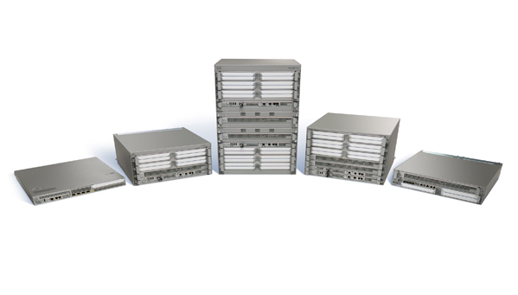
Where do they come from?
Now generated in the actual router hardware
Exported via the network to the flow processor.
NetFlow (5, 7, 9)
IPFIX (IETF)

Slide 5
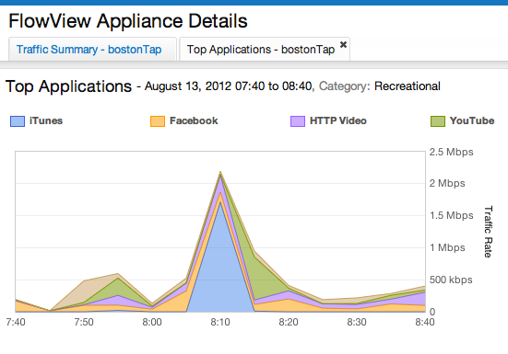
Goals
Compare flow approach to packet approach.
Generate a prototype system
Using NetFlow Version 9
Separate into 4 components:
Processing of raw flows
Data storage of processed flows
Analysis of stored data
Representation of analysis

Slide 6
What Analysis
Flow frequency
Flow volume
Flow sequence (Communication)
Can analyze according to many categories
Flows from a specific net-block
Flows to a particular port
Flows to a particular internal subnet
Flows of a certain protocol
Flows from a specific region (Geolocation)

Slide 7
Questions

