Slide 1
The modeling of cheating in an examination environment using Stochastic petri nets
By: Greg Pennefather
Supervisor: Yusuf Motara

Slide 2
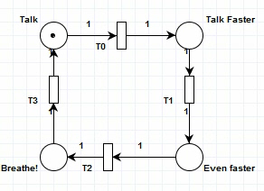
Project Overview
Most research focused on reasons for and extent of cheating.
More interested in understanding techniques and conditions required.
Explore the modeling of human interaction using Stochastic Petri Nets.
Stochastic Petri Nets achieve nondeterminism through timed transition firing.

Slide 3
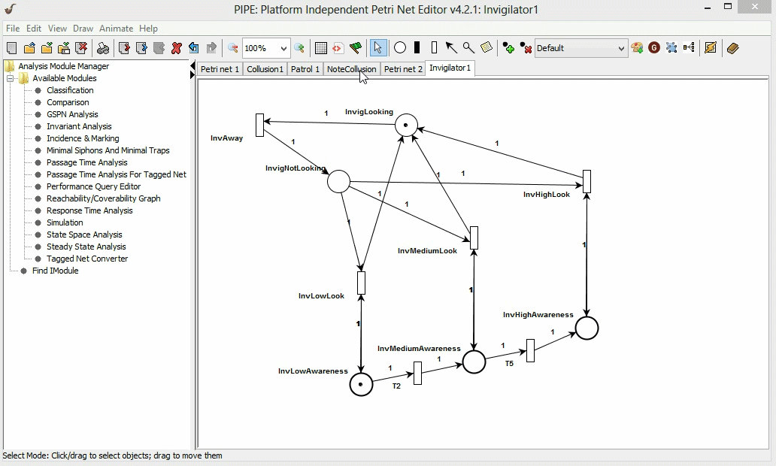
Design Environment

Slide 4
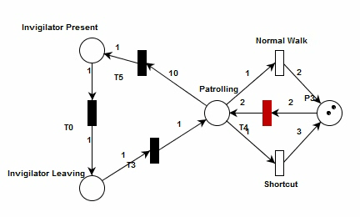
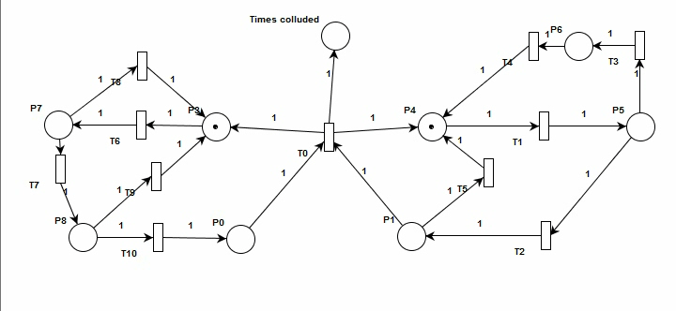
Issues encountered
PIPE Issues
Conceptual mistakes
Increasing complexity

Slide 5
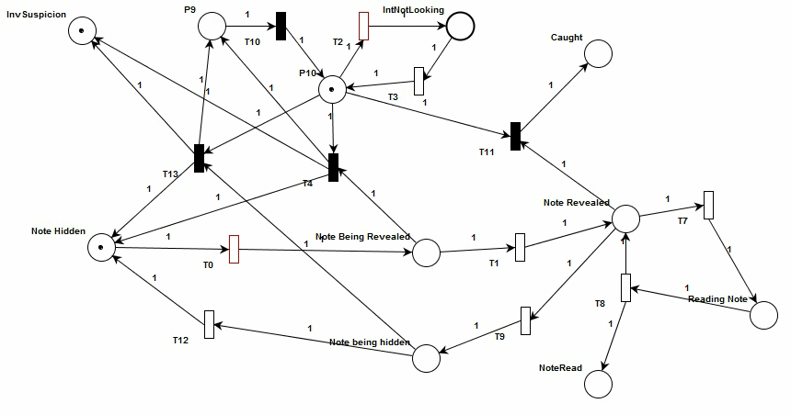
Moving forward
Further understanding of analysis tools available
Develop more models representing techniques in various ways
New cheating techniques

Slide 6
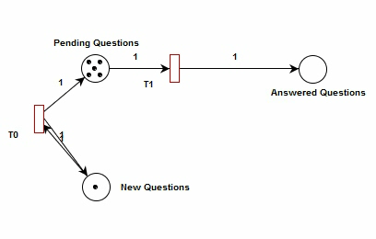
Questions?

