Slide 1
Navigational autonomy using quadcopters
By Alessandro Triaca

Slide 2
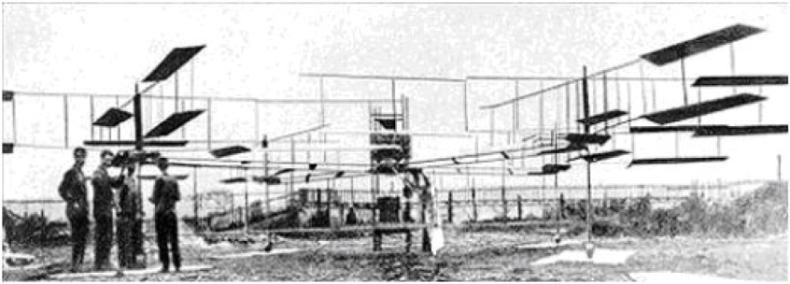
History
Original quadcopters seen as solution to vertical takeoff and landing
Problems with controlling four rotors simultaneously
Quadcopters as competition to helicopters
Original quadcopter designed by Louis Breguet

Slide 3
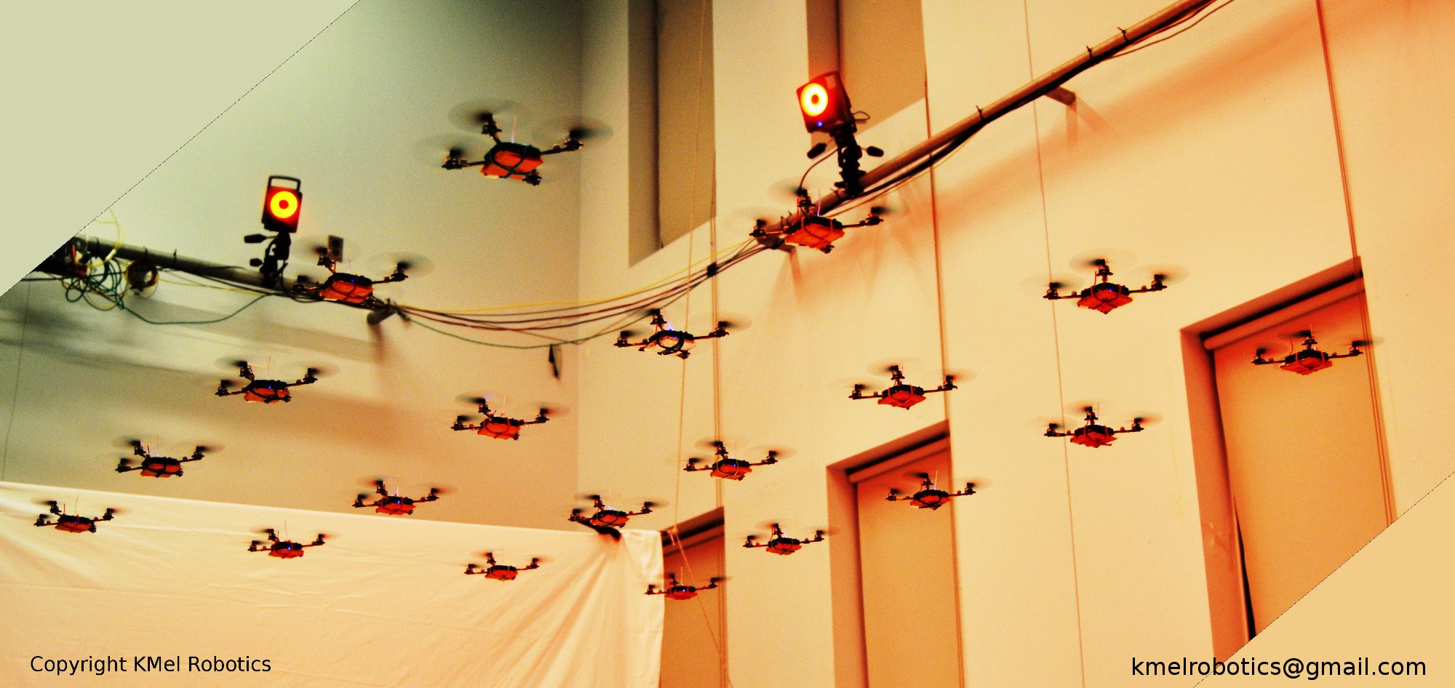
Micro Aerial Vehicles
21st centaury technology has made MAVs widely available
Recreational and research with MAVs
A swarm of quadcopters performing in unison

Slide 4
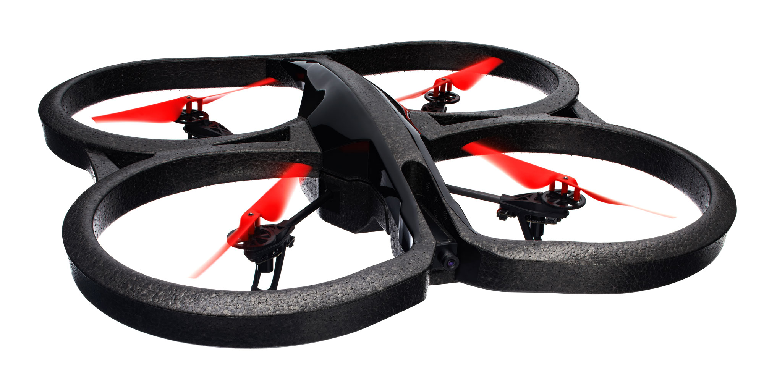
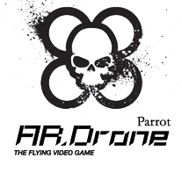
Parrot a.r. Drone
Developed as a gaming platform
On-board sensors have made it useful for research
AR Drone SDK
EZ Robot
The Parrot AR Drone

Slide 5
Project Phases
High level movement control
Distance based movement control
Fly search patterns and route planning
Object detection and avoidance
Relief mapping

