Slide 1
Tracking and mapping with the parrot a.r. drone
Alex Triaca
Supervisor: James Connan
Project Presentation 2

Slide 2
Overview of literature review
Define drones
The Parrot A.R. Drone
Controlling the A.R. Drone
Search patterns and methods
Aerial mapping techniques

Slide 3
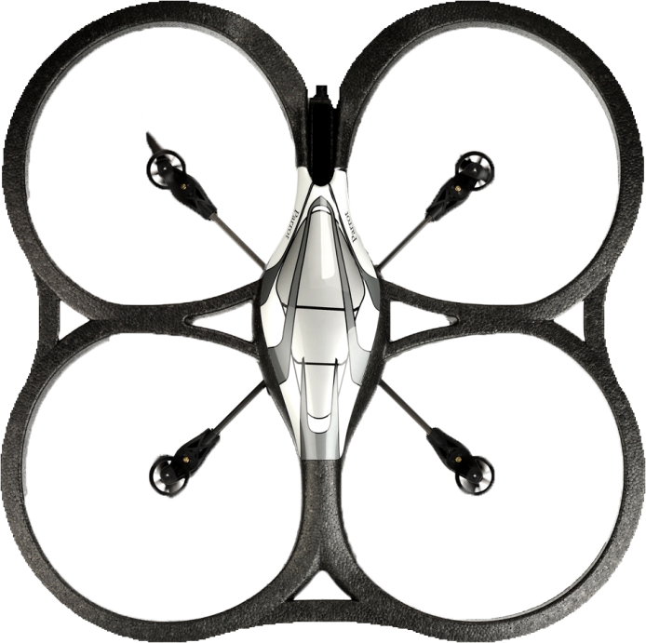
Pitch and roll
A
B
C
D

Slide 4
YAW
A
B
C
D

Slide 5
Overview of literature review
Define drones
The Parrot A.R. Drone
Controlling the A.R. Drone
AT commands
Navdata
Video stream
Search patterns and methods
Aerial mapping techniques

Slide 6
The plan
Glyph detection and processing
Glyph dictated flight plan
Aerial cartography

Slide 7
Implementation
Connecting to the drone
SDK (C++)
Library
Wrapper
OpenCV for glyph translation
Map creation with SIFT

Slide 8
Questions

