Slide 1
Increasing computer science popularity and gender diversity through the use of games and contextualized learning
By Mikha Zeffertt
Supervised by Mici Halse and Hannah Thinyane

Slide 2
OVERVIEW
Objective
Research design
Initial Surveys
Game implementation
Follow up survey
Results
Conclusion
Future work possibilities

Slide 3
THE ORIGINAL PROBLEM
Computer science enrolment rates are dropping
50% of students that enrol drop the subject
The lack of gender diversity in the subject
Only 12% of CS graduates are female

Slide 4
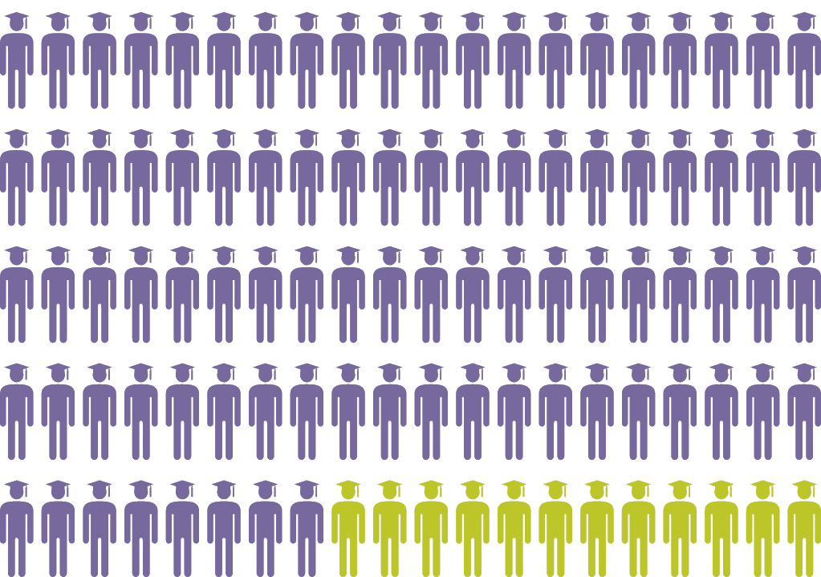
While, 57% of bachelor’s degrees are earned by women, only 12% of computer science degrees are awarded to women in the US
(code.org/stats)

Slide 5
RESEARCH GOALS
Develop a game to teach computational thinking contextually to CSc 112
Discover if this could positively influence falling enrolments and the skewed gender diversity in computer science
To establish the current effect CSc 112 is having on students (especially females)

Slide 6
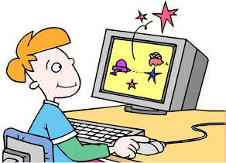
RESEARCH DESIGN
Interdepartmental survey
to ascertain opinions
about gender and
contextualized learning
Initial CSc 112 survey
to establish baseline
Follow up CSc 112 survey
to establish game success
and change in attitudes

Slide 7
LITERATURE REVIEW
Many successes for contextualised learning if managed correctly
Uses up lecture time and resources
Contextualised learning acts to encourage both genders equally
Helps combat low confidence levels in female students
Females generally have lower confidence and less experience in the field
Very few computational thinking educational games have been developed

Slide 8
INTERDEPARTMENTAL SURVEY (brief recap)
Contextualized learning received mixed responses
Need a meeting of ideas between traditional teaching and contextulization
Only gender difference: whether CS was biased towards male learning
Indicating need for gender neutral approaches

Slide 9
INITIAL CSC 112 SURVEY
Provide baseline of student attitudes to compare against at the end of the course
Based on Computer Science Attitude Survey by Wieber et al., (2003)
Five areas of focus: Confidence, attitude towards success, gender divide, relevance, and motivation
405 participants (50% female and 50% male)
18% were considering majoring in CS

Slide 10
INITIAL SURVEY ANALYSIS
Descriptive statistics on all questions
One-way ANOVA with assumed equal variance
Compare responses from males and females
Factor analysis to look at the groupings of the statements to validate connection to Wiebe et al., (2003)
Not an exact match but probably due to difference in sample set

Slide 11
INITIAL SURVEY SUMMARY
Females were less confident and felt less experienced
Students were motivated to achieve
Did not believe in nerd stereotypes
Significant difference on questions related to having females in the field
Males were less inclined to believe females should be in CS
CS and problem solving skills were seen as relevant and important

Slide 12
GAME DEVELOPMENT
X

Slide 13
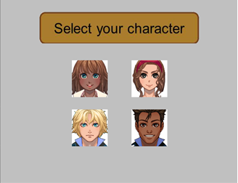
GAME STRUCTURE character selection

Slide 14
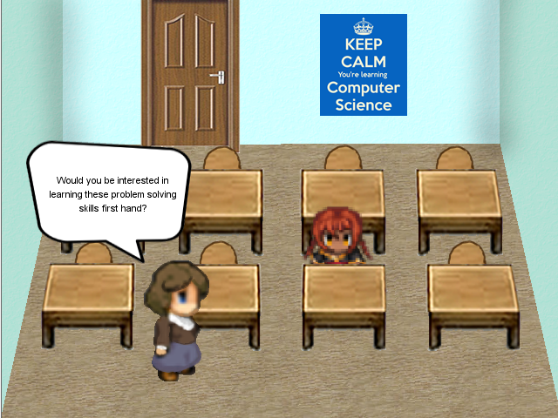
GAME STRUCTURE narrative cut scenes

Slide 15
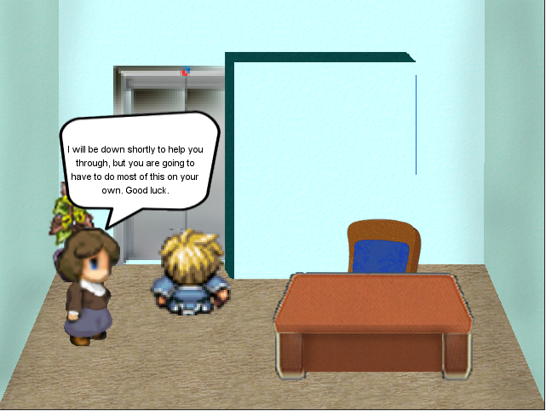
GAME STRUCTURE narrative cut scenes

Slide 16
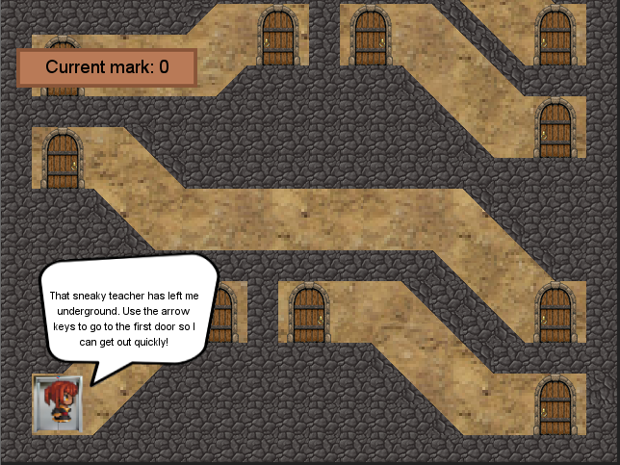
GAME STRUCTURE map

Slide 17
GAME STRUCTURE computational thinking sections
Trial and error
If statements
Variables
While loops
Algorithmic thinking

Slide 18
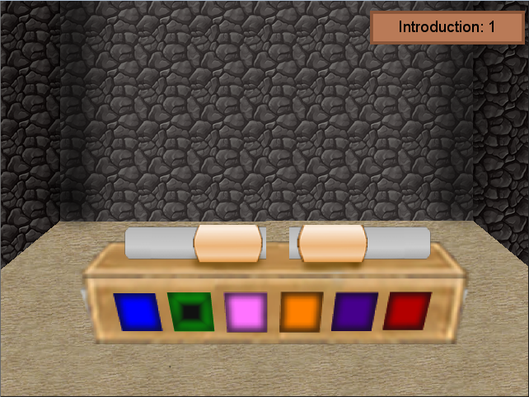
GAME STRUCTURE trial and error

Slide 19
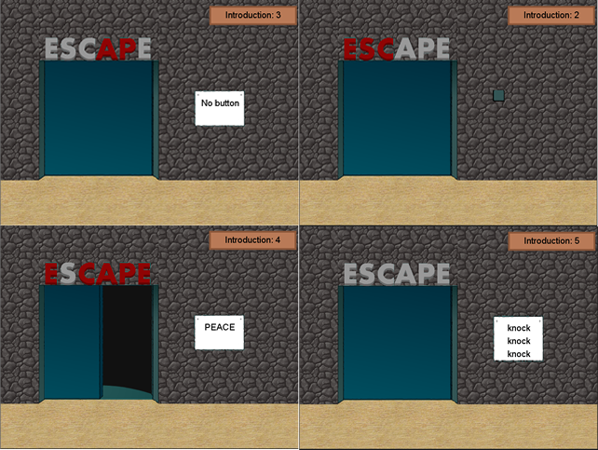
GAME STRUCTURE trial and error

Slide 20
GAME STRUCTURE if statements

Slide 21
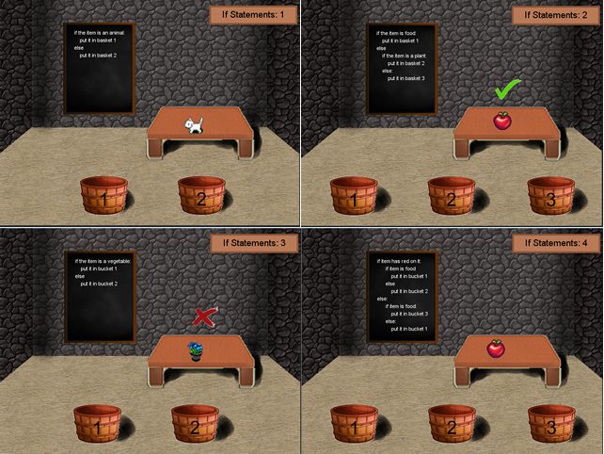
GAME STRUCTURE if statements

Slide 22
GAME STRUCTURE variables

Slide 23
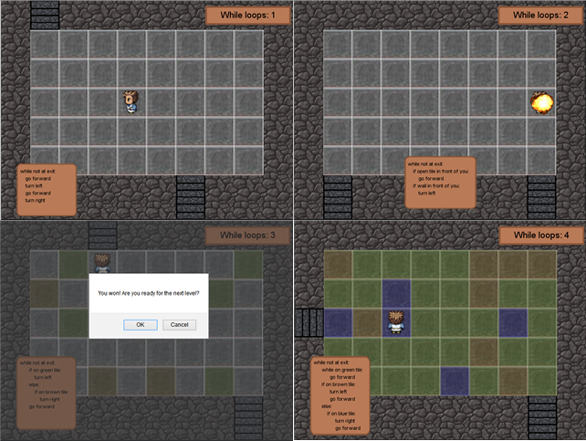
GAME STRUCTURE while loop

Slide 24
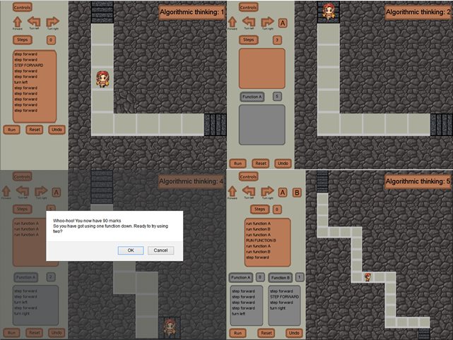
GAME STRUCTURE algorithmic thinking

Slide 25
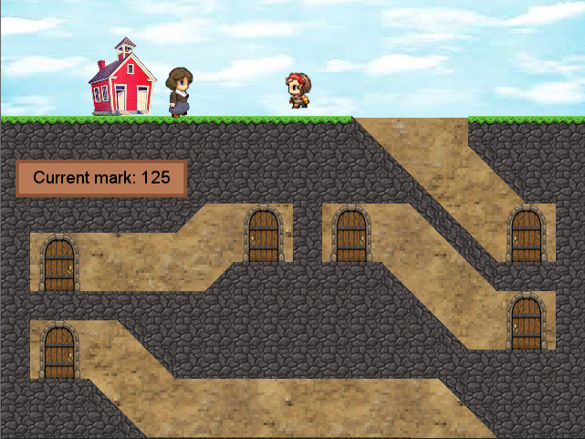
GAME STRUCTURE ending

Slide 26
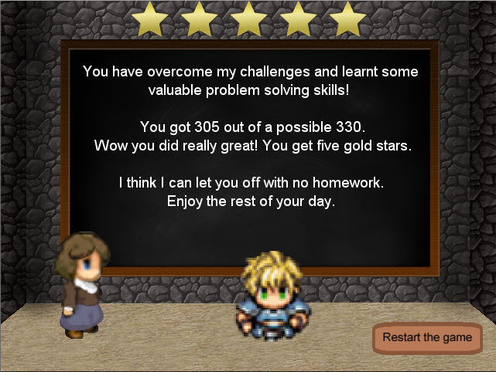
GAME STRUCTURE ending

Slide 27
GAME TESTING
Pilot study amongst peers
People in CS
University students with no CS background
High school students with no CS background

Slide 28
FOLLOW UP CSC 112 SURVEY
Comparison to initial survey
Evaluate game play
229 participants (50% female and 50% male)
19% considering majoring in CS

Slide 29
FOLLOW UP CSC 112 SURVEY ANALYSIS
Descriptive statistics on all questions
One-way ANOVA with assumed equal variance on new questions and game questions
Compare males and females
Compare majoring and non-majoring students
Two-way ANOVA to compare two surveys

Slide 30
COMPARISON OF TWO SURVEYS
Most areas showed a decline in interest and attitude
More so amongst females
Students were less confident about computer skills and less encouraging about females in computer science
CSc 112 might not be cause

Slide 31
GAME QUESTIONS
The game was generally enjoyed
Almost all participants understood what was being taught
60% enjoyed using the game to learn and wished more modules used games for teaching
72% liked learning contextually
2% found the game unhelpful
The majority of students thought the game increased their problem solving confidence
10% more than normal practicals

Slide 32
GAME QUESTIONS
Only one question had a significant gender difference
Gender neutral approach
No difference between majoring students and non-majoring students
Game use is not affected by amount of experience

Slide 33
CSC 112 SURVEY CONCLUSION
Only four questions showed no adjustment between gender or time
Correlation between CSc 112 and negatively affected attitudes
The average female’s response reduced for both their perception of themselves and the subject
Many other factors could have affected this shift in attitudes

Slide 34
GAME OBSERVATIONS
CSc 112 introductory programming logic prac

Slide 35
CONCLUSION
The game was successfully developed and implemented
Students responded positively to game use as a learning tool and to contextualized learning
Game proved to be gender neutral
CS students’ attitudes are generally becoming more negative
More research is required to ascertain exactly why

Slide 36
FUTURE WORK
More narratively complex game
Possible test frameworks
Multiplayer as students tend to work together
Implement game at highschool level
Less solidified opinions on CS and stereotypes

