Slide 1
Project : The phone reader
Presenter: Marilyn Bihina
Supervisor: James Connan

Slide 2
Overview
What is a phone reader?
What is the importance of a phone reader?
Who has done similar work?
What are the required resources for developing the system?
What are the different steps to develop the system?

Slide 3
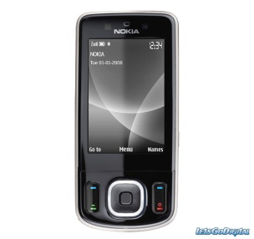
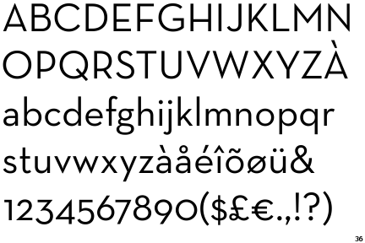
What is a phone reader?
The user takes a picture of a text with his phone
The user selects a language
The phone reads the text for the person in the chosen language

Slide 4
The importance
Blind people
Dyslectic people
Illiterates
Non-native speakers

Slide 5
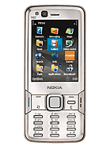
Similar work previously done?
2009 : Hossein and Hadi Shayesteh: computer science honours students in the University of Western Cape
2008: Joint Venture of Kurzweil Technologies and the National Federation of the Blind(USA) for the Nokia N82

Slide 6
Required resources
Modern mobile phone
Android
Apache Server
Optical Character Recognition program
Text-To-Speech program
Translation program

Slide 7
Methodology
Review existing technologies
Determine system requirements
Configure web service
Implement OCR
Implement and evaluate pre-processing
Implement user interface/phone client
Testing
Documentation

Slide 8
? ? ?

