Slide 1
Phone Reader Project
Presenter: Marilyn Bihina
Supervisor: James Connan

Slide 2
Presentation
Intro
Related work
Design
Implementation
Problems encountered
Functionalities of the system
Current results
Questions

Slide 3
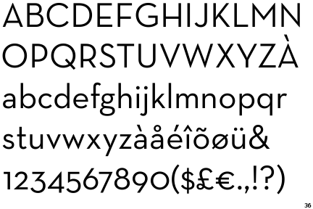
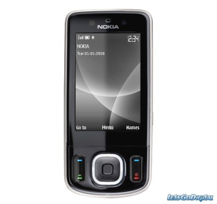
Introduction - Reminder
What is a phone reader?
The user takes a picture of a text with his phone and selects a language
The user listens to the text extracted from the picture

Slide 4
The importance
Blind people
Visually impaired
Non-native speakers

Slide 5
Related work
Captura Talk: Android application designed in UK in 2008
knfbREADER (1000 USD): First Cell Phone that Reads to the Blind and Dyslexic (USA) in 2008
Google goggles : visual search system does not automatically read

Slide 6
Design of the system
User takes a photo with his phone
The photo is uploaded to the server
The image is processed
OCR performed + post-processing
Text translated
Text to Speech performed
The user hears the text being read

Slide 7
Implementation
Tools
- Ubuntu
- smart phone
- Android SDK
- web server (Lamp server)
- java (Eclipse)
- Imagemagick
- Tesseract OCR
- translation program
- Text-To-Speech (espeak / Android TTS)

Slide 8
Problems encountered
Design a system for blind people (testing)
Provide accurate results (OCR)

Slide 9
Progression until today
Image pre-processing
Web server
Optical Character Recognition
Text to Speech
Translation
Client interface (just starting)

Slide 10
Functionalities not developed yet
Post processing: correct spelling mistakes
User interface for the server
Testing and improving the system
Final documentation

Slide 11
Current results
Original picture -> processed picture

Slide 12
????????????
????????????
????????????

