Slide 1
Phone Reader Project
Presenter: Marilyn Bihina
Supervisor: James Connan

Slide 2
Overview of the presentation
Intro - Statement of the problem
Description of the Phone Reader project
Design of the system
Implementation
Demo
Tests
Future work
Questions

Slide 3
Statement of the problem
Reading and understanding a text can be difficult for:
Non-native speakers
Dyslectics and blind people
Illiterates
The Phone Reader project aims to help users read and understand a text from a picture.

Slide 4
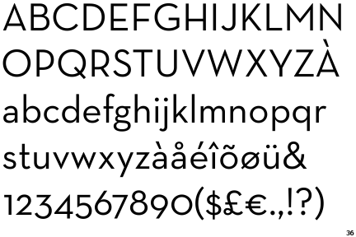
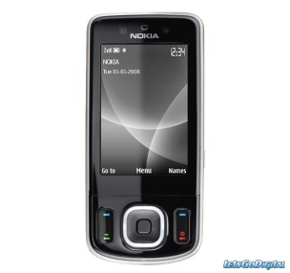
Description of the Phone Reader project
What is a phone reader?
Photo of text converted to speech through a phone.

Slide 5
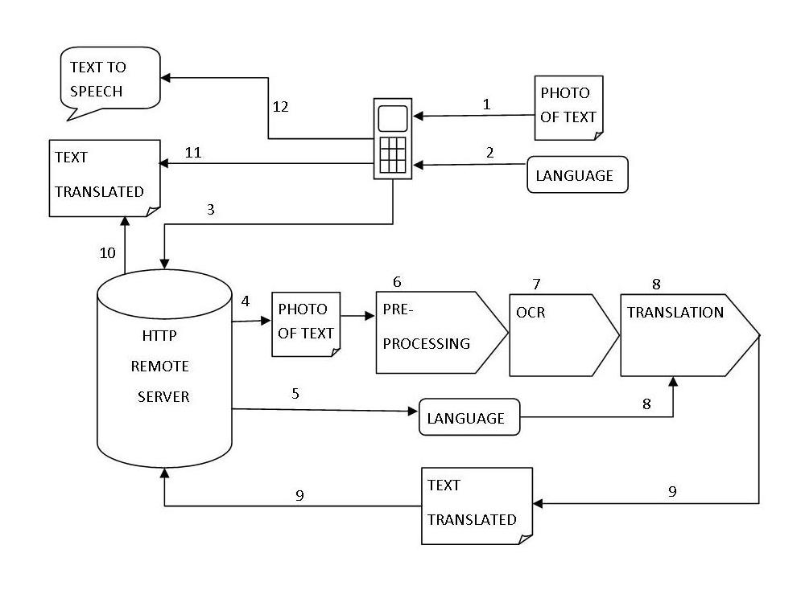
Design of the system

Slide 6
Implementation
System specifications
Operating system | Ubuntu 11.04 Android 2.1
Programming languages | PHP 5.0 Java OpenJDK 6 Runtime
HTTP server | LAMP server
Processing software | Imagemagick 6.8.0-2
OCR program | Tesseract OCR 2.04-2.1
Translation program | Apertium 3.1.0-1.2
Database | MySQL
Smart phones | HTC Desire C with Android 2.1 Samsung Galaxy Tab GT-P1000 with Android 2.2.

Slide 7
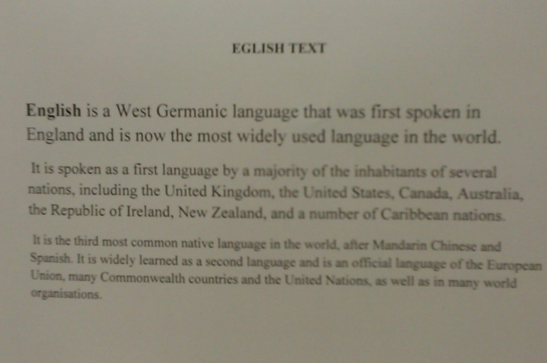
Implementation
Pre-processing methods used with Imagemagick:
Crop
Despeckle
Grayscale
Threshold
Deskew
Unsharp

Slide 8
Demo
Video 1
Video 2

Slide 9
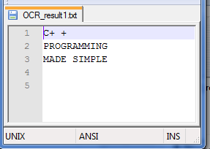
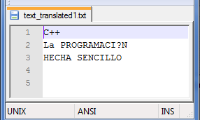
Tests
1
2
4
3

Slide 10
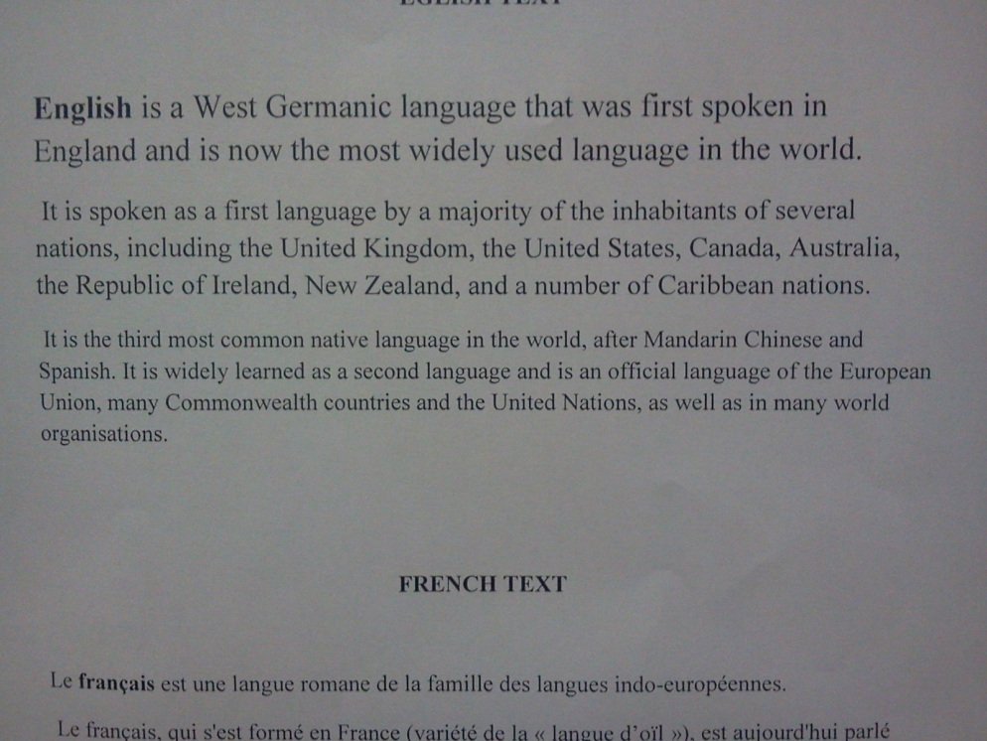
Tests with good picture quality
Original Image Processed Image

Slide 11
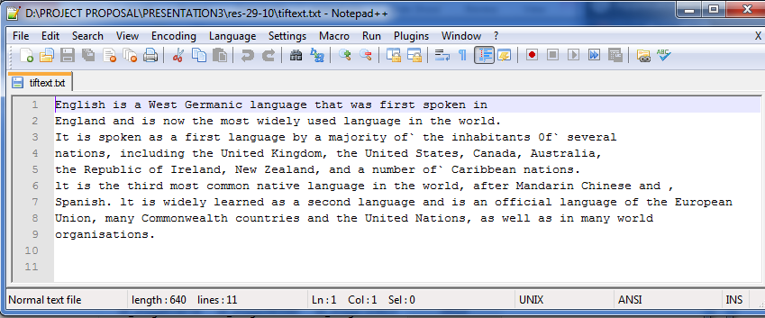
Tesseract results from a good picture

Slide 12
Tests with bad picture

Slide 13
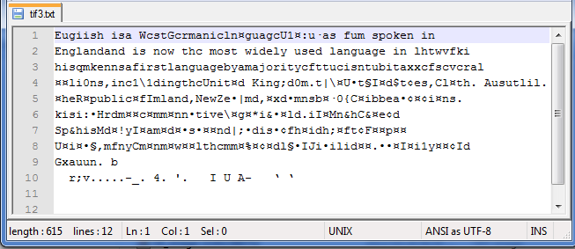
Tesseract results from not processed bad image

Slide 14
Bad quality processed image

Slide 15
Tesseract results from bad processed image

Slide 16
Future work
Display special characters(é, ï, ç) in translated text
Include a spell checker to improve the final text
Allow more languages to be recognized and translated

Slide 17
Conclusion
Main challenge: take a good picture!!!!

Slide 18
Questions
????????????
????????????
????????????

