Slide 1
Analysis and Processing of Cryptographic Protocols
Bradley Cowie
Supervised by Barry Irwin
Security and Networks Research Group
Department of Computer Science
Rhodes University

Slide 2
Introduction
Agenda
Introduction
Objectives of Research
The TLS Protocol
System Design
Experimental Design
Results
Conclusion

Slide 3
Introduction
Glossary
Some terms and terminology
PRF : Psuedo random function, a function that guarantees that all
of its output appears to be random.
PCAP PacketCAPture, API for capturing network traffic

Slide 4
Introduction
Problem Statement
Cryptographic protocols have become incredibly popular in recent times and have a variety of applications such as securing web based communications.
We have a reliance on these protocols to provide authentication, integrity and confidentiality to our communications.
However, we note that it is rather difficult to perform legitimate analysis, intrusion detection and debugging on data that pases through cryptographic protocols, as that data is encrypted.

Slide 5
Introduction
Problem Statement (cont.)
It would be nice if there was framework developed to solve this issue
We approach this problem statement from the prospective of having legitimate access to encrypted traffic for doing analysis, debugging or data collection.
The novelty of the project lies in the design of a system that could be extended to provide decryption for any arbitrary cryptographic protocol

Slide 6
Research Objectives
Objectives of Research
Design a framework/system that allows for the decryption of network traffic that has been encrypted by any arbitrary cryptographic protocol
Given encrypted data in the form of stored PCAP files, extending to live pcap streams, be able to determine the algorithm used and then together with the recovered session key be able to decrypt to plain-text.
Provide implementation for TLS to show feasibility.
Test the accuracy of decryption produced by application.
Compare the efficiency of developed application against an industry standard decryption tool/protocol analyser

Slide 7
TLS
Packet Structure
Logical Packet structure
TLS Record Layer Structure
TLS Record Layer
Ethernet
IPv4
TCP
TLS Message Data
Content Type
Version
Length

Slide 8
TLS
TLS Handshake (cont.)
Client
Handshake phase
Server
Bootstrap
Client Hello
Client Hello
Client Hello
Client Hello
Server Hello
Server Hello
Authentic-ation
Server Auth

Slide 9
TLS
TLS Handshake (cont.)
Client
Server
Key
exchange
Cipher Change
Server Finish
Client Finish
Data exchange phase

Slide 10
TLS
TLS PRF
The TLS PRF is the core of the TLS protocol.
Using cryptographic parameters that are transferred during the TLS Handshake the TLS PRF generates the key block from which the symmetric keys for encryption/decryption are cut.
Cryptographic parameters used :
Client.Hello from the client hello message
Server.Hello from the server hello message
Decrypted pre-master secret from client key exchange message
Master Secret
A label used to identify what the TLS PRF is being used for.

Slide 11
TLS
TLS PRF Pseudo-code
TLS_PRF(String Secret,Integer Secret Length,String
Label,Int OutputLen)
{
MD5Key = Client.Hello + Server.Hello
TempHash = HMAC_MD5(Secret,MD5Key + Label)
hashedLength = 16
while hashedLength < OutputLen
TempHash = HMAC_MD5(TempHash,MD5Key + Label)
hashedLength += 16
MD5HashedValue += TempHash
SHA1Key = Server.Hello + Client.Hello
TempHash = HMAC_SHA1(Secret,SHA1Key)
hashedLength = 20
while hashedLength < OutputLen
TempHash = HMAC_SHA1(TempHash,SHA1Key + label)
hashedLength += 20
SHA1HashedValue += TempHash
Return SHA1HashedValue XOR MD5HashedValue
}

Slide 12
Design
Logical Design
Obtain crypto suite used
Load PCAP file or stream
Decrypt
Analysis
Start
Get Session keys

Slide 13
Design
System Design
After considering the logical design and the structure of TLS is was decided that that following modules were required :
Decryption module :
The decryption module needs to be able to decrypt generic application traffic, given the decryption key and the name of encryption algorithm used to encrypt the traffic.
This is achieved by using the OpenSSL EVP interface.
Packet Capture
This module needs to capture traffic based upon some filter rules (tcp.port ==443) .
This captured traffic is then passed onto the analyzer module

Slide 14
Design
System Design
Analyser Module
The handshake analyser needs to parse packets received from the packet capturer in order to find the cryptographic parameters required in order to build the symmetric keys that are to be used by the Decryption module

Slide 15
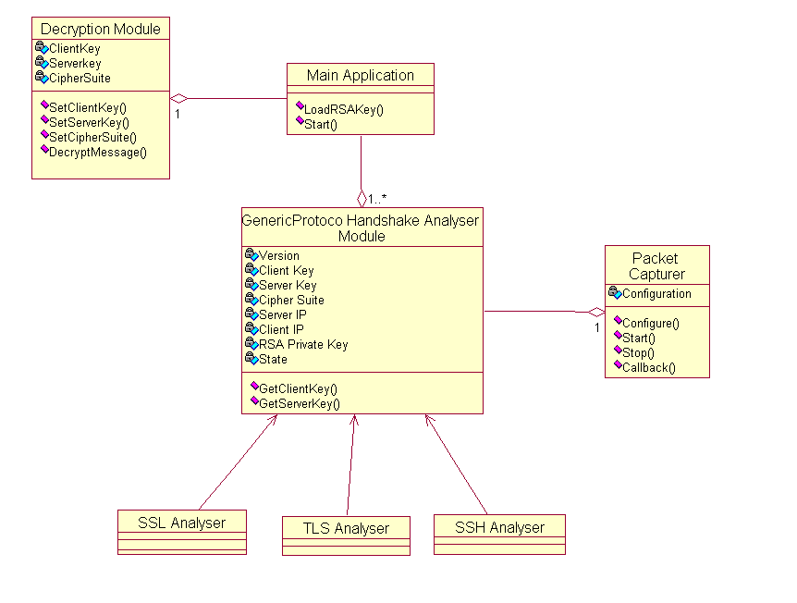
Design
Class Diagram

Slide 16
Design
Experimental Design
In order to test the accuracy and efficiency of the decryption provided a “test bed” was built using a TLS enabled Apache2 server (acting as the TLS Client) and a configured Opera 10 web browser (acting as the TLS client).
Accuracy Testing : A test file was copied through HTTPS. The resulting packets were captured using Wireshark and stored as a PCAP file.
Efficiency Testing : Random files of specified lengths were generated using a PHP script. These files were then copied through HTTPS and the resulting traffic was captured using Wireshark. A bash script was used to automate the decryption of the encrypted files in the PCAP traffic using Tshark and Project Bellerphron, recording the execution time (script is automated to repeat experiment 1000 times per application)

Slide 17
Test File Parameters

Slide 18
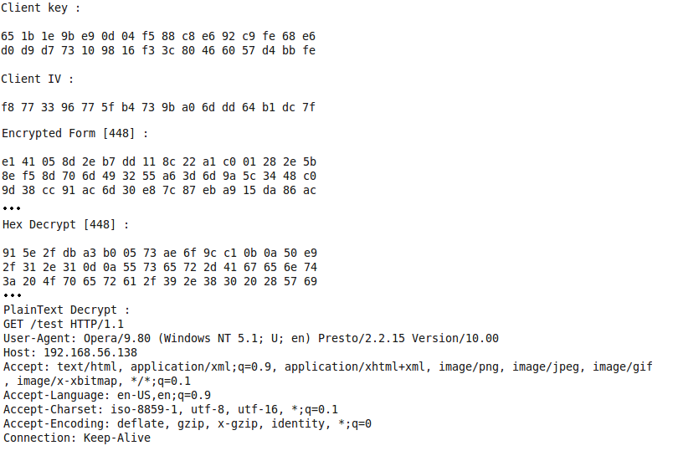
Results
Accuracy Results 1

Slide 19
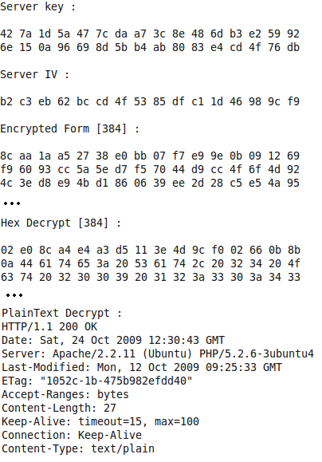
Results
Accuracy Results 2

Slide 20
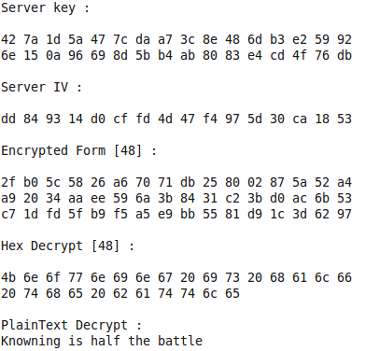
Results
Accuracy Results 3

Slide 21
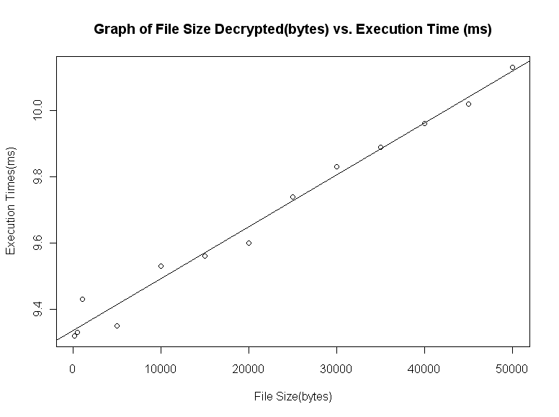
Results
Establishing a baseline using OpenSSL

Slide 22
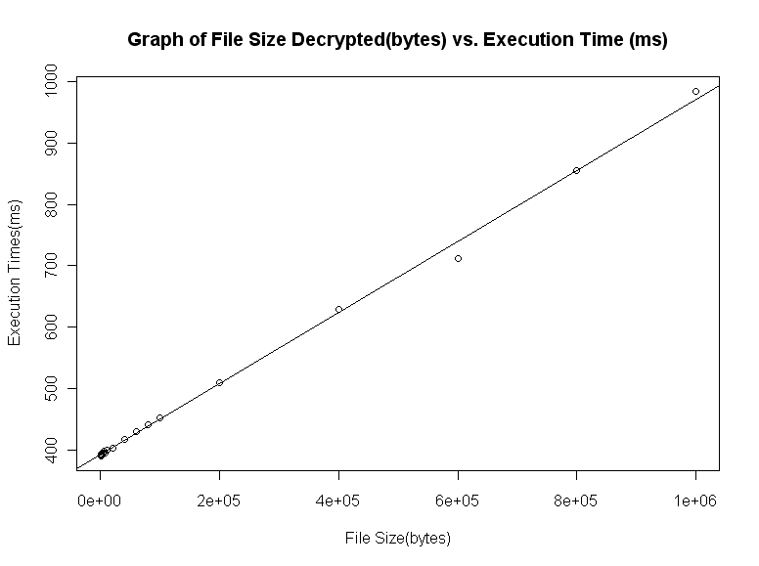
Results
Efficiency results for TShark

Slide 23
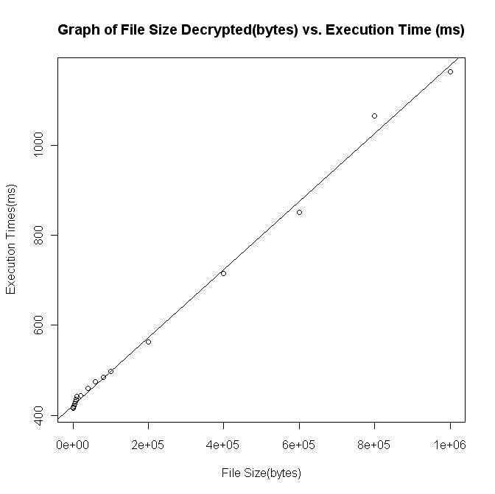
Results
Efficiency results for developed application

Slide 24
Conclusion
Comparing the execution time for Tshark and the developed application
From the graphs it appears that there is a linear relation between execution time and file size for both Tshark and developed application
Performing linear regression yields the following results
Tshark : y = (4.22 x 10²) x + 7.57 with R² = 0.9968
Developed application: y = (4.61x 10²) x + 7.08 with R² = 0.995
Considering the linear relationships Tshark and the Project Bellerphron have with regards to file size and execution time, Tshark is more efficient as it has as lower increase in execution time for given change in file size
However, it would be unfair to say that this difference could be considered significant

Slide 25
Conclusion
Summary and Conclusion
An application framework has been designed for the decryption of traffic encrypted by an arbitrary cryptographic protocol.
Implementation for the TLS protocol has been provided
The implementation has shown to be accurate by showing that it produces the correct decryptions
The implementation has been shown to be sufficiently efficient when compared to an industry standard protocol analysing tool

Slide 26
Conclusion
Extensions
Provide implementation for more protocols such as SSH and IPSec
Consider code optimization and parallel processing techniques
Add traffic analysis modules

Slide 27
Questions and Comments ?

