Slide 1
Management, processing and analysis of Cryptographic Protocols
Bradley Cowie, Barry Irwin and Richard Barnett
Security and Networks Research Group
Department of Computer Science
Rhodes University

Slide 2
Introduction
Agenda
Introduction
Problem Statement
Background
Applications of Research
Relevance and Background
Existing Tool Suites
Research Objectives
Research Design
SSL Handshake
Objectives and progress

Slide 3
Introduction
Problem Statement
Cryptographic protocols have become incredibly popular in recent times and have a variety of application such as securing web based communications.
We have a reliance on these protocols to provide authentication, integrity and confidentiality to our communications.
However, we note that it is rather difficult to perform legitimate analysis, intrusion detection and debugging on cryptographic protocols, as the data that passes through is encrypted.

Slide 4
Introduction
Problem Statement (cont.)
So it would be nice if a set of tools existed for dealing with these problems.
We approach this problem statement from the prospective of having legitimate access to encrypted traffic for doing analysis, debugging or data collection.
We are looking at building a system to decrypt encrypted traffic that is easy to managed, cross platform and can be extended to implement a number of different protocols.

Slide 5
Background
Applications of Research
ISP's are often served with court orders to provide logs of clients activity; this data is often encrypted.
Attacks that use HTTPS as their means of entry are harder to detect once again as they are encrypted. While tools do exist to do this, they aren’t sufficiently generic.
Its often difficult to debug errors related to cryptographic protocols once again due to the encrypted nature of the data.

Slide 6
Background
Relevance and Background
SANS one of the most respected Information Security trainers and certifiers released a list of the top 10 security menaces for 2008 (compiled by 10 security veterans). The number 1 security menace for 2008 was :
“Increasingly Sophisticated Web Site Attacks - Especially On Trusted Web Sites”
“..web site attacks have migrated from simple ones based one or two exploits posted on a web site to more sophisticated attacks based on scripts.. attackers are actively placing exploit code on popular, trusted web sites where users have an expectation of effective security”
Source: http://www.sans.org/2008menaces/

Slide 7
Background
Existing Tool Suites
The CSUR Project
CSUR is a project about automatic analysis of cryptographic
protocols written in C. However its distributed under copyright and is
still in its beta phase.
HTTP Analyzer 4
HTTP Analyzer is a utility that allows you to capture HTTP/HTTPS traffic in real-time. It can trace and display a wide range of information. However its not sufficiently generic.
SSLDump
A tool that can be used to decrypt live SSL encrypted traffic

Slide 8
Research Objectives
Objectives of Research
Given encrypted data in the form of stored pcap files, extending to live pcap streams, be able to determine the algorithm used and then together with the recovered session key to decrypt to plain-text.
Once the plain has be derived we can continue on to provide some analysis on data that may be useful for detection of possible attacks or for debugging purposes.
Investigate sensible means to store symmetric keys for later use.
Initially provide implementation for SSL then TLS following up with possible implementation for SSH.

Slide 9
Research Objectives
Prototype Design
Obtain crypto suite used
Load PCAP file or stream
Remove packet header
Decrypt
Analysis
Start
Get Session key

Slide 10
SSL Handshake
SSL Handshake (cont.)
Client
Handshake phase
Server
Bootstrap
Client Hello
Client Hello
Client Hello
Client Hello
Server Hello
Server Hello
Authentic-ation
Server Auth

Slide 11
SSL Handshake (cont.)
Client
Server
Cipher Change
Server Finish
Client Finish
Data exchange phase

Slide 12
Project Goals
Capture traffic using libpcap [Complete]
Obtain the parameters used in the SSL Handshake [Complete]
Get back the session keys from Client.random and Hello.Random [In progress]
Use the keys together with OpenSSL and the information from the traffic capture to decrypt the traffic [No progress of yet]
Build Webfront for tools [No progress]
Perform the same process for TLS and potentially SSH [No progress]
Analyze solution built [No progress]

Slide 13
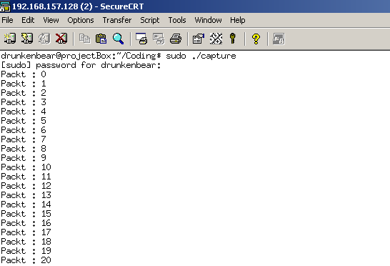
Screenshots!

Slide 14
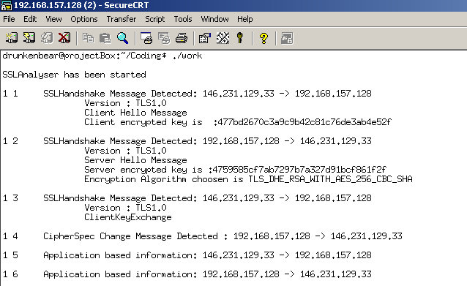
Screenshots!

Slide 15
Questions and Comments ?

