Slide 1
Management, processing and analysis of Cryptographic Protocols
Bradley Cowie
Supervised by Barry Irwin
Security and Networks Research Group
Department of Computer Science
Rhodes University

Slide 2
Problem statement 1
The use of cryptographic protocols as a means to provide security to web servers and applications at the transport layer is becoming increasingly popular. However it is difficult to analyze this sort of traffic as it is encrypted
ISP's are often served with court orders to provide logs of clients activity; this data is often encrypted.
Attacks that use HTTPS as their means of entry are harder to detect once again as they are encrypted.
Its often difficult to debug errors related to cryptographic protocols once again due to the encrypted nature of the data

Slide 3
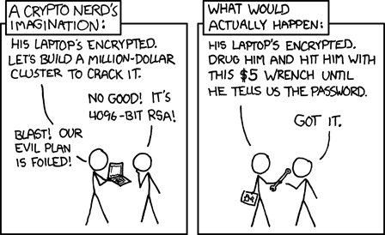
Problem statement 2
So it would be nice if a set of tools existed for dealing with these problems. We approach this problem statement from the prospective of having legitimate access to encrypted traffic for doing analysis, debugging or data collection. There are a number of systems that implement parts of the problem statement. We are looking at building a system that is easy to managed, cross platform and can be extended to implement a number of different protocols.
From the popular web-comic XKCD,
http://www.xkcd.com/538/

Slide 4
Objectives of Research 1
Given encrypted data in the form of stored pcap files ( extending to live pcap streams) can we determine the algorithm used and then together with the recovered session key to decrypt to plain text. Of course the algorithm used for encryption is dependant on the protocol used and the algorithms that were negotiated between client and server.
Investigate sensible means to store symmetric keys for later use.
Provide some analysis on data that may be useful for detection of possible attacks or for debugging purposes.
Initially provide implementation for SSL then TLS following up with possible implementation for SSH.

Slide 5
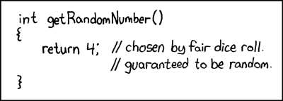
Objectives of Research 2
Possible extensions
Develop plug-ins for Wireshark to allow for similar functionality
Implement for a wide variety of different protocols.
The approach taken by one of the Debian openSSL developers. Removing the randomness from a cryptographic function can’t have too negative a effect …
http://www.xkcd.com/221/

Slide 6
Relevance and Background 1
Recent concerns :
SSLStripper:
Moxie Marlinspike announced at the 2009 Black Hat Federal that he had developed a tool for performing "man-in-the-middle” attacks on secure websites that make use of SSL.
Rogue CA’s exploiting MD5
A research group at the Eindhoven University of Technology has developed a method to create rogue CA (Certification Authority) certificates from commercial CA certificates which are trusted by all common web browsers.

Slide 7
Relevance and Background 2
SANS one of the most respected Information Security trainers and certifiers released a list of the top 10 security menaces for 2008 (compiled by 10 security veterans). The number 1 security menace for 2008 was :
“Increasingly Sophisticated Web Site Attacks - Especially On Trusted Web Sites”
“..web site attacks have migrated from simple ones based one or two exploits posted on a web site to more sophisticated attacks based on scripts.. attackers are actively placing exploit code on popular, trusted web sites where users have an expectation of effective security”
Taken from : http://www.sans.org/2008menaces/

Slide 8
Relevance and Background 3
Existing tool suites which partially solve the problem statement
The CSUR project :
CSUR is a project about automatic analysis of cryptographic protocols written in C. However its distributed under copyright and is still in its beta phase.
HTTP Analyzer 4 :
HTTP Analyzer is a utility that allows you to capture HTTP/HTTPS traffic in real-time. It can trace and display a wide range of information. However its not sufficiently generic.

Slide 9
Approach and Design 1
Research related protocols : develop my own flowcharts and psuedo-code to understand how they function.
Setup, configuration and gaining of experience in the use of valuable software like TCPDump, SSLDump, openSSL and modSSL.
Experimentation with generation of CA certificates using openSSL and TinyCA
Choose the platform for development (currently considering a web-platform using PHP for scripting)
Develop tools to perform decryption and develop a front end to the tool set

Slide 10
Secure Socket Layer
SSLv2 Record Layer: Client Hello
Length: 103
Handshake Message Type: Client Hello (1)
Version: SSL 3.0 (0x0300)
Cipher Spec Length: 78
Session ID Length: 0
Challenge Length: 16
Cipher Specs (26 specs)
Cipher Spec: SSL2_RC4_128_WITH_MD5 (0x010080)
[ more Cipher Specs deleted ]
Challenge

Slide 11
Approach and Design 2
Implementation of analysis of data (entropy)
Possibly compare to other tools that perform similar functions.

Slide 12
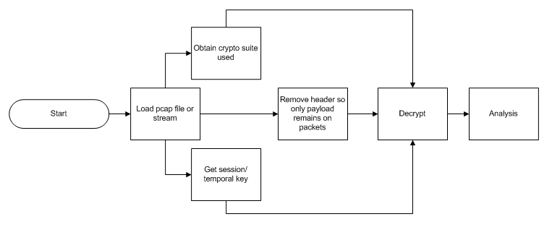
Approach and Design 3
Prototype design of system

Slide 13
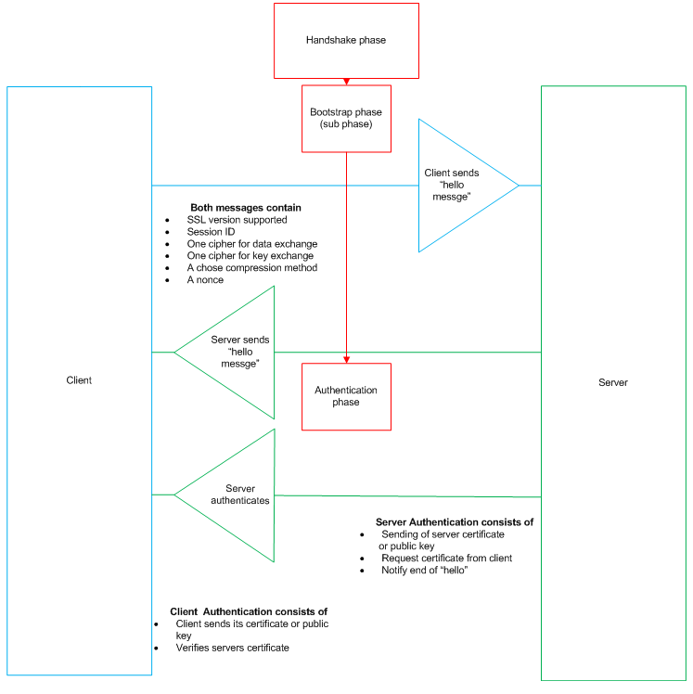

Slide 14
Questions ?

