Slide 1
Diameter & Ericsson Charging SDK
Technical Meeting Presentation
Moses T Nkhumeleni
Supervisors: Mr Mosiuoa Tsietsi and Professor Alfredo Terzoli

Slide 2
Introduction
Topics
Diameter Protocol
Ericsson Charging SDK
Research Project
Notes:
I will be presenting on the Diameter Protocol
Most of the Presentation will be about the Ericsson Charging SDK
Highlight some points on the research project

Slide 3
Diameter
Introduced by IETF, RFC 3588
Diameter used to perform AAA(Authentication, Authorisation , and Accounting)
Introduced as a replacement for RADIUS
Radius runs on unreliable UDP
Diameter runs on TCP
Notes:
IETF (Internet engineering task force)
Authentication: verifying the identity of the object
Authorization: What the object is allowed to access the requested resource
Accounting: Collecting information about the use of resources, used for billing and auditing
Radius runs on top of UDP protocol and lacked congestion control

Slide 4
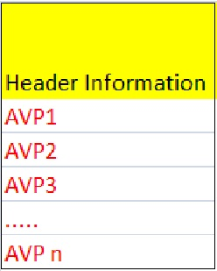
Diameter Message
Diameter message contains header information and number of AVP(Attribute Value Pairs)
AVP’s contains data
Diameter Message can be
Request or an Answer
Notes:
Header Information consists of number of fields, namely Version, Message Length, Command-Flags, Application ID, etc.
What Attribute-value- pair means is that we have a variable that contains an attribute name and a value

Slide 5
Diameter Commands
Command Name
Abort-Session-Request
Abort-Session-Answer
Abbreviation
ASR
ASA
Command Code
274
274
Accounting-Request
Accounting-Answer
ACR
ACA
271
271
Session-Termination-Request
Session-Termination-Answer
STR
STA
275
275
Notes:
We have already noted that diameter uses Request or Answers
The table shows few Diameter Commands.
Note that the corresponding Request and Answer messages share a same command code.
------------------------------------------
The Abort-Session-Request and Abort-Session-Answer, used to stop providing a service, this can be due to a number of reasons such as insufficient credit.
The server will send ASR to a client and the client will respond with ASA as confirmation of executing the command
------------------------------------------
The Accounting Request and Answer are important as they send information to the server about the usage of resources. The client would send Accounting-Request to server and the server would respond with an accounting answer.
------------------------------------------
When the client is no longer using a service, it will send a session termination request, and the server response with a session termination answer

Slide 6
Ericsson Charging SDK
Goals
Develop applications quickly
Provides a testing environment
Provide High-level API to abstract away from Diameter Base API
Notes:
Developers can quickly develop applications that have charging incorporated into them
The Charging SDK contains a emulator that allows developers to test their applications
Instead of working directly hard coding with AVP’s the high-level API provides a simpler abstraction from the base API

Slide 7
Charging SDK
Contains
A test client
Used to set up connections to the server
You can set up connection parameters such as PeerID, Realm, Vender ID, and IP address
A test Server
Acts as an emulator
Responds to request from the client
Contains DB with accounts, currency and tariff info
Charging API
The charging API implements the Diameter Base API
Provides high level abstraction
Notes:
The test client is an example application that can be used as an example for different charging approaches. Not much of interest for us.
A test Server is more important to us since it allows for us to test for the services we develop. The services i.e mobicent application would send messages towards the Test Server.
The next slides shows the abstraction from base protocol

Slide 8
Charging API
SCAPv2 API
HLAPI
DCC API
Diameter Base API
Notes:
Diameter Base API implements Base Protocol RFC 3588
DCC(Diameter Credit Control Application) implements RFC 4006
HLAPI(High Level) API another layer of abstraction to make programming easier.
SCAP(service context for application). Limits HLAPI to SCAP scope

Slide 9
Demonstration
Event based java program
Notes:
/**
*
* @author Thizwilondi
*/
public class Main {
//define a listener class
public static class ansListener implements SCAPAnswerListener
{
//these methods need to be defined for the listener
//method called when answer is received from the server
public void processAnswer(SCAPResult results)
{
System.out.println("Answer process");
long s = results.getResultCode();
System.out.println(s);
}
//issued when tx timer has expired
public void txTimerExpired()
{
System.out.println("tx timer expired");
}
//called when STA is recieved
public void staReceived(DiameterMessage staMsg)
{
System.out.println("sta is received");
}
public ansListener()
{
}
}
private static SCAPStack stack ;
//This method initializes the stack
public static void initialise()
{
stack = new SCAPStack();
//set the uri
stack.setOwnDiameterUri("aaa://localhost:3869;transport=tcp");
//set the realm
stack.setOriginRealm("ericson.test.com");
//set the productID
stack.setOwnProductId("tester");
try
{
//add a route to the server - in this case to the server emulator
stack.addStaticRoute("test.com", -1,-1, "aaa://127.0.0.1:3868;transport=tcp");
}
catch(Exception ex)
{
System.out.println(ex.toString());
}
//now we try to start the stack
try
{
stack.start();
System.out.println("The stack is started");
}
catch(Exception ex)
{
System.out.println(ex.toString());
}
}
public static void debit(SCAPSessionProperties sProp)
{
//define a listener
ansListener list = new ansListener();
//create an event
SCAPEvent debitEvent = SCAPChargingFactory.createEvent(stack, sProp, list);
//define rating function
SCAPRatingParameters ratingParameters = new SCAPRatingParameters();
ratingParameters.setTimeZoneAvp(new TimeZoneAvp((byte)2, (byte)0, (byte)0));
//define quouta
//---------------------------------------------------------------------------------
RequestedQuota reqQouta = new RequestedQuota();
//define the value and exponent and ID of the money unit
MoneyUnit reqMoneyUnit = new MoneyUnit(10,-1,978);
//set the money unit to the requested quouta
reqQouta.setRequestedMoneyUnit(reqMoneyUnit);
//---------------------------------------------------------------------------------
try
{
debitEvent.doDirectDebit(reqQouta, ratingParameters);
}
catch(Exception ex)
{
System.out.println(ex.toString());
}
}
/**
* @param args the command line arguments
*/
public static void main(String[] args) {
// TODO code application logic here
initialise();
//destination realm
String destRealm = "test.com";
//id
String subID = "12345";
//~~~~~~~~~~~~~~~~~~~~~~~~~~~~~~~~create a session property~~~~~~~~~~~~~~~~~~~~~~~~~~~~~
//define a new session property
SCAPSessionProperties sProperties = new SCAPSessionProperties(destRealm, subID);
//define a service ID
long serviceID = 1;
sProperties.setServiceIdentifier(serviceID);
//~~~~~~~~~~~~~~~~~~~~~~~~~~~~~~~~~~~~~~~~~~~~~~~~~~~~~~~~~~~~~~~~~~~~~~~~~~~~~~~~~~~~~~
System.out.println("start debiting");
debit(sProperties);
}
}

Slide 10
The Research Project
A number of charging Models have been identified
Event-based
Time-based
Volume-based
Reward-based
Subscription-based
Notes:
My literature review identifies a number of charging models. Charging models can be considered
Event based- a chargeable event occurring, such as sending an sms
Time-based – based on the duration of the call
Volume-based – the amount of data being transferred
Reward-based – based on usage criteria of the user, for instance the more the user consumes the service, the price decreases
Subscription-based – user pays a fixed amount over a period of time.

Slide 11
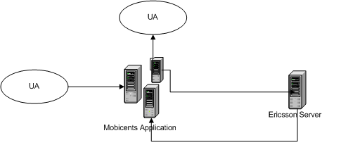
Systems under development
Systems under development as proof of concept
Messaging system
Event-based charging model
Session system
Time-based charging model
Notes:
To demonstrate the even-based charging model…
Two services are currently under development, the messaging system and the Session system. The messaging system uses a simple event-based charging model, when the user sends a message the mobicents application captures the event and sends credit control request to the Ericsson server, which replies with a credit control answer.
Session system described in detail on the next slide.

Slide 12
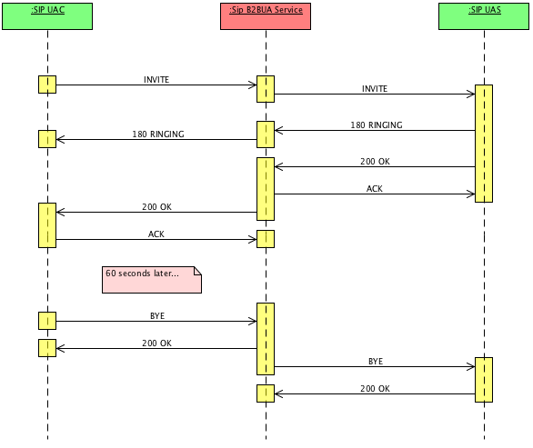
Session System
Extended from the sip B2BUA mobicents application.
Notes:
Extended from Sip Back to Back user agent. The example divides sip communication into two sip session as show the sip B2BUA services runs on top of a mobicents server and captures the sip messages before sending them to the destination user agent. This allowed us to add additional code to perform billing and accounting of resources.

Slide 13
Conclusion
Diameter Base protocol improves on former RADIUS protocol.
Ericsson Charging SDK simplifies the development of charging application.
Ericsson provides a testing environment
Next step we look at more advanced services
That incorporate volume based, and reward based charging model.
Consider applications that uses a combination of the two charging models e.g event-based and session based charging model.

Slide 14
Questions

