Slide 1
Honours Project
Name: Moses T Nkhumeleni
Degree: Bachelor of Business Science 4
Notes:
Introductions: My name is Moses Nkhumeleni, I am currently in 4th year Bachelor of Business Science .

Slide 2
Research Topic
Title: The development of Mobicents-based billing system and a new billing framework.
Supervisors
Professor Alfredo Terzoli
Mr Mosiuoa Tsietsi
Notes:
The title of my Research is “The development of Mobicent-based billing system and a new billing framework”
I am part of the convergence group and my supervisors are Professor Alfredo and Mr Tsietsi.

Slide 3
Background Information
Services offered by convergence group
IPTV, Video on demand, Voice services, Location based Services
Traditional strategies of billing are unsatisfactory.
Innovative ways of billing these services is required.
e.g. Location based services
Billing strategies
Volume based, time based, subscription based
Notes:
Currently the Convergence group offers a number of newly developed services such as IPTV, video on demand, location based services.
These newly developed services requires a billing system.
The difficulty is that the traditional billing strategies are unsatisfactory, so a new way of billing these services is required.
By strategies we talking about how billing is conducted, whether its time-based billing or volume based.
For instance with location based services, different rates might apply to based on where the individual is located.

Slide 4
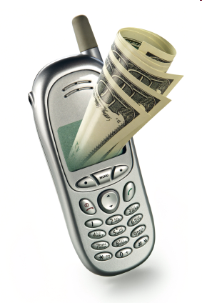
Project Aim
Develop a billing system
Investigate the new paradigms of billing
Produce a suitable billing framework
Notes:
The main project aim is to develop a billing system for these services and possible future services. The billing system will be based on existing implementation of the base protocols such as Diameter. Which we will get to in the next section.
I will also be Investigating billing strategies, that can be used to bill for the available services.
Once the project research is completed and given the time frame I hope to produce a billing framework that can be used for current and possible future services.
Further investigation will be conducted to consider different business/revenue models when suggesting a billing framework.

Slide 5
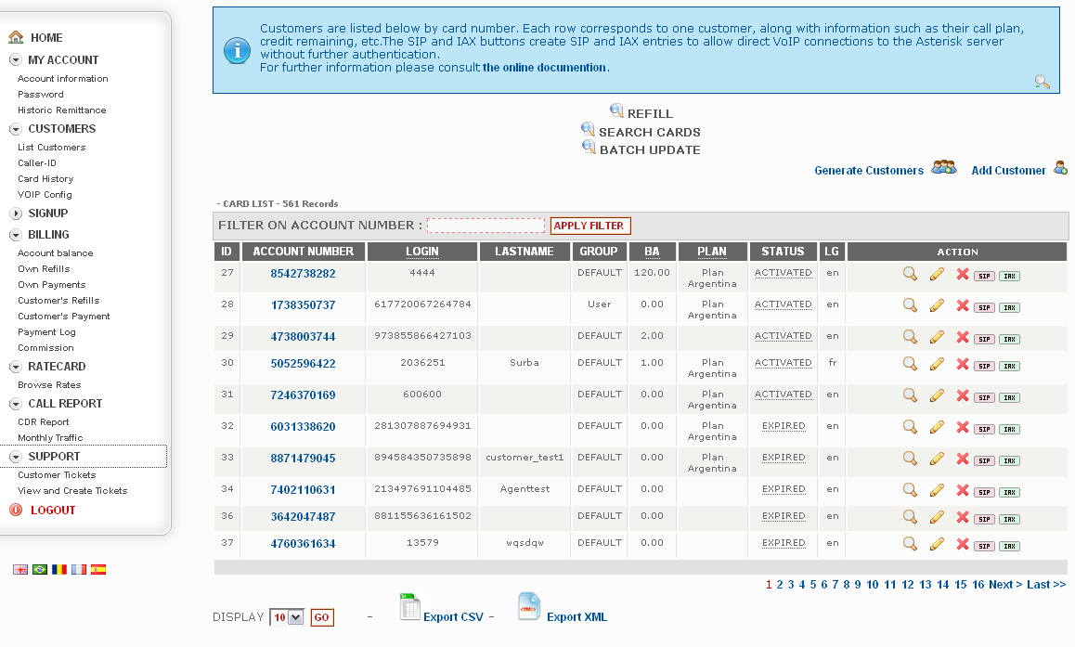
Other Tools
A2Billing
Focused on post paid and prepaid billing
Mainly for voice services billing
Notes:
http://www.asterisk2billing.org/cgi-bin/trac.cgi/wiki/User%20Manual
There are tools that offer billing services for voice services, Such as a2Billing.
A2Billingoffers billing mainly to voice services, hence its unable to cater for the mentioned services such as video, or location based services.
In addition, A2Billing is focused mainly on post paid/pre paid billing.
Does not offer other charging/revenue models such as subscriptions.

Slide 6
Tools used
Open source
Certified for JAIN SLEE
Allows creation of billing and call control services
Diameter charging SDK
Used to incorporate billing into systems
Developed by Ericsson
Notes:
Mobicents is an open source voice over IP platform.
Certified for JAIN SLEE (Service logic Execution environment).
#Jain SLEE Java standard for SLEE#
Hence mobicents is a standard approach in telecommunication industry.
Mobicents allows the creation of billing services and call control services.
Diameter SDK which is developed by Ericsson, based on diameter protocol. This tool allows for the development of systems which have real time billing.

Slide 7
Conclusion
Traditional billing is unsatisfactory
Innovative billing strategy required.
The tools used

Slide 8
Questions

