Slide 1
The development of a Mobicents-based billing system and a new billing framework
Name: Moses T Nkhumeleni
Supervisors: Mr Mosiuoa Tsietsi and Professor Alfredo Terzoli
Notes:
1
Introductions

Slide 2
Outline
Introduction and Recap
Complexities with billing next generation services
Billing concepts
Project Progress
Conclusion
Notes:
The outline will be as follows,
Firstly I am going to introduce the research topic and some recap
Followed by the discussion around the complexities associated with billing next generation services
Then we discuss some of the Billing concepts- sort of unwrap the concepts that are being investigated
Followed by a discussion around the implementation and progress of the project.

Slide 3
Introduction and recap
The convergence of voice video and data allows developers to deliver a wide variety of services.
These services require innovative billing strategies
Project objectives
Develop a billing service
Investigate billing strategies
Notes:
Develop a billing system, or service
In this case we will develop little proof of concepts services that we can add billing to them
Investigate billing strategies and concepts

Slide 4
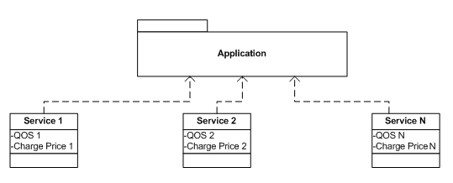
Complexities associated with billing
Convergence of voice, video, and data
Variety of Services
Voice, video, data, conferencing, and e-commerce services
Service Composition
Application made up of
N services
QOS(Quality of Service)
Different Service Providers
Amount shared among service providers
Notes:
Convergence of voice, video, and data
The convergence of voice, video, and data has created a platform where developers are developing a rich applications that offer a number of different services. This adds additional strain to existing charging approaches billed for different services. Most billing in telecommunication space is around time-based charging model.
--------------------------------------------------------------------------------------------------------
Variety of Services
There are a number of different services being introduced such as voice, video, data, conferencing , and e-commerce.
---------------------------------------------------------------------------------------------------------
Service composition
Service composition has become attractive in order to deliver rich services to the user. An application could contain a number of different services from different service providers, each service associated with a different charge price.
--------------------------------------------------------------------------------------------------------
Quality of service
Issues of Quality of Service become apparent when services are offered across and IMS(IP based Multimedia Subsystem) and therefore the charging model should accommodate QOS.
--------------------------------------------------------------------------------------------------------
Different service providers
Applications can consume services from different service providers. This adds additional strain to the charging model since the different providers will require their share of the amount the user is billed for.

Slide 5
concepts
Offline and online Charging
Offline : charging information is sent to an external billing system
Online : With online charging there is real-time interaction with a service
Real time charging
Charging Information is generated, processed, and transported in real time
Different charges
Service, Tariff , and Content charges
Charging Models
Event, Volume, Time, Subscription, Reward
Notes:
Offline and online charging
Offline –charging information is sent to an external billing system. This billing system is not defined by the 3GPP(3rd gen partnership project)
With online charging there is real-time interaction with the service that is being offered
Real-time charging
In real time charging information is generated, processed, and transported in less than 1 second. Therefore in real time the services offered is valued throughout the service.
-------------------------------------------------------------------------------------------------------------------
Service charges – charges for use of a particular service
Content charges – charges for downloading content
Tariff charges – charges for accessing the network
-------------------------------------------------------------------------------------------------------------------
Charging Models are important.
We have identified a number of charging models, Namely:
Event based - a chargeable event occurring, such as sending an sms
Time-based – based on the duration of the call
Volume-based – the amount of data being transferred
Reward-based – based on usage criteria of the user, for instance the more the user consumes the service, the price decreases
Subscription-based – user pays a fixed amount over a period of time.

Slide 6
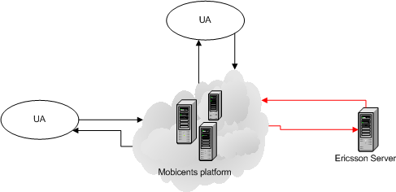
Project Progress
Example Systems under development
Messaging system
Event-based charging model
Session system
Time-based charging models
Notes:
To demonstrate the event-based charging model…
We are developing the messaging system. The messaging system uses a simple event-based charging model, when the user sends a message the mobicents application captures the event and sends credit control request to the Ericsson server, which replies with a credit control answer.
Two services are currently under development, the messaging system and the Session system.
Session system described in detail on the next slide.

Slide 7
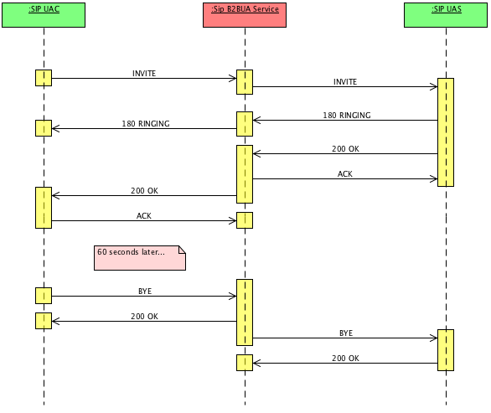
Session System
Extended from the sip B2BUA mobicents application.
Notes:
Extended from Sip Back to Back user agent. The example divides sip communication into two sip session as show the sip B2BUA services runs on top of a mobicents server and captures the sip messages before sending them to the destination user agent. This allowed us to add additional code to perform billing and accounting of resources.

Slide 8
Conclusion
Billing for next generation networks will be more complex
Next step we look at more advanced services
That incorporate volume based, and reward based charging model.
Consider applications that uses a combination of the two charging models e.g event-based and session based charging model.

