Slide 1
A practical investigation of billing for next generation services.
Name: Moses T Nkhumeleni
Supervisors: Professor Alfredo Terzoli and Mr Mosiuoa Tsietsi
Notes:
1

Slide 2
Outline
Introduction and Recap
Research Goals
Diameter Protocol
IMS billing and Related Technologies
Design
Implementation
Testing Examples
Conclusion
Notes:
Diameter protocol -> Important used to implement the proposed billing component.
IMS Billing and Related Technologies -> Factors affecting billing, IMS principles for charging. We discuss some of the tools avaiable.

Slide 3
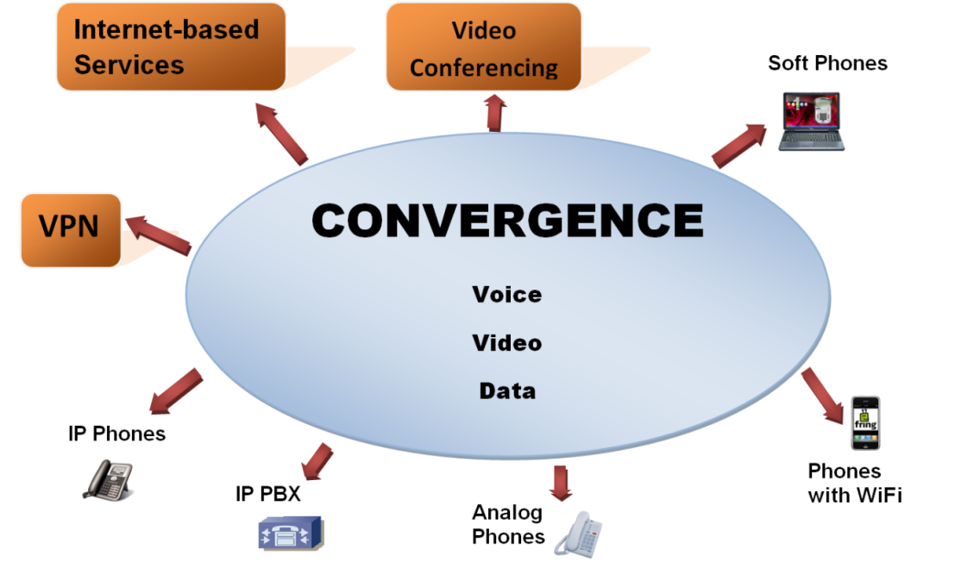
Introduction and Recap
The convergence of voice, video, and data leads to more sophisticated services.
Traditional charging models were primarily time-based.
NGEN services requires more complex charging models.
Moving towards IP networks introduces issues with QoS (Quality of services)

Slide 4
Research goals
To investigate billing and produce a billing framework.
Investigate pricing strategies, charging models.
Explore how potential services can be billed.
Develop a billing system to provide billing for mobicents services
Develop a Billing Component using Ericsson Diameter API
The billing component implements a number of charging models e.g. event, time, subscription, and volume .
Test the Billing system by using Mobicents applications
Use a number of different examples to demonstrate some of the concepts.
The Ericsson Diameter Emulator is used to emulate a prepaid system consisting of user accounts. The emulator handles and responds to charging request.
Notes:
The Ericsson charging SDK will be used to develop the proposed Billing Component. The Ericsson charging SDK has a number of tools that allow developers to incorporate charging into their systems.
The Ericsson Diameter API implements the Diameter Protocol which is used to transport messages with accounting information.

Slide 5
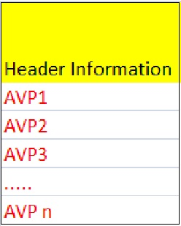
Diameter Protocol
Introduced by IETF, 2003, RFC 3588
Performs Authentication, Authorisation, and Accounting
Authentication is verifying the claimed identity of a subject
authorization is focused primarily on access that the subject has.
Accounting is focused on collecting information with regards to the amount of resources being used.
Diameter Messages
Composed of a number of AVP(Attribute Value Pairs)
AVPs are tuples<attribute_name, value> that contains data
Messages can be requests or answers
Notes:
IETF(Internet Engineering Task Force)
IETF proposed Diameter as a replacement of former
RADIUS protocol. RADIUS runs on unreliable UDP protocol. Diameter runs on TCP
which offers reliability

Slide 6
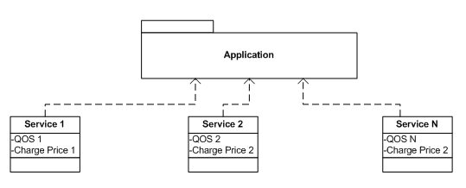
IMS Billing and Related Technologies 1
IMS billing requires more innovative billing strategies instead of charging by the amount of traffic.
IMS billing used to market services.
Factors Affecting IMS Billing
Variety of services
Quality of Service(QoS)
Service Composition
Different Service Providers
User Preferences
Notes:
Billing for next generation services will be the driving force behind releasing services into the market due to high competition and the variety of services that will be available to the user.
3G networks operate using packet switching and therefore allow the users to access the Internet via the IP protocol. However, the IP protocol offers only best-effort delivery.
Variety of services: services to its users such as voice, data, video, conferencing and e-commerce services.
QOS: When providing services across IMS, the issue of QoS becomes important. The quality of service should therefore be considered in the charging model.
Service Composition: applications combine different media forms such as voice, data and video. . For example, if we have an application that consumes n different services from different service providers as shown in Figure 1.1, each service is associated with a certain quality of service and charge price. During the execution of the application, the service bundles will change and the QoS will vary.
Different Service Providers: Services can be consumed from different service providers. . This poses challenges to the charging model, since the service providers will require their share of the amount that the user is billed for.
User Preferences: This means that all the customers were charged in the same manner. There was no personalised pricing strategy which considered the customers preferences. For example a user can have a tailored billing scheme based on their preferences.

Slide 7
IMS Billing and Related Technologies 2
Different Services with Respective Charging Models
Service | Charging Approach | Charging Model
Voice | Charge the duration of the session | Time-based charging
Video and Audio Streaming | Charge by the amount of content downloaded. Irrespective of the users usage criteria, charge the user a fixed monthly rate. | Volume-based charging Subscription-based charging
Multimedia messaging | Charge per message. Charge by the amount of content sent. | Event-based charging Volume-based charging
Location based services | Charge user for location information received. | Event-based charging
Downloadable content | Charge by the amount of data retrieved | Volume-based charging

Slide 8
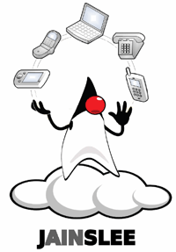
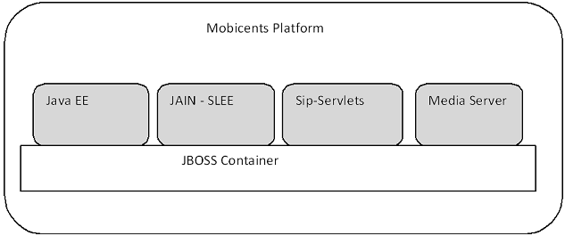
IMS Billing and Related Technologies 3
Mobicents
Service development platform for next generation applications.
certified as JAIN SLEE compliant
Built on top of JBOSS application server
Resource adapters act as wrappers that allow SLEE applications to communicate with external resources.
Notes:
The Mobicents platform is certified as JAIN SLEE compliant. SLEE (Service Logic Execution Environment) is a popular standard in the telecommunications industry.
The use of resource adapters allows developers not to be concerned with the underlying network technologies.

Slide 9
IMS Billing and Related Technologies 3
Diameter APIs
Implements Diameter Protocol
Open Diameter
C++ is used.
Source code available but little documentation
Ericsson Diameter API
Java is used
Provides High level abstraction
Pre-compiled binary files; Source code not available.
Ericsson Testing Emulator
Acts as a potential prepaid system
Responds to requests from client application.
Notes:
Open Diameter
Open diameter has little documentation. However, the advantage with Open Diameter is that source code is available. Open Diameter is not used for implementation, since preference was given to a Java implementation of Diameter.
Ericsson Diameter API
The Ericsson SDK provides a high level implementation of the Diameter Protocol.
The Ericsson SDK provides a number of examples that demonstrate how to develop billing applications.
The disadvantage is that the entire source code for the Charging API is not available to the user, since the API works with pre-compiled binary jar files.
Emulator
The Ericsson emulator is a server application. The emulator acts as a potential prepaid system. Therefore, it would respond to the requests from the client.
he emulator contains a database with all the accounts, currency, and tariff records.
We use the emulator to test our Billing Component.

Slide 10
Design 1
Design approach
Monolithic Design
Billing logic and service logic tightly bound
Motivation
NGEN services billed differently based on requirements.
Tailor made billing strategy for a service
Disadvantages
Code maintenance, no code separation.
Code replication since many services use combination of core charging models(event, time, volume, subscription)
Requires different number of examples.
Service Building Approach
Component Design
Notes:
One approach is to incorporate billing logic into a service. In this case, billing logic is added to the SBB that contains the code for the service

Slide 11
Design 2
Non-monolithic
SBB(service building block) approach
Mobicents provides “plug-and-play architecture through SBBs
SBBs are service object that can send and receive SLEE events
Multiple SBBs combined to create services
Advantages
Ease of extension
Similar to service creation, developers can add billing SBB
Disadvantages
Billing service limited to Mobicents
Component Design
Develop a Java object(Billing Component)
Advantages
Similar to SBB approach but more simpler.
Use the object in different platforms other than Mobicents

Slide 12
Design 3
System specification
Billing Component should demonstrate different charging models(event, time, volume, reward)
Easily extensible(i.e. adding additional charging models)
Allow developers with limited knowledge of Diameter to implement billing into their service.
Charging Models
Core Charging Models
Event, time, volume, subscription
Extended Charging models
Based on core charging models
Reward, flexible session
Notes:
We have not bothered to implement subscription based charging since the user pays a fixed amount irrespective of the usage. This is a trivial charging model to implemented, hence it is omitted here.
With reward based charging the user can be billed differently based on their usage criteria.
Flexible session.
Similarly if the user upgrades a session, e.g. requests higher QoS during a session we can adjust the charge price accordingly to accommodate the user’s changes.

Slide 13
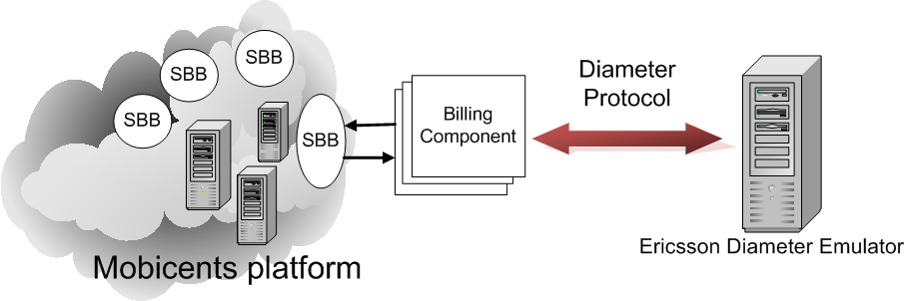
Design 4
System Architecture
Mobicents Application composed of different SBBs
Billing Component instantiated by an SBB
Billing Component contains implements charging models
Ericsson Diameter Emulator receives and answers requests.
Notes:
Mobicents provides a platform where developers can create services that allow for the convergence of voice, video, and data
Application will be composed of different SBBs
The SBBs are java files containing code that is used to create a service.
The billing component contains methods to implement different charging models.
The billing component has public methods that allow communication between the SBBs(service building blocks) in Mobicents application.
The communication between the Billing component and the Emulator is based on the Diameter protocol.
Ericsson Diameter Emulator acts as A PPS(Prepaid system) and responds to requests from billing componet.

Slide 14
Design 5
Billing Component Class Diagram
Notes:
The AbstractBillingComponent class contains a number of protected methods that are mainly for returning various Objects such as UsedQouta, Requested Qouta, SessionProperties object.
The BillingComponent interface contains all the public methods required to implement different charging models.
The billing component is the main class that contains most of the logic to implement different charging models.
The billing component contains a number of private methods to support the methods described in the BillingComponentInterface.
This is a listener class that is used to listen to responses from the Diameter Emulator.

Slide 15
Implementation 1
Billing Component
Developed in Java using Ericsson Diameter API, implements different charging models
Event-based charging
Notes:
When the user service wants to perform charging it calls the charge_Event() method in the billing component.
The billing component performs initializations. This includes setting up connection parameters, and starting the Diameter stack.
The Billing component creates and sends CCR (credit control request) message to the Ericsson Emulator in order to perform a direct debit.
The Ericsson Emulator server responds with the answer, indicating whether or not the transaction was successful.

Slide 16
Implementation 2
Time-based charging model
Notes:
When a session is established within the user service, the charge_startSessionBilling() method in the billing component is called.
Similar to event-based charging the billing component performs initializations.
The billing component creates and sends CCR message to the Ericsson Emulator in order to start the session. The CCR message will contain the CC-Request-Type AVP that is set to INITIAL_REQUEST.
The Ericsson Emulator responds with an Answer message.
The Billing component calls the Start() method of the Timer object.
A second lapses and a tick event is generated by the timer object.
The timer object sends a CCR message to the Ericsson emulator in order to perform an update. The CC-Request-Type AVP is set to UPDATE_REQUEST.
The Emulator will respond with an answer message static the success of the transaction. Steps 6 – 8 repeated until the end of the session.
When the session is complete the service will call the charge_stopSessionBilling() method in the billing component.
The Billing component calls the stopTimer() method.
The StopSession Method is called. This action will send a CCR messaged with the CC-Request_Type AVP set to TERMINATE_REQUEST.
The emulator responds with an answer.

Slide 17
Implementation 3
Reward-based charging model
Notes:
Steps 1 till 4 is similar to event-based charging
5) The service will call the charge_Reward_Incentive() method when the user performs a task that affords him/her the ability to receive an incentive.
6) We count the number of incentives
7) If the number of incentive equals the threshold we send a CCR (credit control request) to perform direct refund. The CC-Request-Type AVP is set to REFUND_ACCOUNT
8) The Emulator responds with an answer.

Slide 18
Implementation 4
Flexible session charging

Slide 19
Test examples 1
Google Talk Bot
Mobicents example
Uses XMPP (Extensible Messaging and Presence Protocol) resource adapter
Notes:
XMPP (Extensible Messaging and Presence Protocol) is used for real-time communication and supports applications such as instant messaging, voice and video calls, and presence.

Slide 20
Test examples 2
Notes:
Event-based charging model

Slide 21
Test examples 3
SIP B2BUA example
Call Controlling service
Components
SIP UA
SIP B2BUA service
SIP UA
B2BUA services handles sip messages between user agents.
Notes:
1) To initiate a session the originating user agent sends an invite message.
2) The answering user agent responds with a message 180 ringing.
3) When the second user picks up the answering user agent; a 200 OK message is sent to the originating user agent.
4) The originating user agent receives the 200 0K and responds with an ACK. At this point a session is established, this is where accounting for the use of resources is initiated
5) Either the originating user agent or the answering user agent hangs up; a SIP BYE message is sent to the other user agent. The receiving user agent will respond with a 200OK. At this point we stop accounting of resource usage.

Slide 22
Test examples 4
Notes:
Time based charging model (Per second billing)

Slide 23
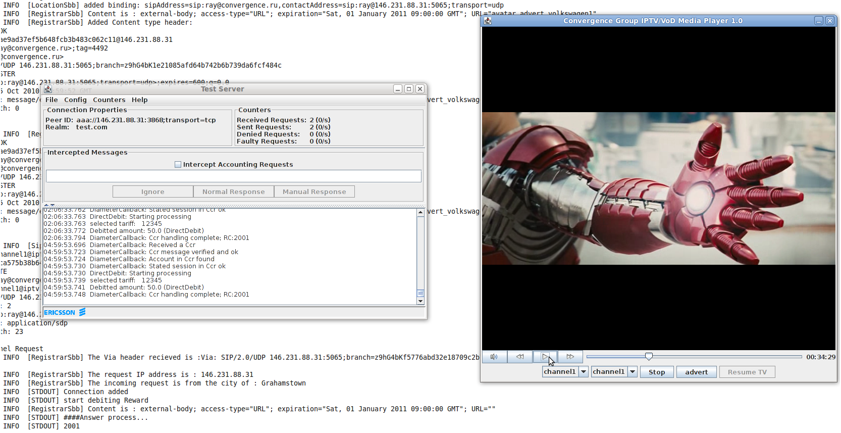
Test examples 5
Customised Video on Demand service, Rhodes University
On-Demand advertising
Notes:
Billing approach is pay per view with incentive to view adverts. (Event based charging)
On-Demand advertising – chose when you want to view your videos … Additionally this service lets you chose the advert you want, which is beneficial to the advertisers since they know that they are targeting the right user.

Slide 24
Conclusion
Billing for next generation services was investigated.
We showed how potential services can be billed.
We developed a Billing Component to implement event, time, volume, reward, and flexible session billing.
We tested the Billing Component using Mobicents services.
Possible future work
Extend the core charging models to produce more sophisticated billing.
Notes:
Billing for next generation applications will be more complex. A number of factors such as QoS, service composition, variety of services is driving the search for more innovative billing. Billing for next generation will be important since it will affect the success of the service.
We have developed a centralised billing component that can easily be added to services requiring billing. The developed billing component implements various charging models: event, time, volume, reward, and flexible multi session billing. By combining the core charging models, we produced more sophisticated charging models such as reward, and flexible multi session billing.

Slide 25
Questions

