Slide 1
An Information-theoretic investigation of cheating in traditional examinations
By: Greg Pennefather
Supervisor: Yusuf Motara

Slide 2
Introduction
Motivation
Research Goal
Not much research into techniques
Cheating is an interesting problem to solve
How can we understand this problem?
Define cheating in a more practical way
Assess feasibility of applying Information Theory and Steganography to cheating

Slide 3
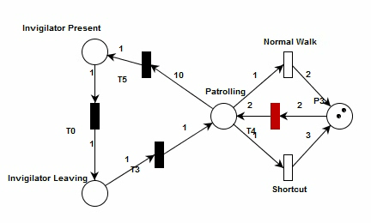
Project Origins
Simulation
Petri Net Modeling
Initially aimed to create a simulator for testing the effectiveness of cheating techniques
Cheating as a problem became more interesting
Attempted to model different techniques to understand problem
Techniques didn’t differ considerably

Slide 4
Defining cheating
Knowledge & Information
What is cheating?
Data – raw content from observations
Information – representation of knowledge or processed data
Knowledge – internal understanding of knower, created by information
Exams assess knowledge of candidate.
Cheating is access to external information
Three categories for cheating are Information Smuggling, Stealing and Communicating

Slide 5
Information Theory
A Mathematical Theory of Communication
Quantifies information in a communication system
Coding Theory
Error correction on noisy channels
Compression for storage and transmission
Built upon the concept of entropy

Slide 6
Steganography
Concerned with concealing the existence of information
Different from Cryptology
Originates from physical techniques
Modern Steganography concerned with information systems and statistical analysis
Makes use of coding theory to embed a message inside of a covertext
In doing so changes the probability distribution of that covertext
Should aim to alter the probability distribution as little as possible
Prisoners’ Dilemma Problem

Slide 7
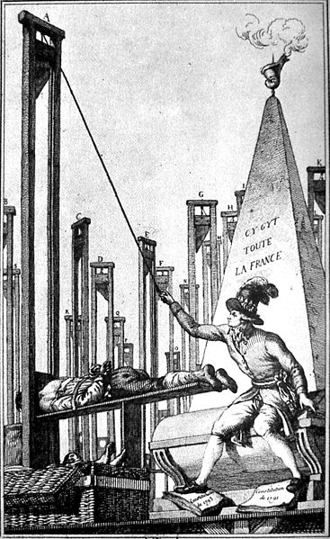
Our Example
Alice and Bob are classmates
They have an upcoming History Examination on the French Revolution.
In it they are required to have knowledge on the events of The March on Versailles, The Storming of the Bastille and The Reign of Terror

Slide 8
Prerequisites
Motivation
Information Lists
Why do candidates cheat?
A candidate is unwilling to internalise the knowledge required.
A candidate lacks the cognitive competence to perform on an examination.
Time to master is a consideration
We can reduce knowledge into information that can create that knowledge.
Communication or storage of this information allows for cheating

Slide 9
Information Smuggling
The covertext medium is important
Relies on Examiner Oversight
Information lists can be coded into a symbol set

Slide 10
Communicated Information
Partnerships
Alphabets
Unidirectional – A competent candidate assists an incompetent candidate
Bidirectional – Two competent candidates assist one another
How is information best represented?
A practical alphabet for representing messages should:
minimises characters required to transfer single message
be easily translatable
be practical

Slide 11
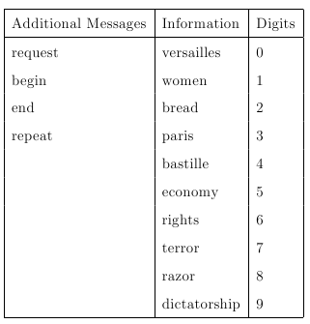
Communication System
Message set made up of:
Meta messages
Information List
Digits
Size of message set must be considered when creating alphabet

Slide 12
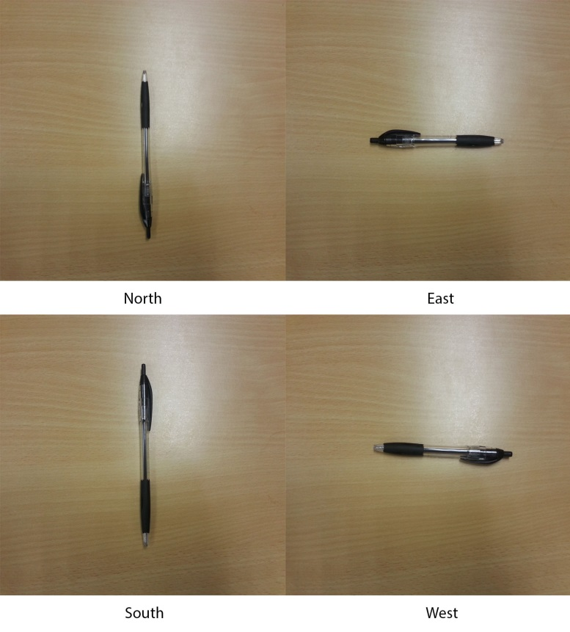
Visual Communication System
States sets of medium represent letters of alphabet
States should be distinct
Combination of different state sets allow for larger but still distinct alphabet

Slide 13
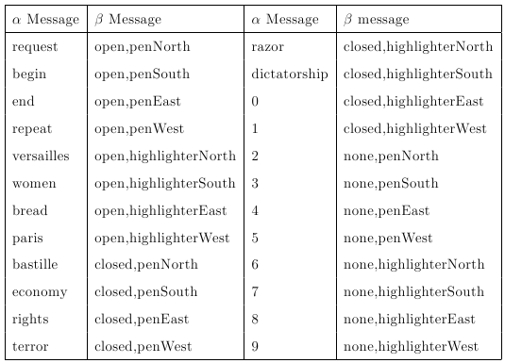
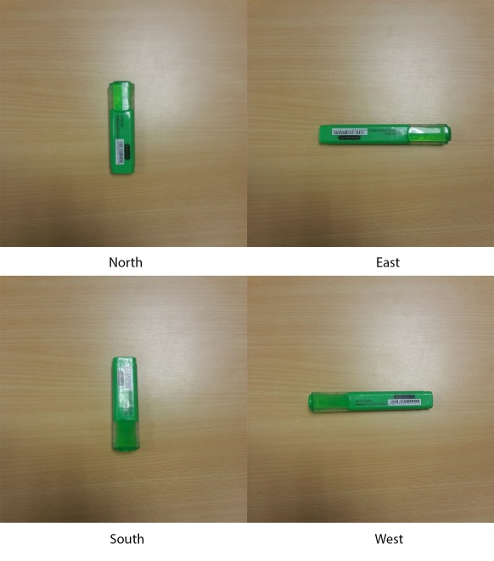
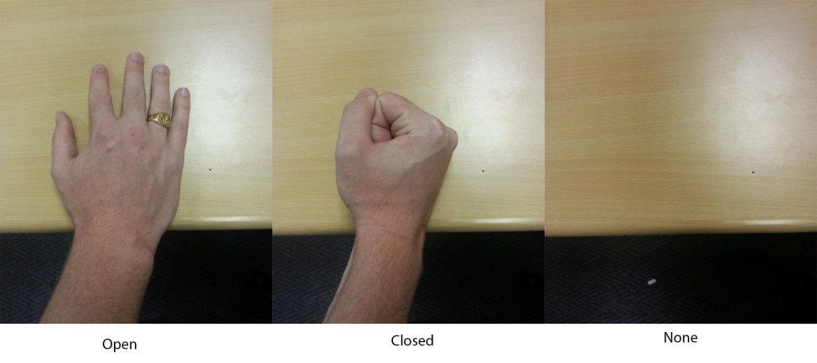
Visual Communication System Cont

Slide 14
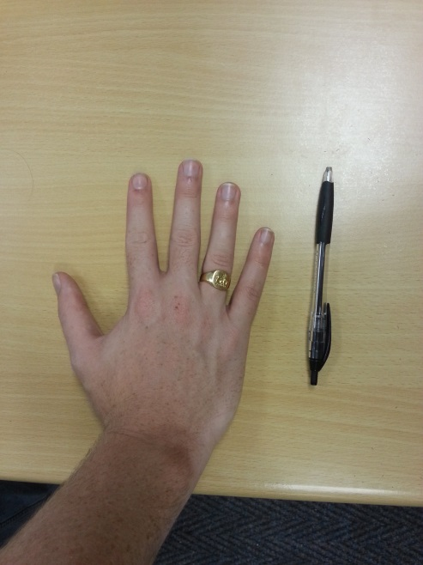
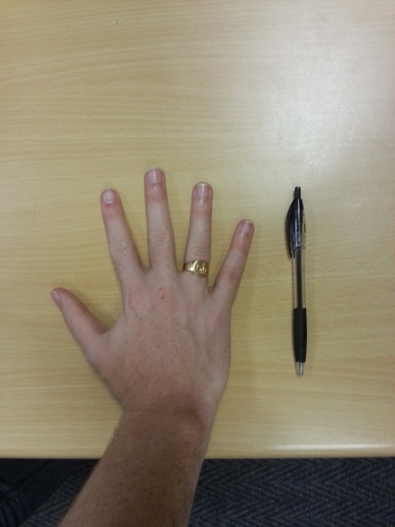
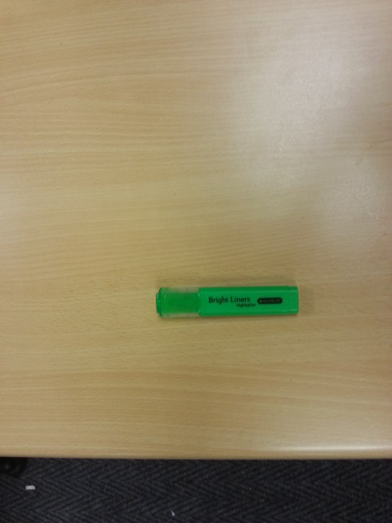
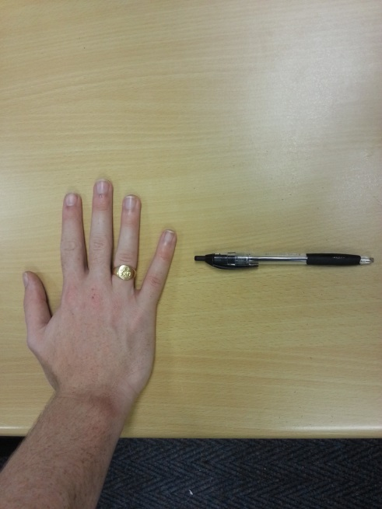
Visual Communication System Cont

Slide 15
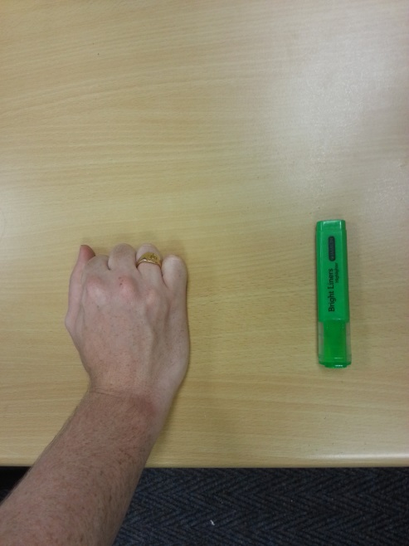
Visual Communication System Cont

Slide 16
Conclusions and Further Research
Information Theory
Steganography
Allows for understanding of communication
Coding theory relevant to language creation
Potential for further investigation
Feasible, but reliant on oversight
Presents a different problem to typical steganographic problems

Slide 17
Questions?

