Slide 1
A flexible data processing and reporting system for packet capture files
Ignus van Zyl (Iggy)
Overlord Supervisor: Barry Irwin

Slide 2
Overview of project
Internet Background Radiation
Darknet/Network telescopes
Packet capture (pcap) files
Identify dataset trends
Reporting

Slide 3
Datasets being used
That means that there are 66 207 072 packets to mine for data across 5 datasets

Slide 4
Hopefully the end result
Don’t worry there will be pictures soon
A web based system
Utilising d3 and .json to create graphs in web environment
Maybe even some textual reporting output
Takes in pcap, returns report of interesting data and identified trends
Identify trends across multiple pcap files

Slide 5
System view
Graph and text output
Data repository
Web interface
Pcap file
Pcap file
Known security trends
Graph and text output
System back-end
Here pcap is parsed to json, pushed
through to d3 and graphed before
being displayed for user

Slide 6
Comparison of Datasets 146.x.x/24 and 155.x.x/24
Using tables and graphs derived from the pcap files
Remember source data may be spoofed, but other data is accurate

Slide 7
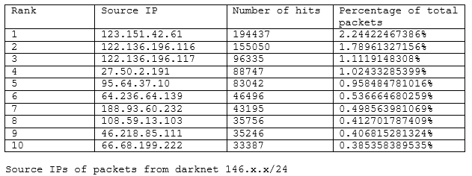
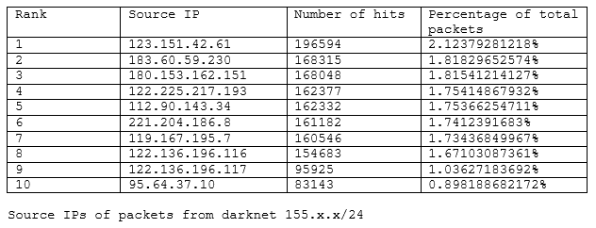
Source IP addresses recorded

Slide 8
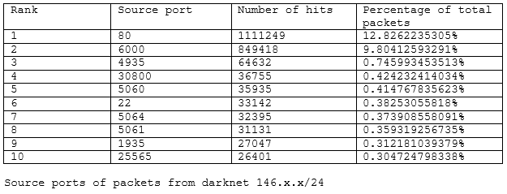
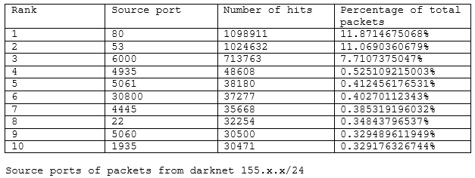
Source Ports recorded

Slide 9
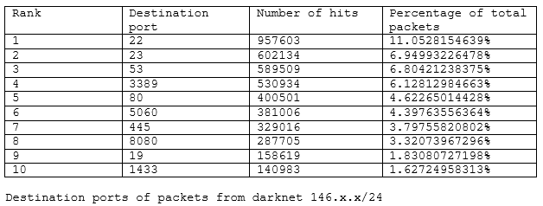
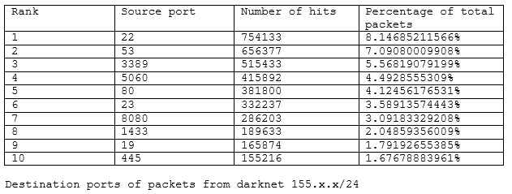
Destination ports recorded
1
3
4
6
5
2
8
10
9
7

Slide 10
Comparison of graphs for 196. darknets

Slide 11
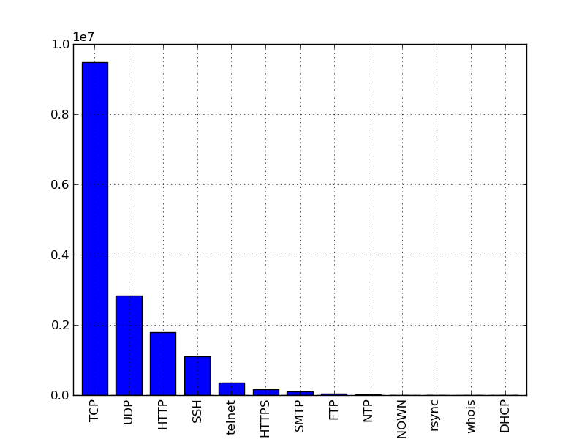
Protocols used
196.21.x/24 (1)
196.21.x/24 (2)
196.24.x/24

Slide 12
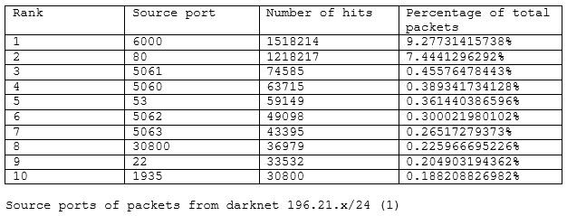
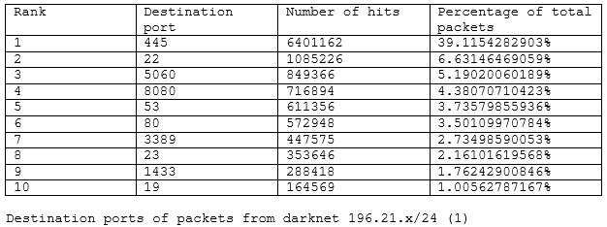
Why does the graph look like this?
Worms such as Conficker and Sasser target port 445
Morto worm known to target port 3389 (RDP)

Slide 13
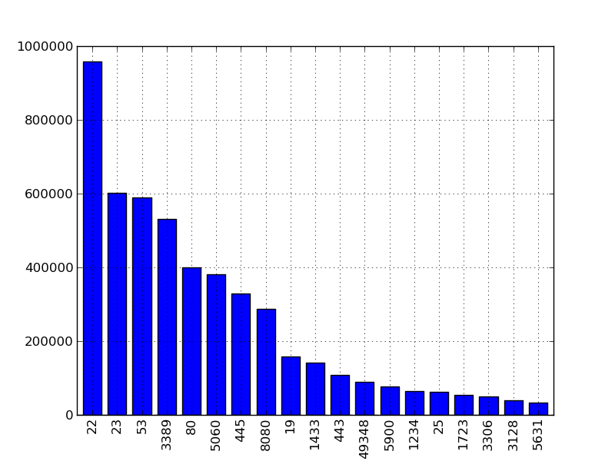
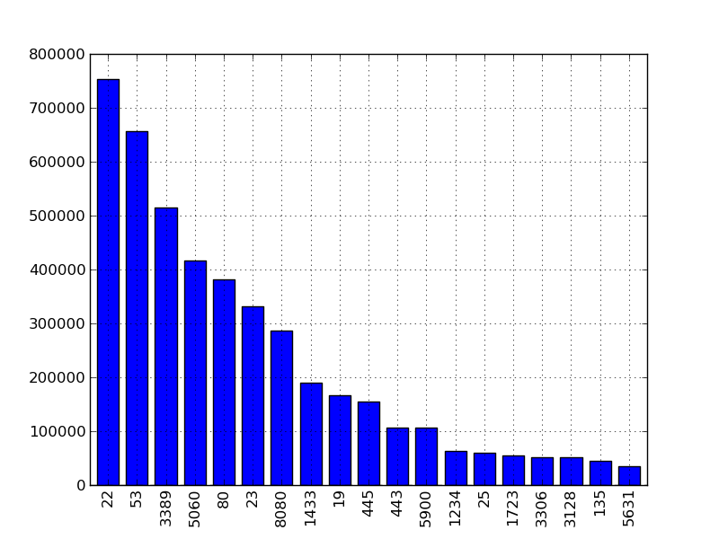
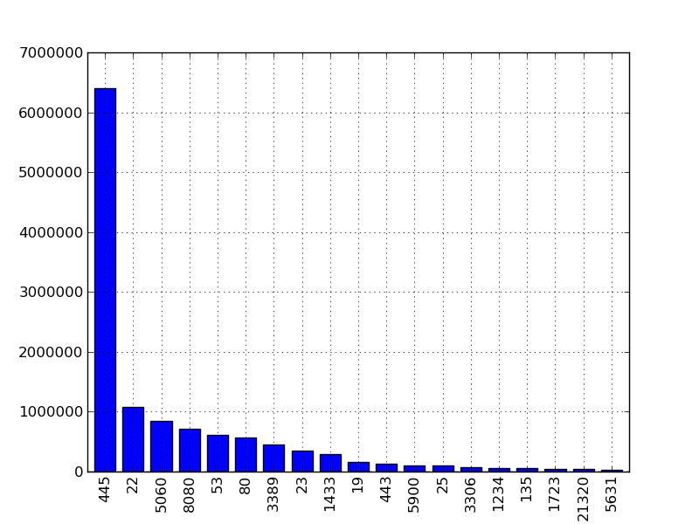
146. vs 155. vs 196.
146.x.x/24
155.x.x/24
196.21.x/24 (1)

Slide 14
Category A and B
Able to group datasets into categories
Idea comes from Nkumeleni thesis
Category A is 146.x.x/24 and 155.x.x/24
Category B is 196.x.x/24
Groupings are made as a result of packet distribution similarity

Slide 16
Questions?

