Slide 1
Towards a flexible data processing and reporting structure for packet capture files
V 3.0

Slide 2
Basic concepts
Internet background radiation
Network telescopes
Datasets
David promises to elaborate on these further

Slide 3
Generated reports
Two reports generated
General report
Drill-down report
Breakdown of activity in dataset
Relevant identifiers

Slide 4
What has been achieved
Reporting framework that outlines the packet results for a pcap file by month and total dataset
Secondary report generation that allows drill-down of results
Identification and analysis of malicious packets and attacks captured by darknets

Slide 5
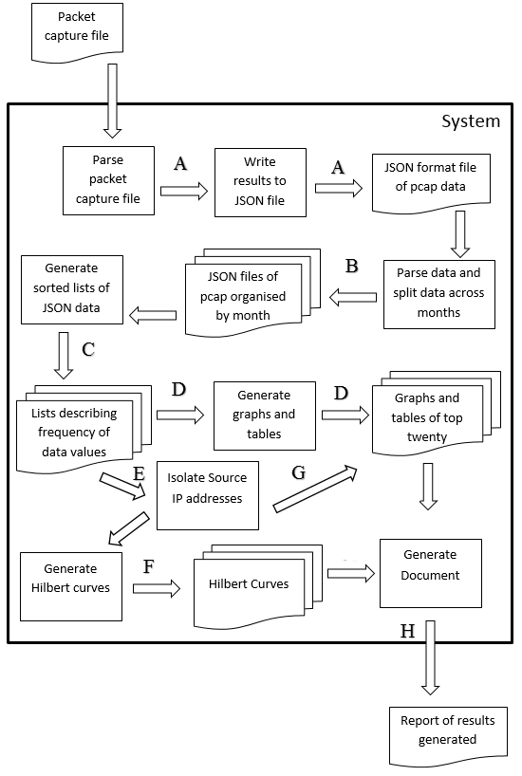
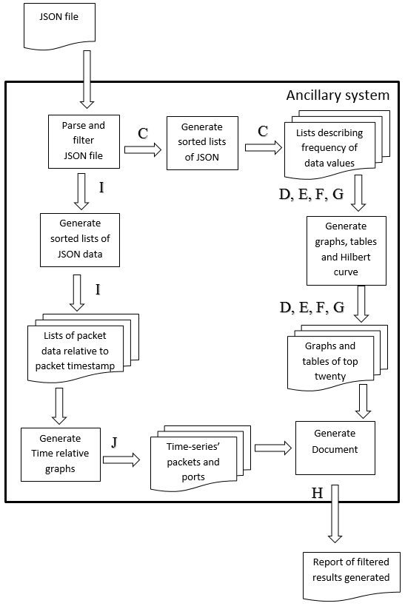
System

Slide 6
Case Studies
Have selected some of the results from the project to show its capabilities
All of the data sampled from the aforementioned datasets

Slide 7
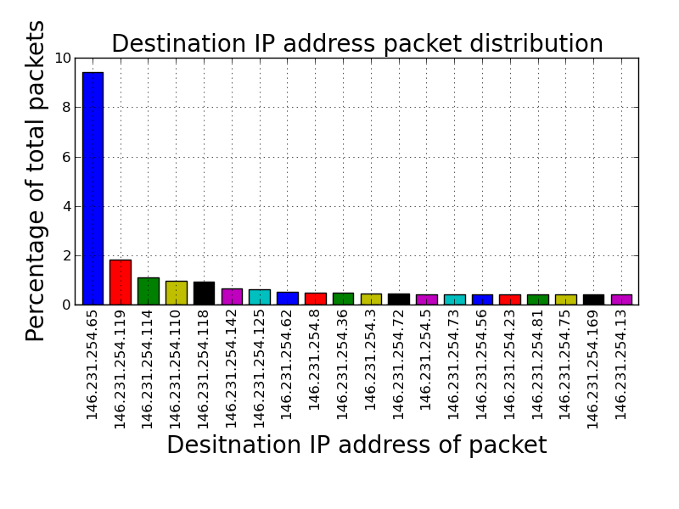
Example output of report
Source IP address | Number of packets received | Percentage of total packets
146.231.254.65 | 92174 | 9.422
146.231.254.119 | 17731 | 1.812
146.231.254.114 | 10594 | 1.083
146.231.254.110 | 9433 | 0.964
146.231.254.118 | 8916 | 0.911
146.231.254.142 | 6237 | 0.638
146.231.254.125 | 6078 | 0.621
146.231.254.62 | 4959 | 0.507
146.231.254.8 | 4809 | 0.492
146.231.254.36 | 4721 | 0.483
146.231.254.3 | 4491 | 0.459
146.231.254.72 | 4358 | 0.445
146.231.254.5 | 4143 | 0.423
146.231.254.73 | 4089 | 0.417
146.231.254.56 | 4069 | 0.415
146.231.254.23 | 4029 | 0.412
146.231.254.81 | 3997 | 0.409
146.231.254.75 | 3988 | 0.408
146.231.254.169 | 3977 | 0.407
146.231.254.13 | 3962 | 0.405

Slide 8
Some great analysis results
Reflected DNS amplification attack
DDoS backscatter
Changing trends in darknets

Slide 9
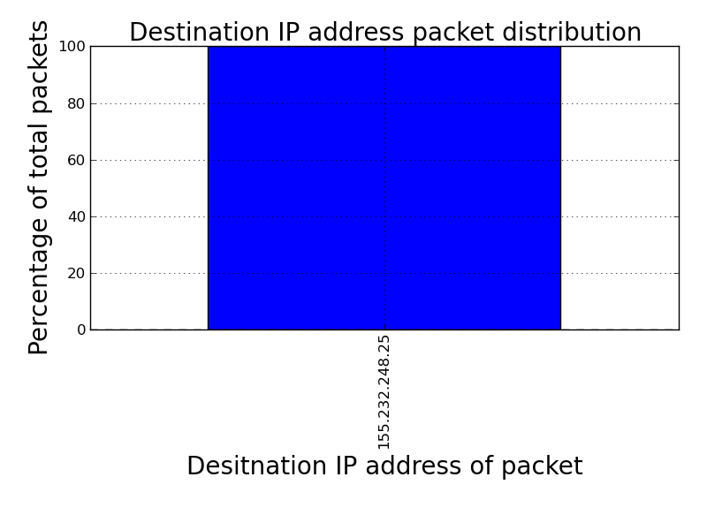
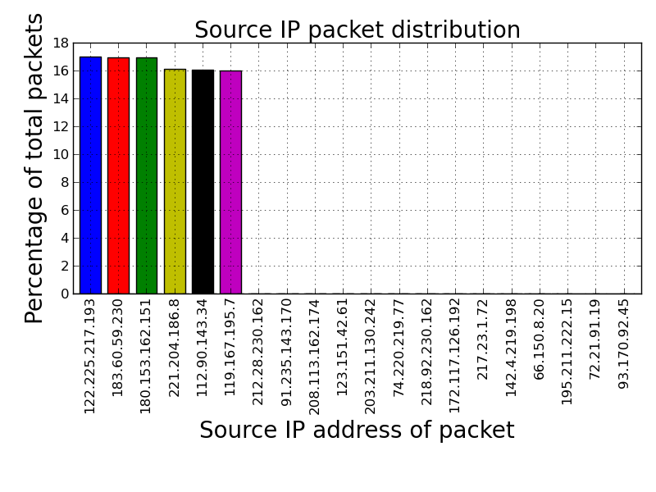
DNS amplification attack

Slide 10
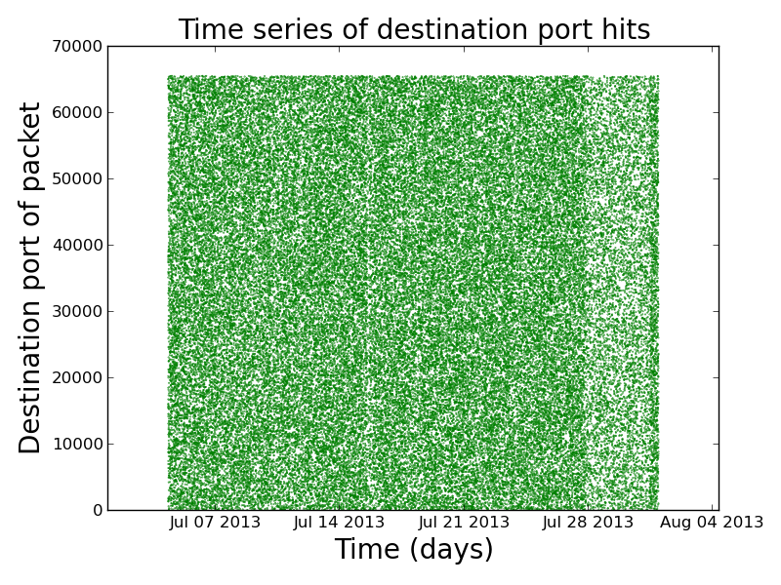
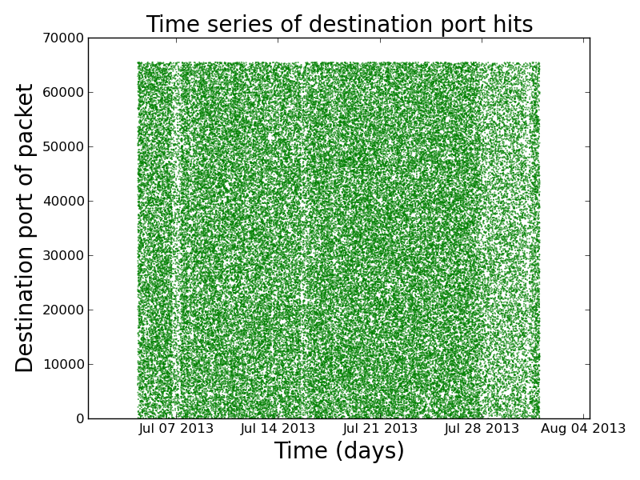
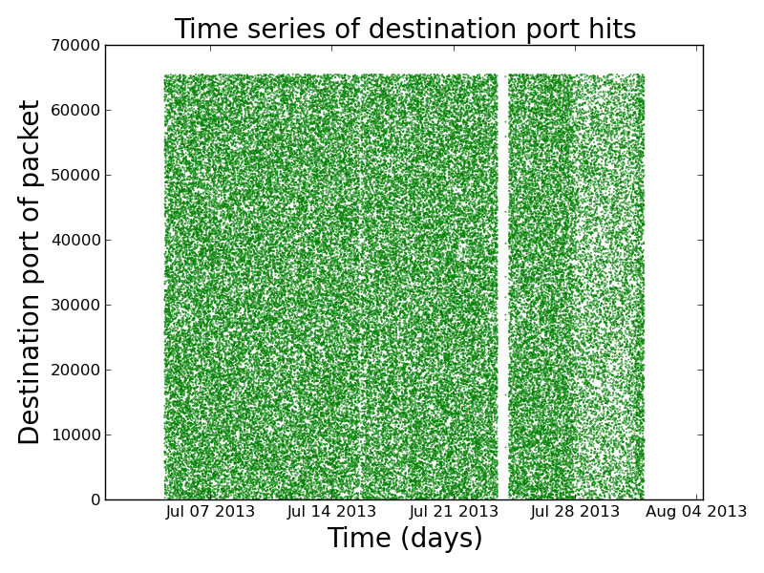
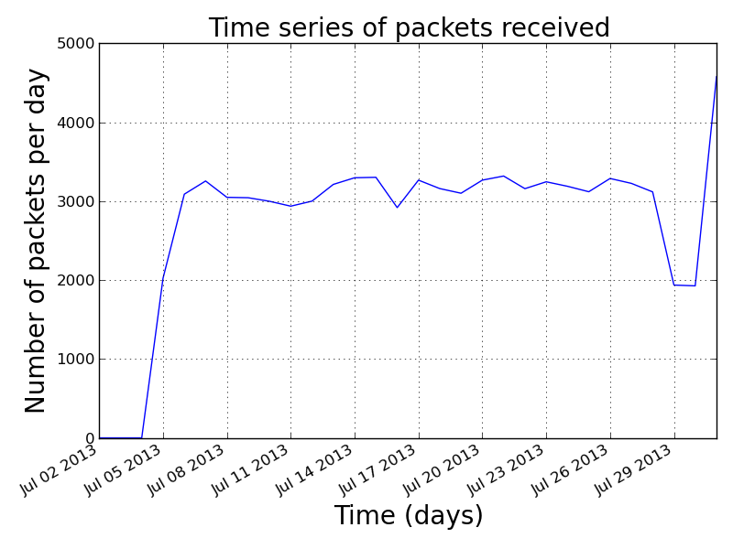

Slide 11
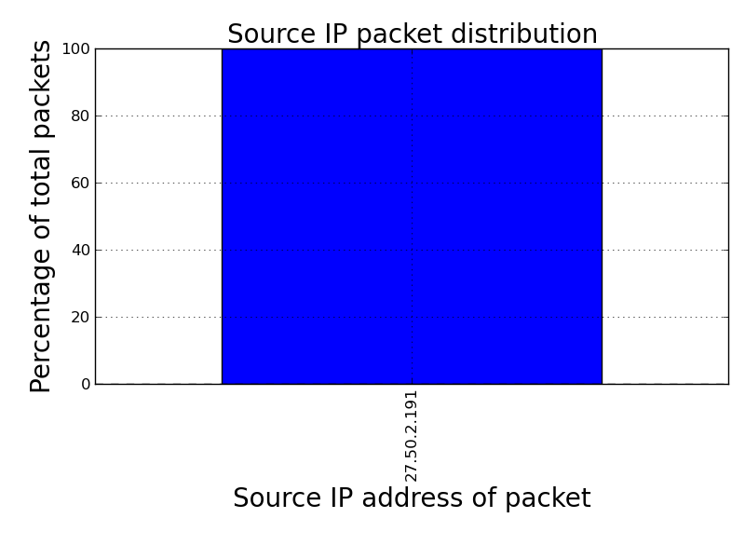
DDoS

Slide 12
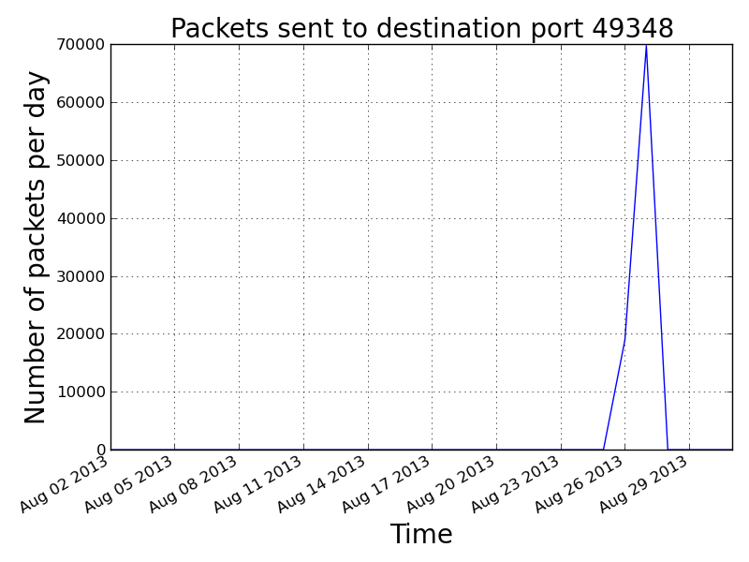
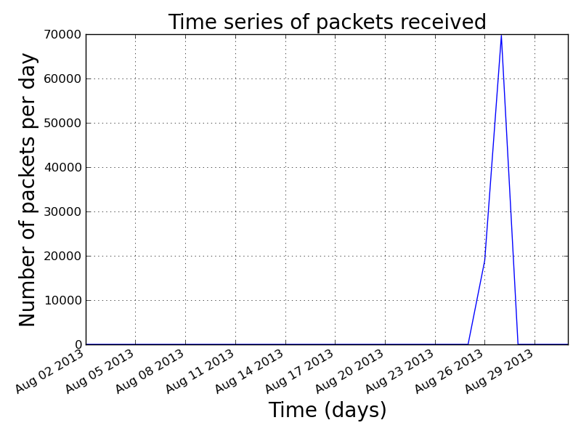
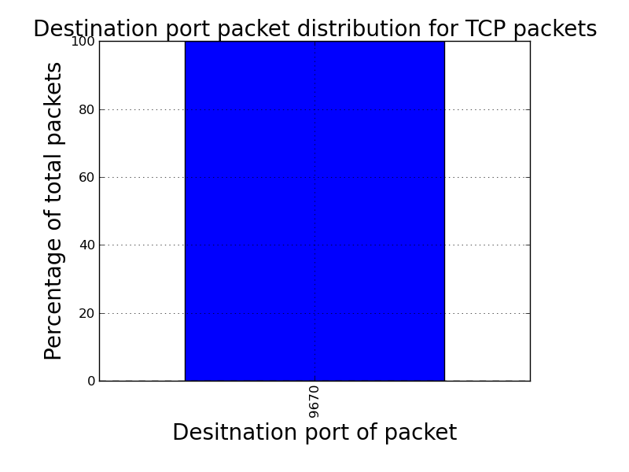

Slide 13
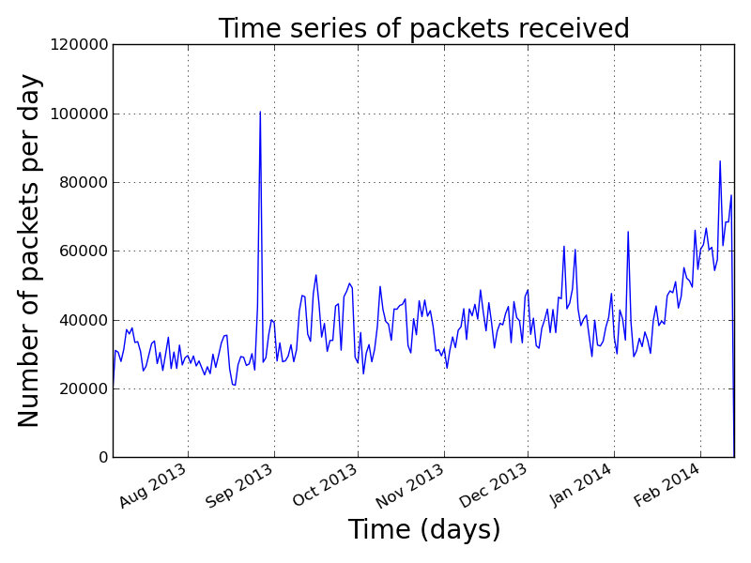
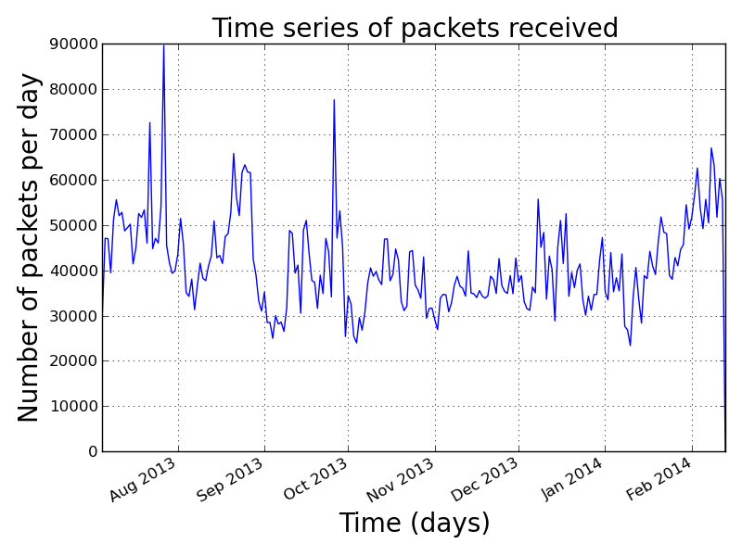
Darknet activity

Slide 14
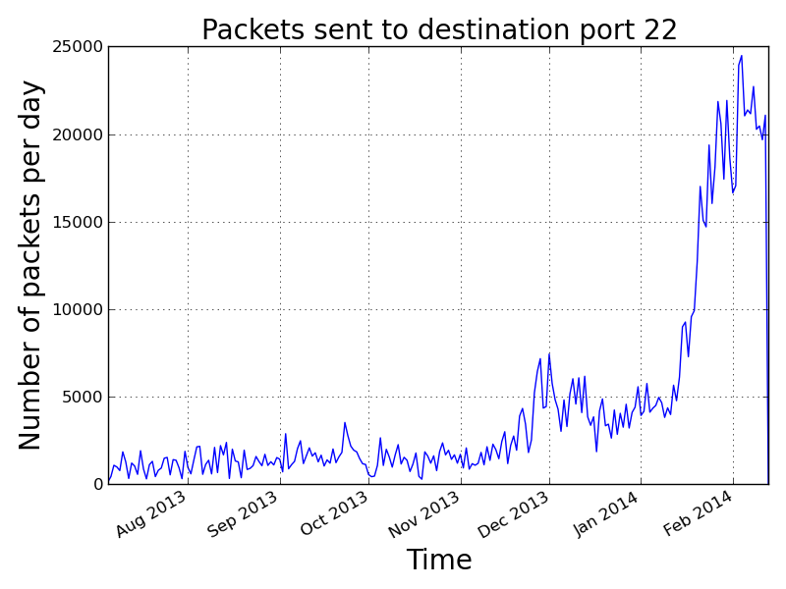
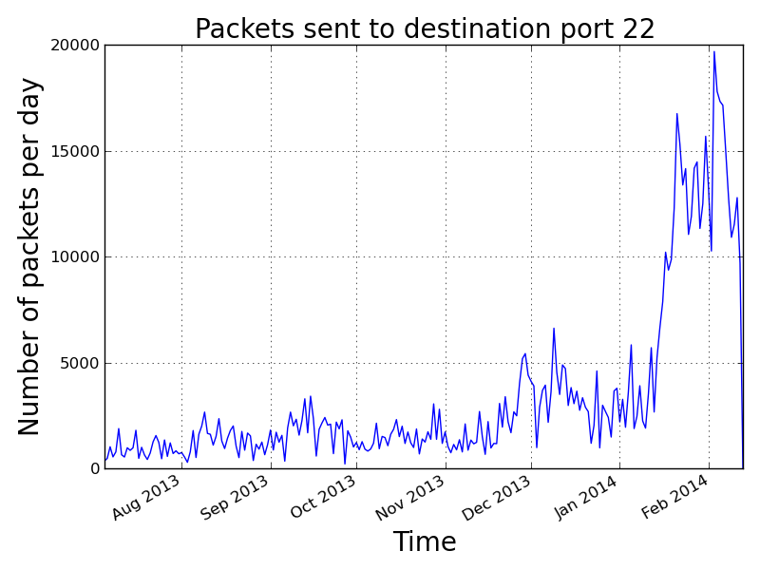
SSH Scanning Activity

Slide 15
Table comparing top 5 TCP destination ports of 146 dataset across two months
12/13 |  |  | 01/14
Destination port | Number of packets received | Percentage of total packets | Destination port | Number of packets received | Percentage of total packets
22 | 129851 | 15.735 | 22 | 336497 | 34.182
80 | 92347 | 11.190 | 3389 | 97787 | 9.933
3389 | 61771 | 7.485 | 80 | 82624 | 8.393
445 | 38227 | 4.632 | 23 | 65364 | 6.640
8080 | 33773 | 4.092 | 8080 | 36397 | 3.697

Slide 16
Future development
Have real-time version of reporting structure
Automatically generate relevant text in document
Give document ability to decide whether drill-down report necessary

Slide 17
Questions?

