Slide 1
Exploring the benefits of contextualised learning in Computer Science
By Mikha Zeffertt
Supervised by Mici Halse and Hannah Thinyane

Slide 2
Overview
Recap of the problem description
Recap of the objectives
What I’ve done
Problems I’ve encountered
What I’d still like to do
Questions

Slide 3
The problem
Computer science enrolment rates are dropping
50% of students that do enrol drop the subject
Computer science is a male dominated field

Slide 4
Main Objective
Teaching computational thinking through contextualised learning
Teaching with a strong relation to real world contexts in order to increase student understanding and participation (Koul & Dana, 1997)
Gender inclusive approach to teaching
Developing a game to teach computational thinking to Csc112

Slide 5
What I have done thus far?
Literature Review
Survey
Unity
Development

Slide 6
Literature Review
Many successes for contextualised learning if managed correctly
Uses up lecture time and resources
Acts to encourage both genders equally
Helps combat low confidence levels in female students
Very few computational thinking educational games have been developed

Slide 7
Survey
The purpose was to access attitudes towards contextualised learning and the gender divide in CS
Run throughout the CS and IS department
Students and lecturers
54 participants
18 females and 36 males

Slide 8
Is the relevance of CS explained in lectures?
Notes:
The distribution between male and female was about the same except for

Slide 9
Do you think the way CS is examined is biased towards a highly abstract and theoretical mode of thinking?
Notes:
The distribution between male and female was about the same except for

Slide 10
Other interesting findings
Most enjoyable thing about programming = satisfaction of success
Very few were opposed to the idea of contextualised learning
Unsure whether it will help the gender divide

Slide 11
Game development

Slide 12
Game development
Developed a game narrative
Levels that cover the basic concepts on computational thinking
Decomposing problems
Patterns
Abstraction
Variables
Algorithms

Slide 13
Game development
Some examples of levels
Still working on cohesive look

Slide 14
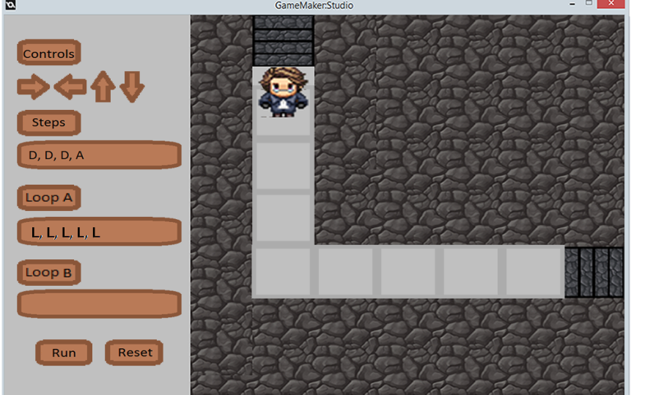
Game development

Slide 15
Problems I have encountered
Unity: learning curve was more like a cliff
Now to learn GameMaker
Time constraints

Slide 16
What is left to do...
Finish games development and testing
Run the surveys on CSc112 and correlate results
Based on Computer Science Attitude Survey by Wieber et al., (2003).
Five areas of focus: Confidence, attitude towards success, gender divide, relevance, and motivation
Let the CSc112s use the game

Slide 17
?
?
?
?
?
?
?
?
?
?
?
?
?
?
?
?
?

